Slide 1


Decision making across the information, technology and sustainability landscape: towards breadth and coherence - London 13 April 2016
Thanks to BILETA and Arnold Porter

Slide 2

Project aim: disputes and decisions
Develop new set of arguments
  To remove importance of forum and legal base for a dispute
For use before and by
  international and domestic courts and regulators
  to assess different legal fields
  together
  in a (more) integrated manner

Slide 3




Judging (for) the future?
Innovation, energy and conflict/resolution
Dr Abbe E. L. Brown
Aberdeen
abbe.brown@abdn.ac.uk
Starting point
Why
Law has recognised many principles to be important
Can courts and regulators address all these together?
To deliver a fair result wherever you start?
Solving contemporary problems
Where is oil and gas, measuring climate change, more renewable power, smart power, adapted crops and medicines
Where?
CJEU, Information Commissioner, courts
Where?
Monitoring, compliance, ECtHR, CJEU, courts
Human Rights/Diversity
Competition
Intellectual Property
Energy
Information
Phone Mast, Ashdown, Astra, Tech Mech, Campbell, Goldeneye, Grune Punkt
TRIPS/WTO DSS
SABAM, Tripartite Report, Laugh it Off, Orange Book, Tech Leadership, TAC, DW Integrators, TRIPS Council, ShrimpTurtle, Credit Suisse, Doha, Marrakesh, Samsung, Microsoft
What?
ICCPR, ICESCR, CRPD, CBD, ECHR, Lisbon, HRA, constitutions
Arts 101/102 TFEU, Competition/ Sherman Acts
What?
DP, Art 8 ECHR, FOI, Aarhus
Kyoto, Petroleum Act, PILOT
Courts, compliance, DECC, JR, arbitration
Where?
Commission, CMA, CAT, CJEU, Courts
Where?
Defeating fragmentation, forum shopping, regime shifting
Using: HRA, EU fundamental rights, constitutions, Vienna Convention
Challenge: regulatory legitimacy?
Need: wider training
Commission, CMA, CAT,CJEU, courts
Where?
Key scholars: Helfer, Slaughter, Derclaye, Aplin, Young, Howe, Morgera, Rimmer, Lynskey

Slide 4
A reminder?
“Be careful what we wish for? Clashing laws, energy and society” AHRC Being Human 2015 Aberdeen
Blurb: “Activists and policymakers often focus on a particular issue – climate change or human rights for example, while others may be arguing a different cause, such as more support for corporate interests or control of technology. When these clash, legal frameworks can deliver unexpected outcomes.”
After event Blog: “For me, as well as highly enjoyable, the evening was a reminder that not only do laws clash over objectives, but that the objectives are rarely clear. Seeking to bring about a common goal might not only be a legal challenge but might not always be the desirable goal – or at least not to all. And who should decide? Courts have always been my answer – but things have to get pretty bad for that to be relevant in a particular scenario, and this model doesn’t work so well for big questions such as energy security.”

Slide 5

A reminder?
“Be careful what we wish for? Clashing laws, energy and society” AHRC Being Human 2015 Aberdeen
Blurb: “Activists and policymakers often focus on a particular issue – climate change or human rights for example, while others may be arguing a different cause, such as more support for corporate interests or control of technology. When these clash, legal frameworks can deliver unexpected outcomes.”
After event Blog: “For me, as well as highly enjoyable, the evening was a reminder that not only do laws clash over objectives, but that the objectives are rarely clear. Seeking to bring about a common goal might not only be a legal challenge but might not always be the desirable goal – or at least not to all. And who should decide? Courts have always been my answer – but things have to get pretty bad for that to be relevant in a particular scenario, and this model doesn’t work so well for big questions such as energy security.”

Slide 6
Case study
A company which owns a small estate in the West Highlands of Scotland (“Scottish Company”) is looking to generate a new revenue source. It harvests an established set of trees planted a few decades ago for use in a wood fuelled heating business which it recently launched, using well established boilers and other biogas related delivery products which it purchased from suppliers. 90% of the shares in the Scottish Company are then purchased by a large international energy company based in Australia (“Australian Company”). The Australian Company drills in the UK Continental Shelf in the North Sea for oil and gas, and wants to support the Scottish Company to assist the reputation of the wider group in the low carbon energy sector. To enable the Scottish Company to grow, it would like to plant more trees (of the same kind which have always been there) including in areas which it has avoided in the past as the areas are popular with tourists for fishing (and tourists don’t like trees as they attract the midges) and because the trees would be near some standing stones. The Scottish Company also decides to make their boilers “smarter”, so that they can contribute to Smart City initiatives taking place across Scotland. The Scottish Company is excited that it can take advantage of the expertise of the Australian Company which has developed a subsea smartgrid, and also has just obtained patents in respect of some key smart technology in the UK and in other countries. These patents enables all data which has ever passed through smart boilers to be recorded and profiled accorded to criteria and then sold on to other businesses for use in their product development. The Australian Company grants an exclusive licence for a UK patent to the Scottish Company. The technology the subject of the patent quickly became entrenched within international efforts to ensure more managed use of energy. The Australian company is pleased to have been invited to meet with an international energy standards body. The Scottish Parliament is considering imposing a compulsory licence for a low fee on the entrenched patented smart technology, however the Australian Department of Foreign Affairs and Trade indicated to the Australian Company that there is a mechanism for the company to object to this under the investment agreement which Australia has just signed with the European Union.

Slide 7

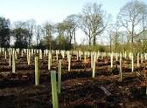
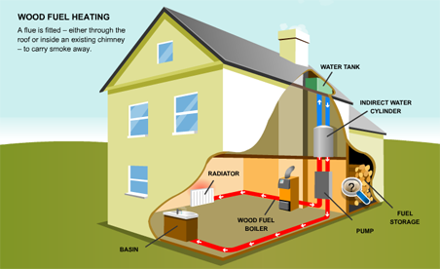
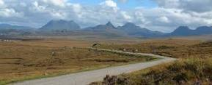
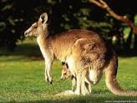


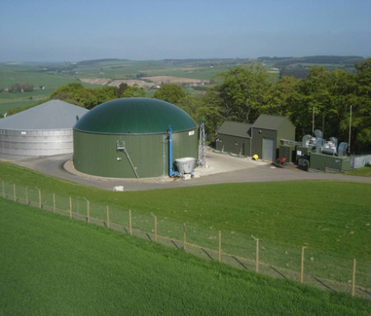
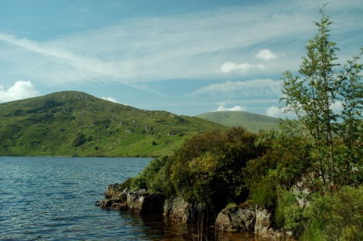



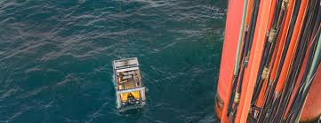





Out of this…
Ackts: Forestry Commission, Frampton, bio-gas.org.uk, Hogg Scottish Heritage, Puri, aflglobal, d-wise, corporateeurope
Brown AEL 'Sustainability through an integrated approach to decision making? A law and regulation Case Study'. International Review of Law, Computers & Technology Jan 2016.

Slide 8

Today, goal is...
  Picking your brains……

Slide 9
ISDS perspective - 1
Could happen - compulsory licensing
Philip Morris v Uruguay
Trans Canada v USA
Eli Lilly v Canada
Key: predictability, fair and equitable

Slide 10
ISDS perspective - 2
Challenging decisions made in one place, one set of priorities in another
Power imbalances/conflict - depends what agreement says
  likely pro IP, and could consider environment, human rights…
  “within” IP decisions (accommodate TRIPS and Doha?)
  special tribunal and rules re interpretation?

Slide 11
CAKES CAKES CAKES CAKES CAKES

Slide 12
Roundtable
Where are we?
Is this a problem?
How could be it addressed?
New problems?

Slide 13
Where next?
Tweets and blogs
Professional journal article
Academic collection
“Education”

Slide 14

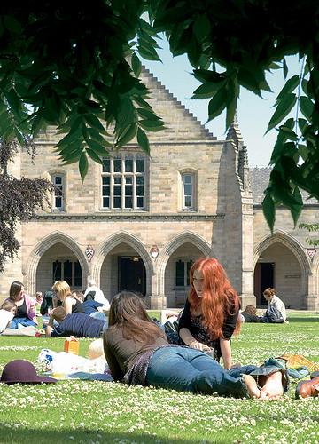
Thank you

