Slide 1


The role of science, technology and engineering in the regulation of arctic oil spills: An Interdisciplinary approach
Presentation at the Second UK Russia Arctic Workshop
Arkhangelsk, Russia 1-3 March 2018,
Northern Arctic Federal University (NArFU), Russia
Professor Tina Hunter
Director, Centre for Energy Law
University of Aberdeen

Slide 2
Presentation Plan
Sources of spill in Arctic petroleum activities
The role of the law in Arctic oil spills
Managing oil spills in the Arctic
  Prevention of spills
  Prepareding for oil spills
  Response to oil spills
Takeaways

Slide 3
Sources of oil spills in the Arctic
Sources of
Arctic Oil Spills
Operational
(Small scale, managed under EP)
Drilling Activities
Operating Activities
(Eg loading and unloading)
Consequential
(Major spill arising as consequence of ‘failure’)
Well
Blowout
Platform failure
(eg pump, pipeline)

Slide 4
Managing Arctic oil spills
Event: Oil Spill
Prevention
Preparedness
Response

Slide 5
Role of Law in Arctic Oil Spills
Law comes from Legislature: Knowledge???
  Input from… ?
Need to have the highest standards for operation in the Arctic: Law needs to capture this
  Prescriptive vs rule based?
  Risk assessment vs set requirements
  Best practice vs good oilfield practice
Does the law underpin, or is it the umbrella?

Slide 6
Preventing oil spills
Engineering
  Highest standards for operation in the Arctic
    Eg: NORSOK DS-010 (Well integrity in drilling and well operations) vs
    API St 65 Pt 2 (Isolation of Potential Flow Zones)
Environmental Science
  Environment plan – zero discharge requirements
  Impact of activity
Geosciences/reservoir engineer
  Reservoir modeling (stratigraphic sequences, pressure, temperature, well placement,
Psychology
  Organizational culture/behaviour
Law
  Set out legal requirements for drilling in Arctic
    EG US Drilling Rules
  Enforcement of requirements

Slide 7
Preparing for Spills
Logistics and planning:
  Stores/materials Civic/state interaction (see next slide)
  Training and planning for incident
  Decion-making and Coordination of response
    lead organisation?
GIS/Sciences
  Modelling predictions of oil spill scenarios
POLIS/International Relations
  Establish and maintain cooperative arrangements – regional agreements for materials?
Law:
  International agreements

Slide 8
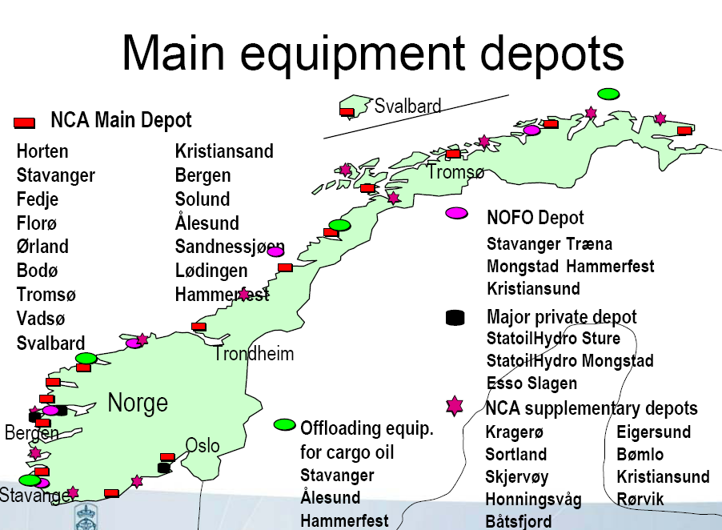

Slide 9

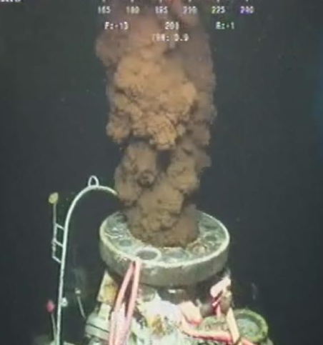
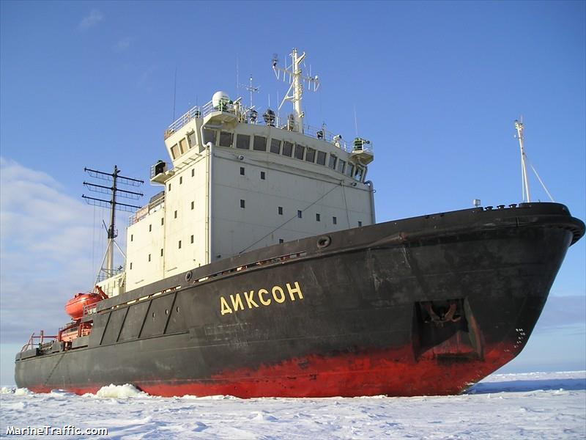
Response: stopping the source
Engineering
  How do we cap the well?
Logistics:
  Capping the well – how do we get the capping stack there?

Slide 10
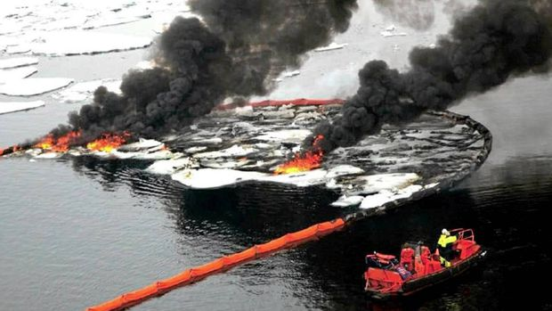
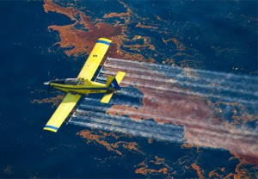
Response: oil spill response
Organisational
  Who is required to respond?
    How long for? Pass over responsibility?
Sciences:
  GIS - Oil spill trajectory modelling
  What method to use?
    Physical (boom and skim)
    Chemical (dispersants)
    Nature (breakdown)
  Impact of response on natural environ
Geopolitics:
  transboundary/regional cooperation
Social sciences
  Impact of response on human environment

Slide 11
Takeaways
Law is both the umbrella and the foundation
Cannot possibly operate without the input of all – truly multi-disciplinary if done well
Need for all: natural sciences, engineering, social sciences, in order to make and enforce law
Achievement in Arctic jurisdictions is variable
However: Structure of the law is also critical

