Slide 1
REGULATING PETROLEUM ACTIVITIES TO PROTECT FRAGILE ARCTIC ENVIRONMENTS:
ARE CURRENT MEASURES ENOUGH TO PREVENT OIL SPILLS?
Dr Tina Hunter
University of Aberdeen Centre for Energy Law
Presentation at the University of Akureyri, Iceland, 7 April 2015.

Slide 2
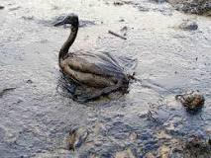
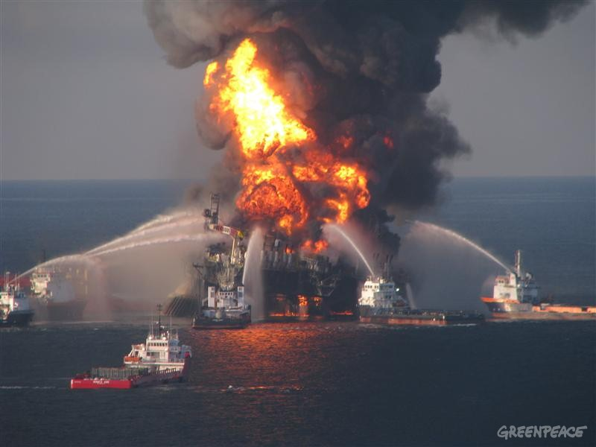
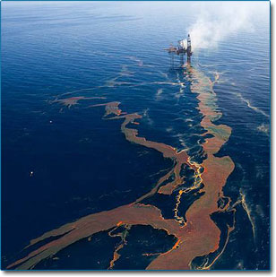

Slide 3
1. How do we regulate petroleum activities?

Slide 4
2. Oil spill prevention
Comprises three areas
  Legal regime
    Platform safety to prevent explosions/spills
      (most spills in production phase from platform incidents)
    Environmental regime
    Well integrity/WOMPS (ALARP vs GOP)
  Science, particularly geosciences (understanding of reservoir and surrounding geology)
    Most blowouts occur in exploration wells
  Engineering
    Well construction
    Use of standards, guidelines and advice
      NORSOK, API, DNV

Slide 5
Concepts of ALARP and GOP
ALARP is a safety/engineering term
ALARP is all about risk
  Identify
  Manage risk
  reduce risk to
  As Low as Reasonably Practicable
Compare this to GOP
  mint juleps and country clubs?
ECONOMICS SHOULD NOT BE A FACTOR IN ALARP
  See Disasterous Decisions by Andrew Hopkins. (CCH, 2013)

Slide 6
3. Are Current preventative measures good enough?
Generally NO!
  Focus on response rather than prevention
  Wide diversity in standards and requirements by regulators
  Focus on oil spill response
  Some focus on well control
    Norway– 12 days
    Greenland similar to Norway
    Canada NEB – same season relief well (but backing away from this?)

Slide 7
Deepwater Horizon
          Also known as the Macondo blowout
          ‘complex systems almost always fail in complex ways’
            space shuttle ‘Challenger’
          Causes
            Cementing of shoe
            Lack of barriers
            Depth
            Technology race
            Regulation not keep up with technology
              MMS
            Profit before safety?
            Response
            wait and see
            hair
            dumping garbage
            topkill
            robotic arm

Slide 8
Why is well integrity important?
What prevents groundwater damage or well blowout
No single HF caused damage… is Loss of well control or failure of integrity of the well..
Don’t want wells to leak – when wells leak need environmental response

Slide 9
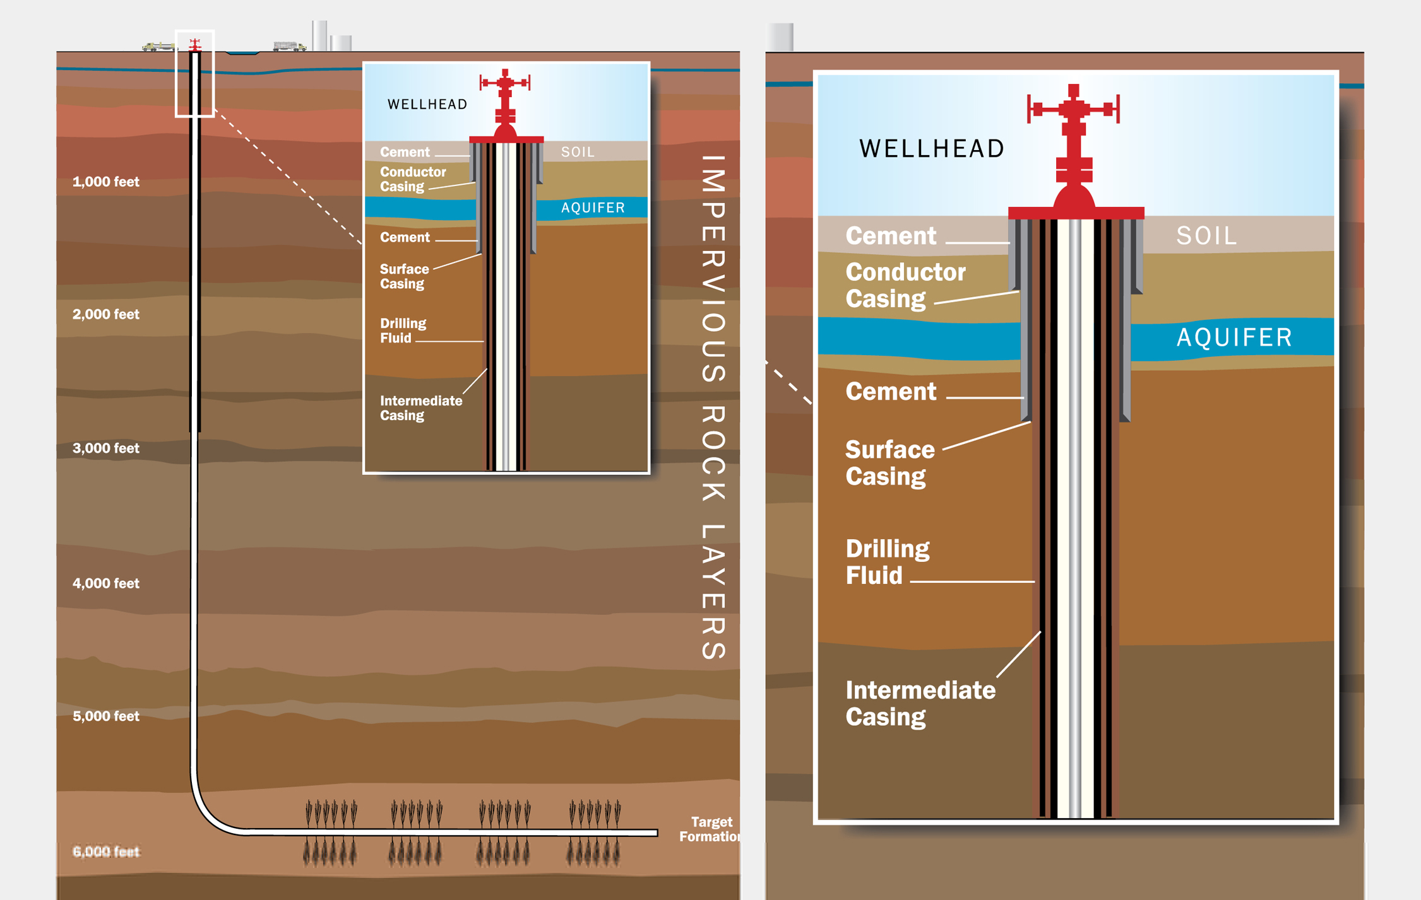
Well integrity

Slide 10
3. Are current preventative measures good enough (continued)
Tackle oil spill prevention and response as legal requirment under the regulatory framework
  Need understanding of role of approval, inspection, compliance, monitoring and enforcement
Need for multidisciplinary approach
    Law
      ALARP vs GOP
      Variable quality of well required – NORSOK vs API
      importance of inspection not just approvals
    Science
      understanding of reservoir and the behaviour of target formations
    Engineering
      well construction and control – function of engineering not law!
      Ageing platforms

Slide 11
  4. How can we prevent oil spills?
Legal - regulation should
  Take into account unique issues related to environment – access, response time, etc, when setting legal requirements
  demand ALARP as standard and accept nothing else
    Rely on reducing risk rather than what everyone else is doing elsewhere in the world
  Adopt NORSOK Standard D-010
  Insist on well inspections during construction and well-ops, not just approval of well plan
  Real-time monitoring of well data (barrier)
  Watch the new kids on the block and minnows
  Achievable relief well capability
    Second drill rig present at all times

Slide 12
  4. How can we prevent oil spills? (cont)
Geoscience
  Gain extensive knowledge of reservoir PRIOR to drilling
    3D Seismic survey (even 4D?)
    Understand the role of depth of reservoir, water depth and overlying geology structure plays in well engineering (esp HPHT Wells)
      Friction, temperature, pressure
      Cairn Energy – use of Ultrahib as lubricant – toxin/slow to dissipate
Engineering
  Well-ops plan – use of best available standards
  Risk assessment of WOPb ALARP not GOP
  Inspection during construction for compliance to approved well plan

Slide 13
  4. How can we prevent oil spills? (continued)
Liability
  Set liability in a manner that discourages spill
    Eg strict liability in Norway
    Liability bonds ($2 billion guarantee in Greenland)
  Remove liability caps
Arctic Council
  Move from soft law to binding law
  Tackle the ‘hard’ issues of liability and same season releif well capability

Slide 14
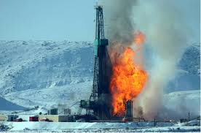
… AND THIS IS ON LAND!

Slide 15
Take-Aways
Not just a regulatory issue
Needs co-ordinated, multi-disciplinary framework and research
Regulators need knowledge to for compliance and enforcement
Inspection is key
Demand highest possible standards
Remove liability caps
Arctic Council to address the hard issues and have ‘teeth’ to address these hard issues

