Slide 1
Working in Labs Health and Safety
Dana Wilson
Oct 2024

Slide 2
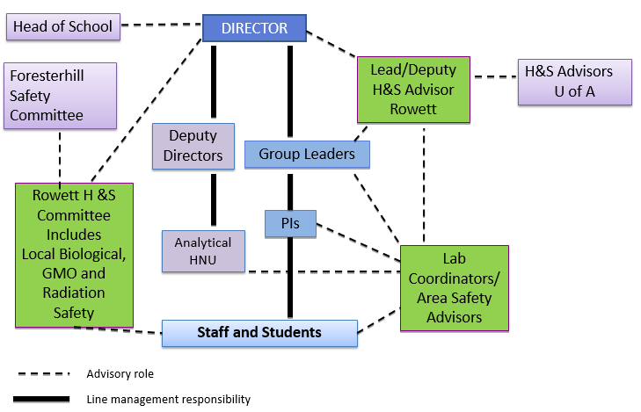
Health and Safety Structure Example of Arrangements/Responsibilities
School of Medicine, Medical Sciences and Nutrition
dana.wilson@abdn.ac.uk
Notes:
All responsible for one anothers H&S

Slide 3
Key Safety Contacts
Local Health and Safety Advisers
who can give general advice on safety in your place of work
Supervisors/ Lab managers
who have more specific knowledge relating to your project
Other Advisers that may need to be consulted
Biological Safety Adviser
Radiation Protection Supervisor
Genetic Manipulation Adviser
School of Medicine, Medical Sciences and Nutrition
dana.wilson@abdn.ac.uk
Notes:
Important to meet other advisers before work starts

Slide 4
What to expect when working in a Laboratory
What we provide for you
A safe working environment
Personal Protection Equipment (PPE)
Give you training to ensure that you are able to work competently and safely
What we expect from you
Follow local procedures
Work safely and show consideration to your co-workers
Ask advice if you are unsure of any procedure you have been asked to carry out
Discuss with your supervisor any new techniques you want to carry out and make sure that you risk assess these before carrying out any work
School of Medicine, Medical Sciences and Nutrition
dana.wilson@abdn.ac.uk
Notes:
Any new technique should be written up and risk assessed prior to commencement of the work. The risk assessment process involves recording the significant risks, that are not covered by standard laboratory precautions, on the method, standard operating procedure or in a lab book if method development is occurring.

Slide 5
Working in a Laboratory
Basic Rules
Wear Howie Style lab coat and safety glasses and any other PPE required for the task you are performing
No - eating, drinking, chewing of pens, taking medicines, applying of cosmetics, touching of the mouth or face, wearing of headphones/earbuds(unless for medical reasons) or using mobile phones in the lab (unless a risk assessment has been performed and approved by the Rowett H&S committee)
Do not move around the buildings with gloves on both hands (always remove one and use that hand to open doors)
Label all solutions clearly using tape on glass not pen on glass - including water
Use the correct disposal route for waste
If in any doubt ask an experienced lab member for advice
Always remove lab coat and wash your hands when leaving the laboratory
School of Medicine, Medical Sciences and Nutrition
dana.wilson@abdn.ac.uk

Slide 6
TYPE OF WASTE
Hazardous waste
Bio-hazardous waste
Other hazardous waste
NON-hazardous waste
Radioactive
Chemical
Human tissue
and "highly infectious
Infectious/biological waste
Sharps Non-Sharps
Other
non-infectious
Cytotoxic
Confidential papers
case" waste
GM Sharps
lab waste
Sharps Non-Sharps
Glass
Broken glass, empty
bottles, disinfected
glassware
General waste
(waste paper; food, drink and uncontaminated packaging; empty, clean plastic bottles and containers;
Special procedures
Chemical disposal form Contact Louise Cantlay
Waste Electrical and Electronic Equipment (WEEE); batteries, IT items
Label
Label
"Broken Glass" bucket
other totally harmless items)
Label
YELLOW LID GM SHARPS
container
AUTOCLAVE BAG
(clear with blue lettering)
Label
Recycling bins
WHITE BAGS
RED CONTAINER
Label
PURPLE LID
SHARPS
container
WHITE
YELLOW LID SHARPS
container
Autoclave
CARDBOARD
BOXES labelled
"broken GLASS"
BAGS
Label
Confidential boxes
Residual general waste;
mixed materials
hold at -20ºC
GM SHARPS
(cage behind IMS)
YELLOW BAGS
CYTOTOXIC SHARPS
(cage behind IMS)
COLLECTIONS
SHARPS
(cage behind IMS)
Yellow wheelies
(container IMS/Polwarth)
Cages at IMS back back door, or Polwarth, for skip
COLLECTIONS
Dry Mixed Recycling Bins
M.R.F.
Black bags
Materials Recovery Facility
INCINERATION
HIGH TEMPERATURE INCINERATION
Waste Stream for Rowett - Foresterhill Site (revised October 2022)
 | General Waste Compactor
DOMESTIC INCINERATION

Slide 7
Working in a Laboratory
It can be a dangerous environment
Electrical Equipment
Before use - Visual inspection/PAT Testing
Inexperience, lack of proper training can cause accidents
Samples
Biological hazards working with human samples
Chemicals and substances
Various forms
Various hazards/incompatibilities
School of Medicine, Medical Sciences and Nutrition
dana.wilson@abdn.ac.uk

Slide 8
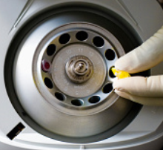
General laboratory equipment
Centrifuge
Always be trained by an approved user
Use the correct tubes and adaptors
Balance tubes correctly
Tubes up to 15ml by volume
15ml – 500ml by weight
[0.5g at rest =25Kg @ 500 000g]
Load the rotor in the correct format
Secure the lid of the rotor
Check the settings are what you require; other users may have changed the settings
Wait until the centrifuge has reached the desired speed, before leaving room.
School of Medicine, Medical Sciences and Nutrition
dana.wilson@abdn.ac.uk

Slide 9
Correct Loading of a Centrifuge Rotor
School of Medicine, Medical Sciences and Nutrition
dana.wilson@abdn.ac.uk

Slide 10
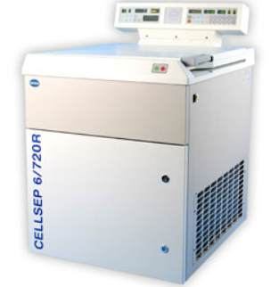
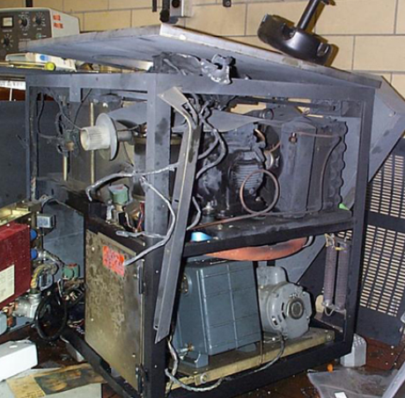
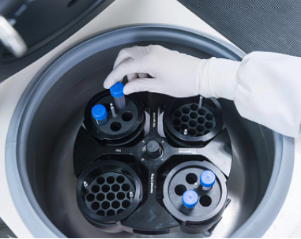
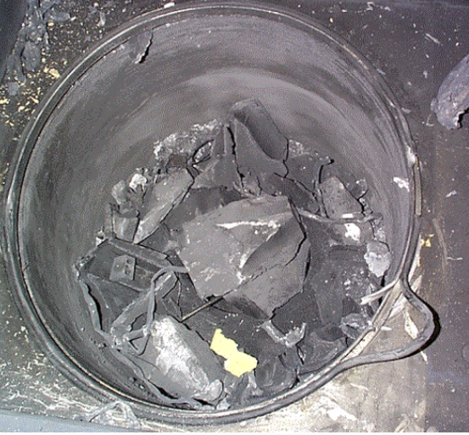
Centrifuge cont
Improper use can result in
Serious injury to you & others working in the area, HSE investigations
Contamination of the area and personnel
Loss of sample
Cost of replacement of equipment and repair of work area
Disruption of the work of the University/Company
School of Medicine, Medical Sciences and Nutrition
dana.wilson@abdn.ac.uk

Slide 11
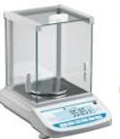
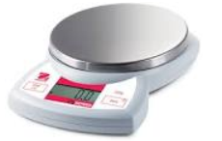
General Lab Equipment
Balances and weighing
Balances are precision instruments
Make sure the balance is level
Check the calibration (using test weights)
Always clean the area immediately after use - other people don’t know what you have been weighing out or what risks it has.
Leave the balance and area as you would like to find it - NOT how you find it!
School of Medicine, Medical Sciences and Nutrition
dana.wilson@abdn.ac.uk

Slide 12
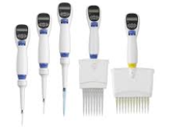
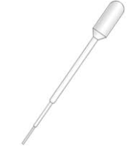
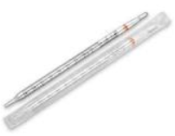
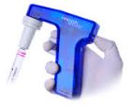
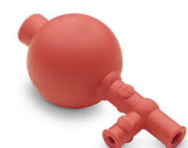
General Lab Equipment
Pipettes
Never mouth pipette
Automatic pipettes – be sure you understand the setting
Remember to use a pipette tip!
Performance Check your pipette regularly
Find out about the calibration and maintenance of Piston Pipettes
School of Medicine, Medical Sciences and Nutrition
dana.wilson@abdn.ac.uk

Slide 13
Biological hazards
Working with Human samples
Risks from unscreened blood samples/faecal samples
Follow code of practice for working with human samples
Use a microbiological safety cabinet if aerosols are likely to be formed (pipetting, vortexing, centrifuging, opening lids are just some examples of times when aerosols are formed)
Training from experienced staff
Vaccination – but still not a replacement for good working practice
School of Medicine, Medical Sciences and Nutrition
dana.wilson@abdn.ac.uk

Slide 14
Cryogenic Substances
Liquid Nitrogen and Dry Ice (Solid CO2)
Eye protection must be worn and cold resistant gloves
Do not travel in a lift with either of these substances
Hazards
Asphyxiation-use in well ventilated areas
Liquid nitrogen; liquid gas increase in vol X ~700 times
Dry Ice; solid gas increase in CO2 concentration toxic effects
Cold Burns
Items become brittle when in contact with these substances
School of Medicine, Medical Sciences and Nutrition
dana.wilson@abdn.ac.uk

Slide 15
Laboratory Chemicals
These are substances which can cause serious harm
Chemical Hazard Symbols are found on all chemicals
Corrosive Irritant Flammable
Toxic Carcinogenic, Teratogenic
Harmful to the environment Explosive
School of Medicine, Medical Sciences and Nutrition
dana.wilson@abdn.ac.uk

Slide 16
Laboratory Chemicals cont.
Some chemicals are incompatible
Use appropriate PPE when working with chemicals
Use a Fume Hood.
Dispose of chemicals in the correct manner
Understand the chemicals and substances you are working with before you start work with them – refer to the MSDS
School of Medicine, Medical Sciences and Nutrition
dana.wilson@abdn.ac.uk

Slide 17
Laboratory Chemicals cont.
Acid and Alkali
When working with concentrated forms a full face visor is necessary – work in a fume hood
When diluting Acids
ALWAYS add acid to water NEVER water to acid
When Making Alkalis
Dissolving Sodium Hydroxide pellets in water is a highly exothermic reaction and therefore the beaker being used should be cooled in an ice bucket while the reaction is taking place
In the event of a chemical contamination to you or someone working near to you; do you know what to do ?
In the event of a chemical spill; do you know what to do?
School of Medicine, Medical Sciences and Nutrition
dana.wilson@abdn.ac.uk

Slide 18
Chemical Contamination/Spills
Contamination of the body - flood the area with water for a minimum 10min - Emergency Showers
Contamination of the eye - irrigate with lots of water with the water running away from the good eye – Eye wash
Get first aid help as soon as possible
Find out where spill response kits are kept (in the corridors on levels 2, 4 and 5)
Absorb and contain any spilt liquids
Collect all hazardous waste in a suitable sealed container for disposal
Fire Service will be called in event of a major spill
School of Medicine, Medical Sciences and Nutrition
dana.wilson@abdn.ac.uk
Notes:
Should be familiar with where safety showers are

Slide 19
First aid
Emergency situation
Dial 9-999 this can be done from any phone
Send someone outside to meet the ambulance
Non Emergency situation
There are lists of First Aiders and their contact numbers located beside first aid boxes around the building if you require a first aider to attend an incident
Safe zone App
Available while on campus gives direct link to first aid help and
university security – may not work in all buildings due to lack of
phone signal, but they can still locate your position via GPS.
School of Medicine, Medical Sciences and Nutrition
dana.wilson@abdn.ac.uk
Notes:
Cards by phones

Slide 20
Accidents and Near Misses
All accidents and Near misses should be reported initially to a technician and your supervisor then report it online within 24hrs of the incident taking place.
A near-miss is anything which happens where someone isn’t injured but they could have been or something which has cause disruption to work taking place – example a gas leak at a weekend causes disruption to work the next week.
Online University reporting system available at Health and Safety | StaffNet | The University of Aberdeen (abdn.ac.uk)
Prevent future accidents
Helps to maintain a safe working environment
School of Medicine, Medical Sciences and Nutrition
dana.wilson@abdn.ac.uk
Notes:
Important to record learn form accidents and prevent accidents by acting on nearmisses

Slide 21
Fire Evacuation
On hearing a fire alarm you must leave the building immediately using the nearest fire exit and go to the Assembly point
Please note the main atrium stairs are NOT a fire evacuation route. Please take a moment to ensure you know your fire exit routes
If it safe to do so turn off electrical equipment, gas supplies and close doors behind you as you leave
If you discover a fire - raise the alarm by activating the break glass point
Do not enter the building if the alarm is sounding
Do not use the lift
(The fire alarm is tested every Wednesday at 9am - constant sound)
The Rowett Institute

Slide 22
Gas Alarm
When a detector is activated the beacon will flash and an intermittent alarm will sound. Leave the room immediately.
If it safe to do so turn off electrical equipment, gas supplies and close doors behind you as you leave
Inform the nearest technician who will make sure the gas response team are aware.
Do not enter any lab where an alarm is sounding or a “do not enter sign” is displayed on the door
You should return to your write up area or another laboratory until the event is dealt with.
NB These alarms can be heard in the write up areas if they are activated in the multiperson labs on levels 4 & 5 but do not require evacuation of the building. Alarm sounds- constant = Fire
- intermittent = Gas
The Rowett Institute

Slide 23
Access and Out Of Hours Working
General access is 7am – 7pm you must fill in the Security Access form in your induction pack, get it signed by your supervisor and return it to me either online or the paper copy to gain access to the building
Out with these hours and at weekends you must sign in and out of the building at reception. There is also a phone there to call security to let them know you are here on 3327
The Rowett Institute

Slide 24
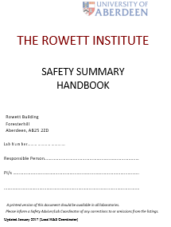
Information on Safety
A copy of the Institute Safety Summary handbooks are given to you today and will also be available in all labs.
Local Safety information should be available
Here we have it available online
Health, Safety and Wellbeing | The Rowett Institute | The University of Aberdeen (abdn.ac.uk)

Slide 25
Wishing you a successful, enjoyable and safe time working in laboratories.
Contact details
Dana Wilson dana.wilson@abdn.ac.uk
School of Medicine, Medical Sciences and Nutrition
dana.wilson@abdn.ac.uk

