Slide 1
Quality Assurance Committee Update on Quality Arrangements
Steve Tucker
QAC Chair
Sept 2024

Slide 2


Slide 3

Development partners from across the tertiary sector

Slide 4
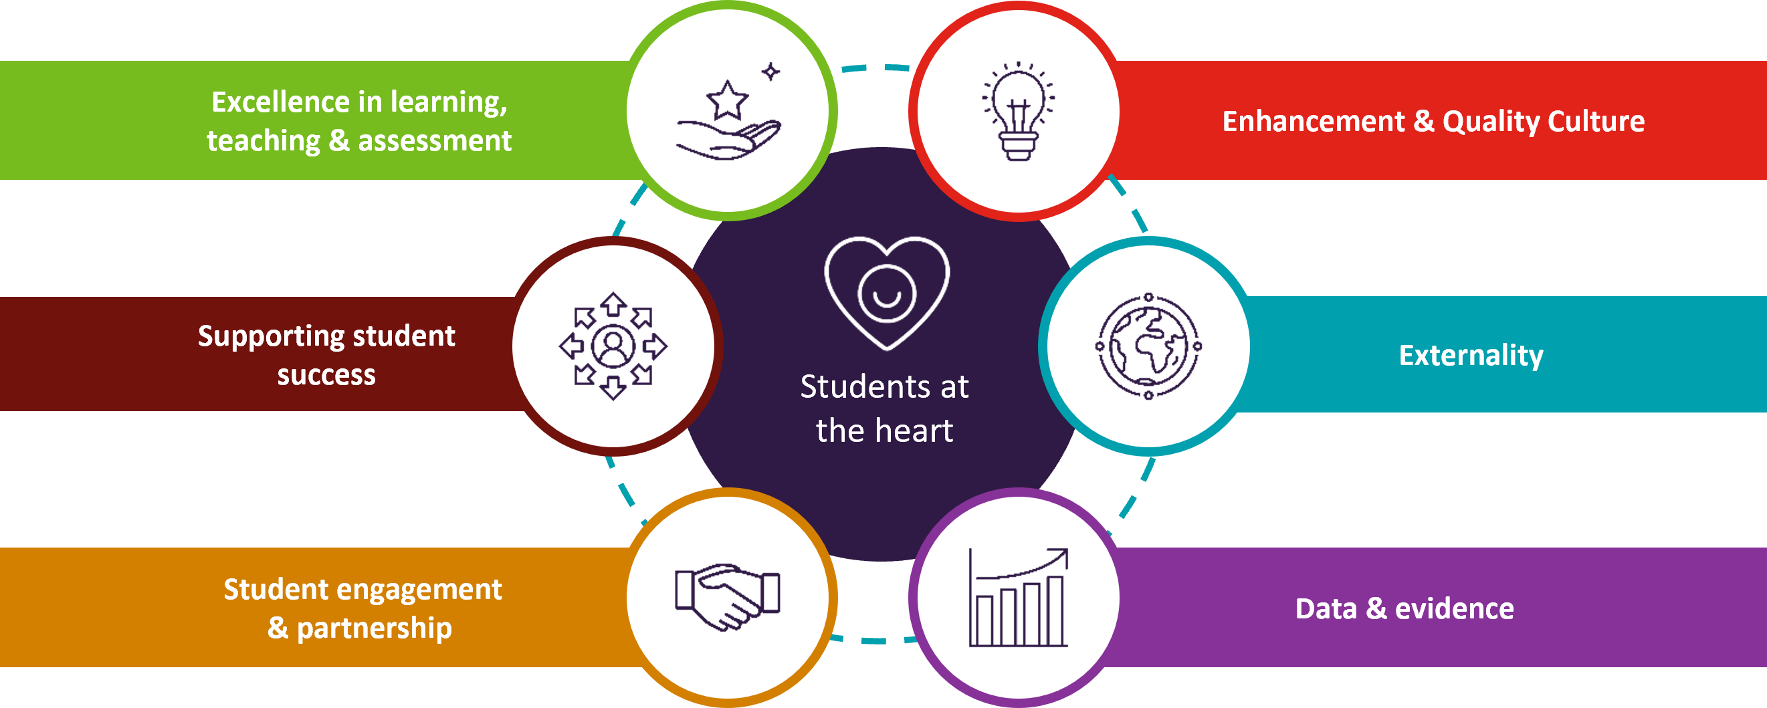
Principles of Scottish Tertiary Quality Enhancement Framework

Slide 5
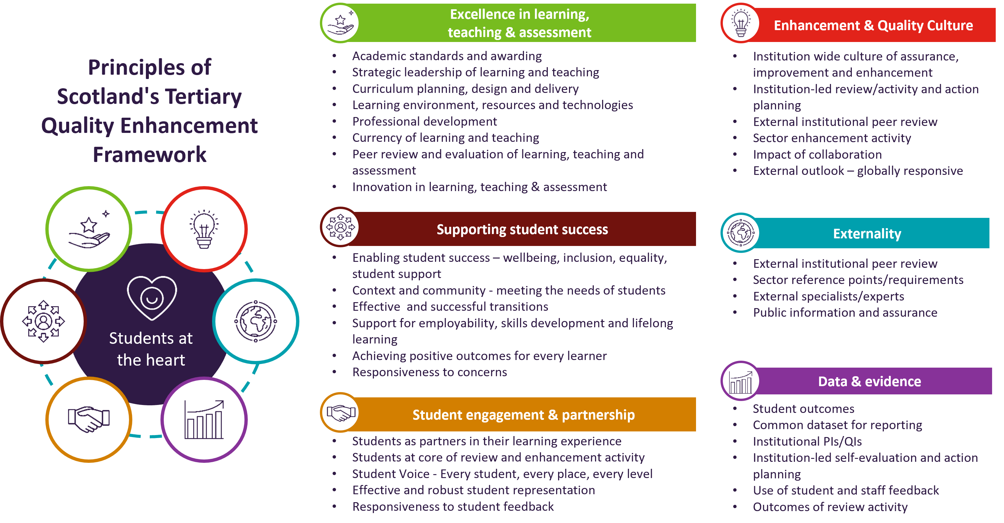
Principles and how they map to institutional activity

Slide 6
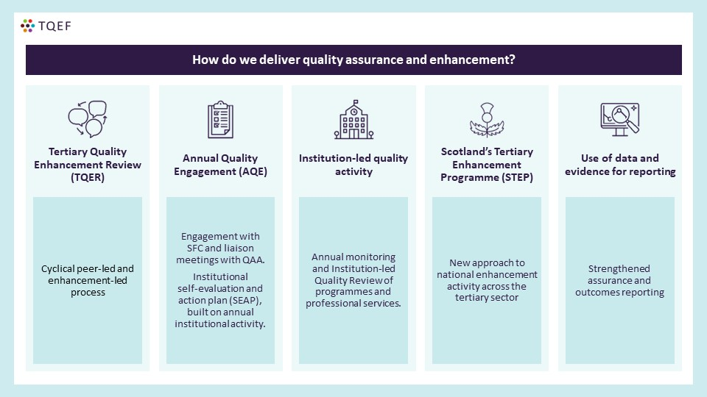
Delivery of QA and QE

Slide 7
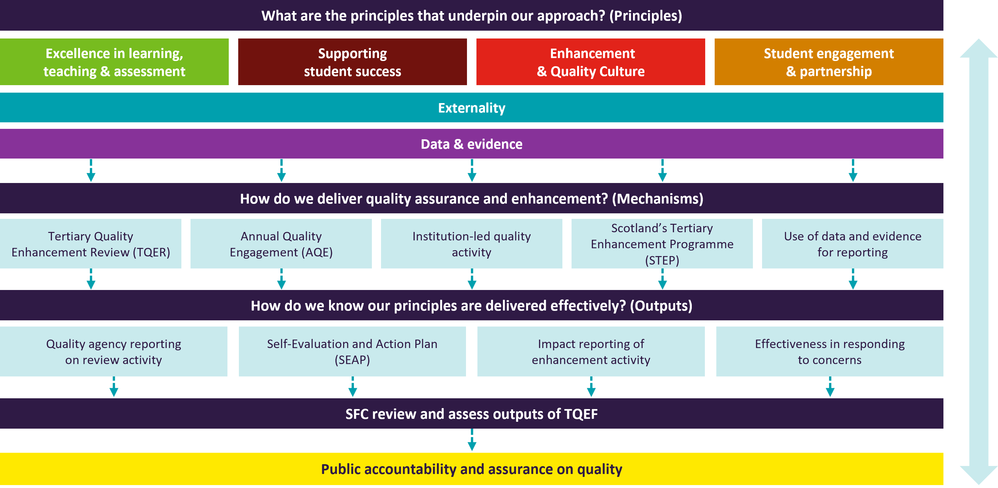
How it all fits together

Slide 8
Go Beyond
Boundaries
Questions?

