Slide 1




Understanding your pension
Jonathan Seed FFA 4 June 2019

Slide 2


About XPS
XPS Pensions Group have been advisers to the Trustees of the University of Aberdeen Superannuation and Life Assurance Scheme (“the Scheme”) since 2011
Jonathan Seed from XPS Pensions Group is the Scheme Actuary.
We recently changed our name, you have previously known us as ‘Xafinity’.
Now we go by ‘XPS’ for short.
2

Slide 3






Today’s session
Your UASLAS benefits
Options at retirement
Your State pension
Risks to your pension

Slide 4





Advice
We can...
Provide information on your pension entitlements Provide information on the options you have
Set out some high level considerations you may wish to make when deciding how to access your pension savings
We cannot...
Provide individual financial advice
If you require individual advice, you should contact an independent financial advisor

Slide 5


Your Scheme benefits

Slide 6


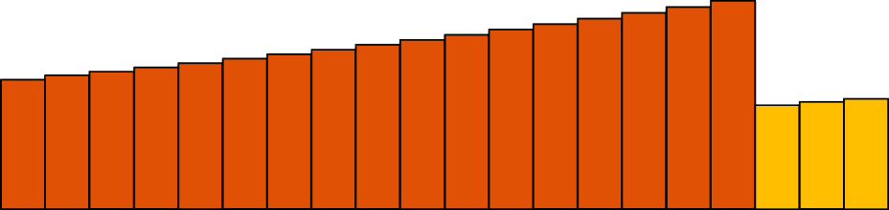
Defined Benefit (DB) pension scheme
(Tax free) lump sum payable at retirement
Dependants’ pension payable when you die
Annual pension increasing in line with inflation
Pay contributions whilst in employment
Join Scheme
Retire
Death
Death
The Scheme promises to pay you a defined pension and lump sum
based on your service and salary

Slide 7

UASLAS - Benefits
Annual pension
Tax free lump sum
Protection benefits
1/80ths of your salary each year of service until 2019
1/100ths of salary each year from 1 January 2019
Pre August 2011 pension linked to final salary
Post July 2011 pension linked to revalued average salary
Inflation linked pension increases in retirement
Frozen pension if leave service before retirement
Additional cash lump sum of 3 times your pension at retirement
Able to give up pension for a higher tax free lump sum (subject to limits)
Can take 25% of the value of pension benefits as a tax free lump sum
Lump sum is NOT subject to income tax
In service – Refund of contributions, tax free lump sum (3 * salary) and a pension for your spouse and any young children
In deferment – Refund of contributions and a pension for your spouse
In payment – tax free lump sum if you die within 5 years of retirement and a pension for your spouse and any young children.

Slide 8

Your pension
Pre88 GMP
Post88 GMP
� We’ll explain what ‘GMP’ is later!
Pre97 Excess
Post97
Post11 Post18
31 Dec 2018
5 Apr 1988 5 Apr 1997 31 Jul 2011
Total is made up of pieces (called Tranches) depending on when you earned it (i.e. when you were paying into the Scheme)
Once earned, your pension increases each year until you retire
Increases every year after retirement
This is to protect it from losing its value over time as a result of inflation
Different Tranches behave in different ways (they increase at different rates)

Slide 9


Your retirement pension (increase rates)
In service to retirement | After leaving service to retirement | After retirement
Linked to salary | Depends when you left | Retail Price Inflation (RPI)
Linked to salary | Depends when you left | None
Linked to salary | Consumer Price Inflation (CPI) or 3% if less | CPI or 3% if less
Linked to salary | CPI or 5% if less | RPI
CPI or 5% if less | CPI or 2.5% if less | CPI or 5% if less
CPI or 3% if less | CPI or 2.5% if less | CPI or 3% if less
Pre97 Excess (Final Salary)
Pre88 GMP
Post88 GMP Post97 (Final Salary)
Post11 (CARE) Post18 (CARE)

Slide 10



Options at retirement

Slide 11


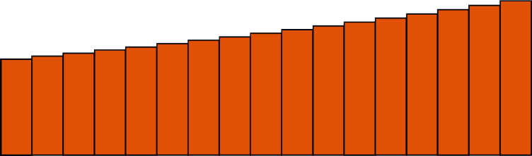
Exchanging pension for more cash
Scheme benefit
= Lump sum
(one-off)
+
Annual pension
(paid every year)
The standard scheme benefit is a lifetime pension plus a lump sum of three times that pension
The lump sum is paid tax free. The pension will be subject to standard income tax rates
You can exchange some of your pension for an extra tax free cash
  Each £1 of pension given up will increase the lump sum payment by around £15
  The amount of cash represents the value of the pension you would give up
  But your pension will be lower (your dependant’s pension is not affected)
You should take financial advice

Slide 12

What factors affect the amount of cash received in this exchange?
Age at retirement
  Members retiring at younger ages would receive more cash, reflecting the longer period over which their pension is expected to be paid.
  But you are giving up that part of your pension for life
Increases on the pension given up
  Each £1 of increasing pension is worth more than each £1 of flat pension
  But that is expected - £1 of pension increasing at 3% each year will grow to £1.34 after 10 years and £1.81 after 20 years
Expected future investment returns
  You receive a lump sum now instead of annual pension payments over the next 20-25 years
  The Trustees need to allow for the ‘lost’ investment returns on the extra lump sum paid
  Higher expected future returns lead to a lower lump sum payment
Members can retire between age 55 and 75 but most retire between 60 and 65

Slide 13


Transfer out of the Scheme
The benefits you have built up can be converted into a cash amount called a ‘transfer value’ (also known as a ‘cash-equivalent transfer value’ or ‘CETV’).
This transfer value can be taken out of the Scheme and invested in a:
Personal or stakeholder pension
Pension scheme with another employer
Self-invested personal pension (SIPPs)
Some people do this to keep their pension benefits together in one place Some people do this to customise their pension plan to suit their needs
There are risks – you are giving up a guaranteed pension for life to get a lump sum that you can use flexibly but without any guarantees
Before you go ahead, you should seek advice from a regulated financial adviser. If your Transfer Value is over £30,000 then you must.

Slide 14


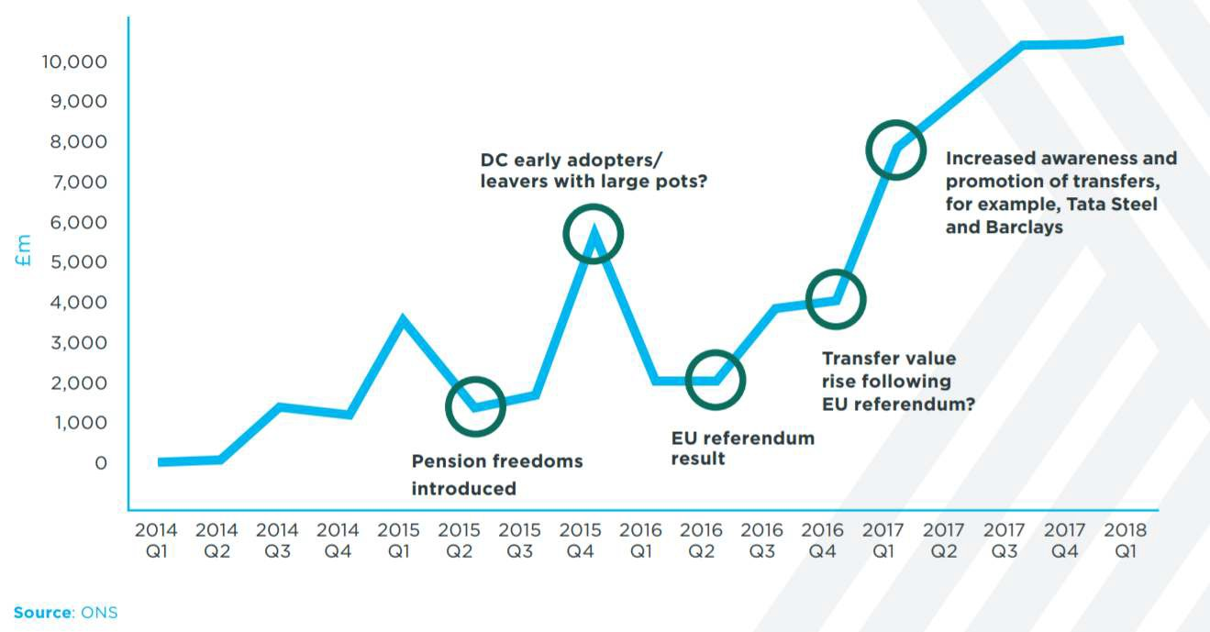
Surge in transfers

Slide 15


Your State pension

Slide 16

Planning for your retirement
Property
Shares
Savings
Children?
Occupational pension scheme
University of Aberdeen Scheme (and others?)
State pension

Slide 17








State Pension entitlement
When?
October 2020
March 2028
April 2046
65
66
67
68
December 2018
April 2026
April 2044
What you receive
How it grows
£164.35
per week
£46.96
Wage inflation
Price inflation
2.5%
Maximum Minimum
(35 qualifying years) (10 qualifying years)
https://www.gov.uk/check-state-pension
– 17 –

Slide 18

What is State Second Pension and Guaranteed Minimum Pension (GMP)?
The State Earnings Related Pension (SERPS) and the State Second Pension (S2P)
Was an earnings-related scheme paid on top of your basic state pension
Replaced in 2016 by the Single State Pension
Prior to that pension schemes could ‘contract out’ of SERPS/S2P
Members of those schemes didn’t earn SERPS/S2P while in the scheme
Instead of SERPS they earned a pension from the scheme called “GMP”
The benefit of this is that the members (and the employer) pay lower NI contributions while they work!
Guaranteed Minimum Pension (GMP)
A SERPS replacement benefit prescribed by the Government
Must be provided where schemes were contracted out of SERPS
Historic benefit – built up between 1978 and 1997
Trustees and University do not control this benefit
Calculated in line with Government rules
Increases in line with Government rules
Has a retirement age associated with the State Pension Age set by the Government (60 F / 65 M) at the time

Slide 19

Why is it unequal?
Pension at exit
£4,000
No matter your gender, the total pension you would receive at the date you leave the Scheme (whether by leaving the University or by retiring) is the same - because of how scheme rules calculate it.
However, the make-up of the “Tranches” is different because of the Government imposed ‘GMP’ Tranche.
Remember that different Tranches behave in different ways.
So over time, this could have an affect. An example is shown on the next slide.
£4,000
£4,000
700
850
1,300
1,150
£2,000
2,000
2,000
£0
Male
Post 97
Female
Pre 97 XS
GMP (M / F)

Slide 20

Why is it unequal? An example
£8,313
2,353
£4,000
2,348
700
1,300
3,612
2,000
Different Tranches increase at
Post 97
Pre 97 XS
GMP (M)
£8,547
£234 higher for female
2,858
different rates
£4,000
2,077
850
1,150
3,612
2,000
Left the Scheme at age 45
Post 97
Pre 97 XS
GMP (F)
Retirement at age 65
20

Slide 21



Why is it unequal? – Other reasons
In the previous example, we looked at the difference that could occur from date of leaving to date of retirement.
In that example, the female member ended up better off.
However, there are other ways in which the tranches behave differently, for example, pension increases.
Scheme pension increases are generally higher for non-GMP pension, than for GMP.
Sometimes female members are better off, sometimes male members are better off!

Slide 22


GMP Equalisation
How will the pensions be equalised?
The Scheme will undergo an exercise to review everyone's pension. If any member is found to be worse off because of their gender, their pension will be increased and arrears will be paid.
Who might be affected?
Members who accrued pension between 15 May 1990 and 6 April 1997 could be affected.
How big of an impact will this have?
The effect is not expected to be big. Some pension may increase, but only by a few percent (our earlier example showed an extreme case). No pension will decrease.
When?
We are still waiting on Government guidance before we can get started. Likely to take place mid to late next year. You will receive a letter if you have been affected.

Slide 23

Risks to your pension

Slide 24


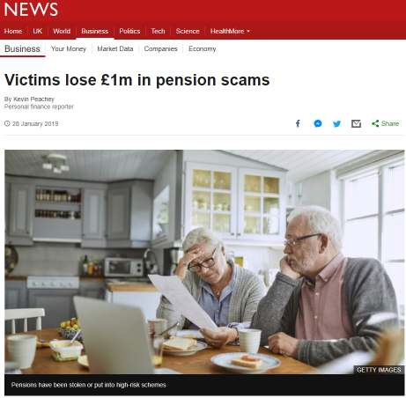
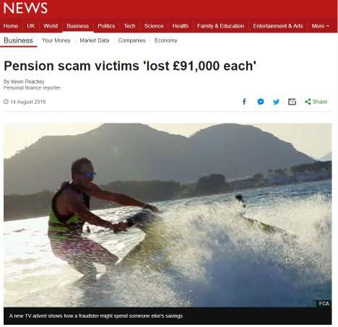
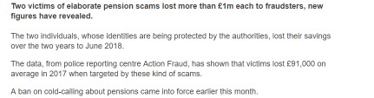
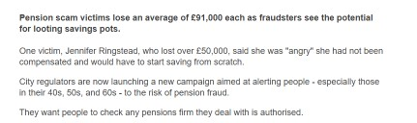
Beware pension scams

Slide 25












Tell tale signs of a scam
Cold call from an advisor
Courier collected the paperwork
Forms were pre-completed
Never met your advisor
25

Slide 26

Thank you
Jonathan Seed FFA / Actuary
T: 01786 237 014
E: Jonathan.Seed@xpspensions.com
XPS Pensions Group, XPS Pensions, XPS Administration, XPS Investment and XPS Transactions are the trading names of Xafinity Consulting Ltd, Punter Southall Ltd and Punter Southall Investment Consulting Ltd.
XPS Administration is the trading name of PS Administration Ltd.
Registration
Xafinity Consulting Ltd, Registered No. 2459442. Registered office: Phoenix House, 1 Station Hill, Reading RG1 1NB.
Punter Southall Investment Consulting Ltd Registered No. 6242672, Punter Southall Ltd Registered No. 03842603, PS Administration Ltd Registered No. 9428346. All registered at: 11 Strand, London WC2N 5HR. All companies registered in England and Wales.
Authorisation
Punter Southall Investment Consulting Ltd (FCA Register number 528774) and Xafinity Consulting Ltd (FCA Register number 194270) are both authorised and regulated by the Financial Conduct Authority (FCA) for investment business.

