Slide 1
REVIEW OF TECHNICAL
STAFF PROVISION
Professor Dame Anne Glover
Brian Paterson
Evelyn Argo
28 November
13 December

Slide 2
FORMAT FOR THE SESSION
Introduction
Why we are undertaking the Review and aims
Review process – Working Group
Methodology and timescale
Summary of current structures and staffing profiles
Key areas to consider
Next steps – how to feedback
Opportunity for questions

Slide 3
WHY ARE WE UNDERTAKING THE REVIEW?
University has undergone significant change
Last review of technical provision over 10 years ago – in 2003/4 when the current structures were recommended/ implemented
Wish to establish whether we have the best structure for technical provision now and in the future
Want input from staff to identify opportunities for a stronger support structure and better working environment

Slide 4
AIMS OF THE REVIEW/TERMS OF REFERENCE
Review existing structures and define a structure that:
  Reflects the composition and skills required;
  Continues to provide high quality support for research and teaching;
  Enables suitable deployment of resource;
  Considers the development of career pathways;
  Provides clarity and accountability regarding cost recovery
Identify improvements around aspects of staff management

Slide 5
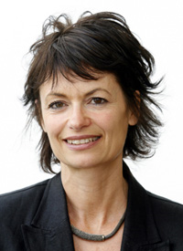
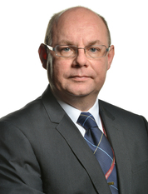
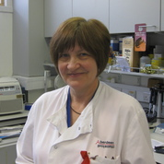
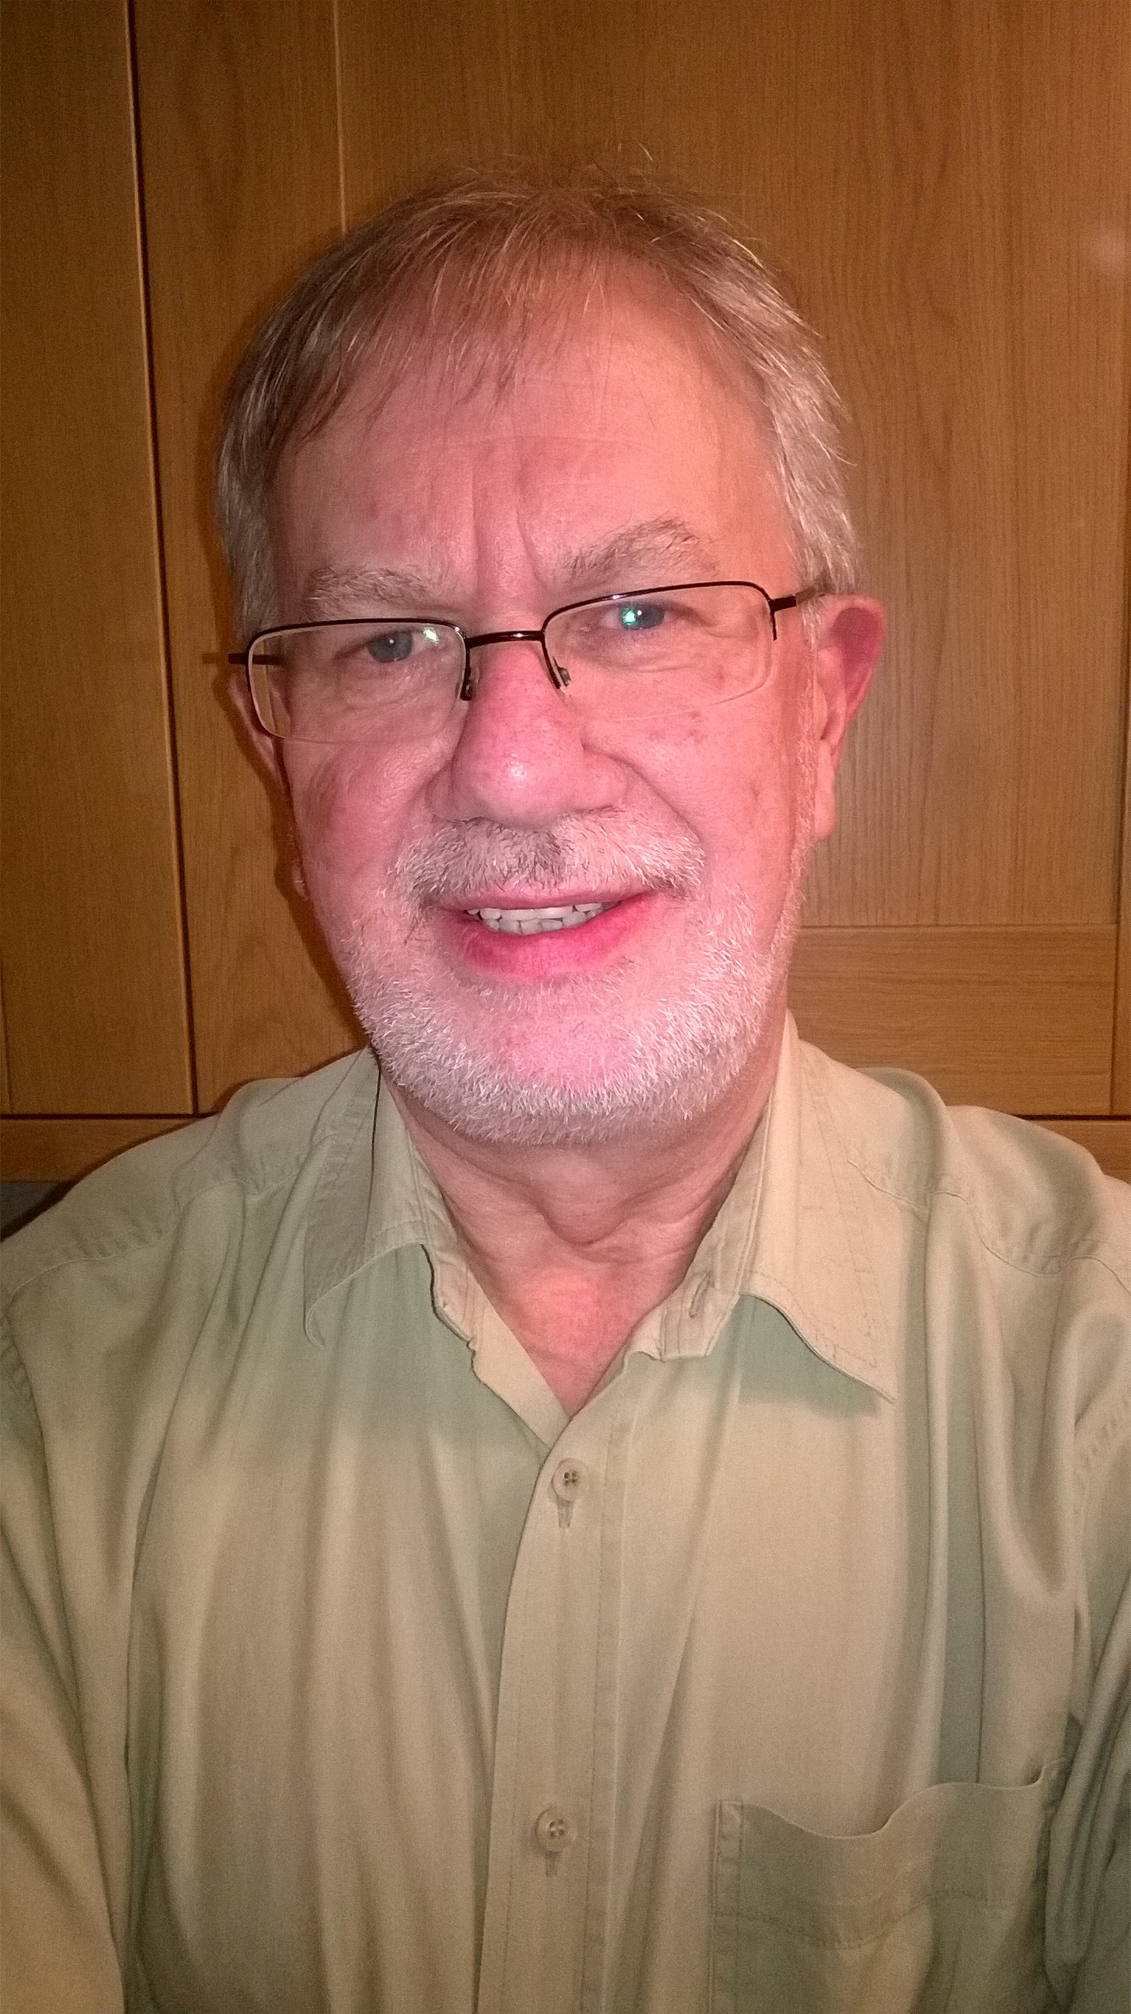
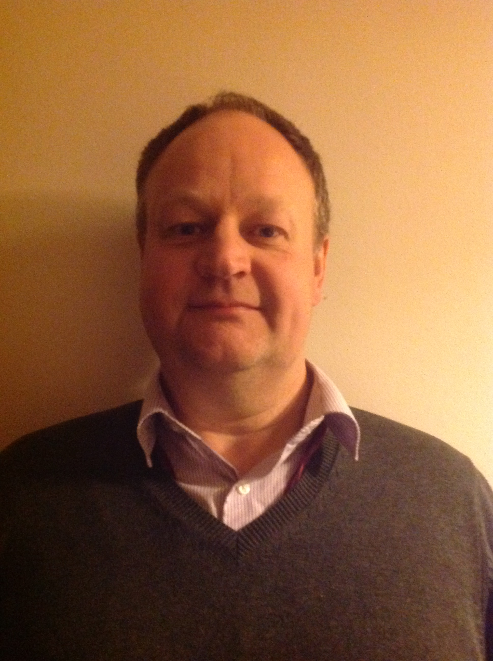
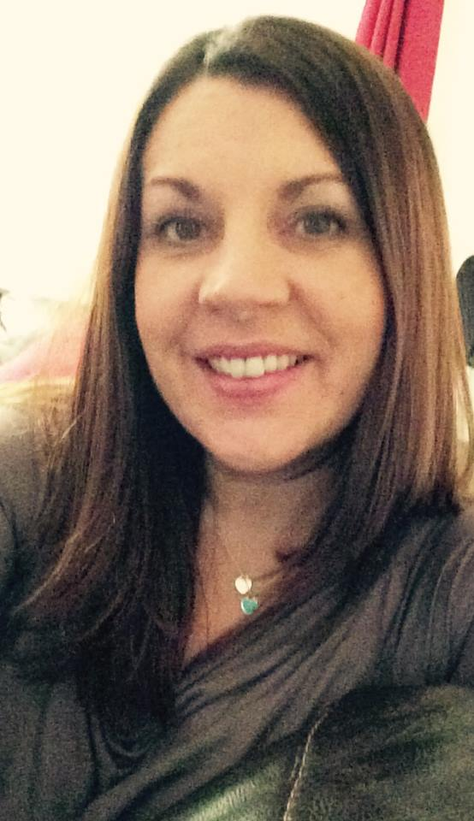
THE REVIEW PROCESS
WORKING GROUP
PROFESSOR DAME ANNE GLOVER
VICE PRINCIPAL EXTERNAL AFFAIRS/CO-CONVENOR
MR BRIAN PATERSON
TECHNICIAN/CO-CONVENOR
MRS EVELYN ARGO,
RESEARCH TECHNICIAN/
CO-CONVENOR
MR TED PRIDHAM
DEPUTY CHIEF AV TECHNICIAN
MR MARTIN COWIE
TECHNICAL RESOURCES MANAGER
MRS TRACEY WHITE
DEPUTY DIRECTOR OF HR/CLERK

Slide 6
METHODOLOGY & TIMESCALE
Working Group - oversee the Review and submit recommendations to senior management
Partnership working between the University and Unite – University and Trade Union co-convenors
Understand current provision and future requirements
Consultation – technical staff to establish current strengths and weaknesses and what could be improved
Consultation – service users to explore their future needs for technical support and their views
Timescale – mid to end January 2017

Slide 7
CURRENT STRUCTURES
Technical Staff reporting to technical manager - COPS
Technical staff reporting to PI/ academic – SMMSN, Social Sciences
Combination of both - SBS

Slide 8
CURRENT STAFF DATA
AGE PROFILE
52% are aged 18 to 44 years
48% are over 45 years

Slide 9
CURRENT STAFF DATA
GENDER
146 females
111 males

Slide 10
CURRENT STAFF DATA
LENGTH OF SERVICE
50% of staff have 0-9 yrs service
31% have 20 yrs or more service

Slide 11
KEY AREAS TO CONSIDER
GENERAL:
  What works well and what doesn’t?
  How can we learn from each other?
STRUCTURES:
    Reporting lines: Technical – vs - Academic
    Recognition that one size may not fit all
CAREER PATHWAYS
  Opportunities for development/promotion
UNIVERSITY
  The University as an employer

Slide 12
NEXT STEPS
Discuss in your own areas and provide feedback
Discuss with members of the Working Group
Feedback to members of the Working Group or the dedicated email address – technicalreview@abdn.ac.uk

Slide 13
ANY QUESTIONS?
ANY COMMENTS?
ANY INPUT?

