Slide 1
Navigating peer Review
A guide to the peer review process, for both authors and reviewers.

Slide 2
Introduction
In the field of academic publishing, control over publication quality is essential. The system of peer review is a way to ensure this, as it involves the expert evaluation of every publication.
In your career, you might be led to both submitting articles for publication, and reviewing articles written by academic peers. This guide will cover the tasks of both authors and reviewers, after a presentation of the process of peer review.

Slide 3
Contents
I. The peer review process
Why peer review?
The mechanisms of peer review
II. Authors
Writing your manuscript
Submitting your manuscript
Revising your manuscript
III. Reviewers
Getting started
Receiving a review invitation
Reviewing the manuscript
Writing the review
Recommendation to the editor
Summary and Resources

Slide 4
I. The peer review process
A quick overview and explanation of the peer review process.

Slide 5
a. Why peer review?
A survey from the Publishing Research Consortium (2015) asks academic authors about peer review:
82%
agreed that without peer review there is no control in scientific communication.
Peer review is effective for:
Improving the quality of the published paper.
Determining the originality of the manuscript.
Determining the importance of the findings.
Detecting fraud.
Detecting plagiarism.
74%
agreed peer review improves the quality of the published paper.
You can find the study here.

Slide 6
b. The mechanisms of peer review
Author chooses a journal
Paper is rejected
Editor rejects it
Author is asked to make revisions
Author submits to journal
Editor assesses the reviews and makes a decision
Editor sends the manuscript to reviewers
PEER REVIEW
The paper is published
Paper is accepted without further revisions
Editor screens the manuscript

Slide 7
Author chooses a journal
Paper is rejected
Editor rejects it
Author is asked to make revisions
Author submits to journal
Editor assesses the reviews and makes a decision
Editor sends the manuscript to reviewers
PEER REVIEW
The paper is published
Paper is accepted without further revisions
Editor screens the manuscript
The author submits their manuscript for a first screening from the editor.
The author needs to choose a journal which fits their field of study, and read that journal’s guidelines.
Usually, the submission is done electronically.

Slide 8
Author chooses a journal
Paper is rejected
Editor rejects it
Author is asked to make revisions
Author submits to journal
Editor assesses the reviews and makes a decision
Editor sends the manuscript to reviewers
PEER REVIEW
The paper is published
Paper is accepted without further revisions
Editor screens the manuscript
The manuscript could be rejected by the editor at this stage.
The paper could be rejected if:
The topic is nor suitable for the journal.
The author has failed to follow the journal’s guidelines.
The paper is too similar to one that has already been published.
The author revises their manuscript and attempts to submit it to a different journal.

Slide 9
Author chooses a journal
Paper is rejected
Editor rejects it
Author is asked to make revisions
Author submits to journal
Editor assesses the reviews and makes a decision
Editor sends the manuscript to reviewers
PEER REVIEW
The paper is published
Paper is accepted without further revisions
Editor screens the manuscript
After accepting the manuscript, the editor reaches out to reviewers.
Journals usually aim for 2 reviewers per paper.
The editor has a database of reviewers, and finds the ones with expertise in the topic and/or method covered in the paper.
The reviewers can choose to accept or decline the review offer.
They are given a few weeks to return the review.

Slide 10
Author chooses a journal
Paper is rejected
Editor rejects it
Author is asked to make revisions
Author submits to journal
Editor assesses the reviews and makes a decision
Editor sends the manuscript to reviewers
PEER REVIEW
The paper is published
Paper is accepted without further revisions
Editor screens the manuscript
The manuscript is sent to the reviewers.
The reviewing process consists of checking:
The relevance and novelty of this article in its field.
Its overall structure and readability.
Its appropriate use of sources and methodologies.

Slide 11
Author chooses a journal
Paper is rejected
Editor rejects it
Author is asked to make revisions
Author submits to journal
Editor assesses the reviews and makes a decision
Editor sends the manuscript to reviewers
PEER REVIEW
The paper is published
Paper is accepted without further revisions
Editor screens the manuscript
There are different kinds of peer review:
Single blind | The peer reviewers know who the authors are, but the authors do not know who the peer reviewers are.
Double blind | Neither party knows who the others are: the authors do not know who the peer reviewers are and the authors’ names are not disclosed to the peer reviewers
Open | Both parties know who the others are: the peer reviewers are given the authors’ names and the authors are told the peer reviewers’ names when they receive the review comments.

Slide 12
Author chooses a journal
Paper is rejected
Editor rejects it
Author is asked to make revisions
Author submits to journal
Editor assesses the reviews and makes a decision
Editor sends the manuscript to reviewers
PEER REVIEW
The paper is published
Paper is accepted without further revisions
Editor screens the manuscript
The editor makes a decision based on the reviews, and their own evaluation of the paper.
The editor can choose to:
REJECT the manuscript
REVISE with MAJOR revisions needed.
REVISE with MINOR revisions needed.
ACCEPT with no revisions.

Slide 13
Author chooses a journal
Paper is rejected
Editor rejects it
Author is asked to make revisions
Author submits to journal
Editor assesses the reviews and makes a decision
Editor sends the manuscript to reviewers
PEER REVIEW
The paper is published
Paper is accepted without further revisions
Editor screens the manuscript
The paper does not pass peer review and is rejected by the editor.
The author receives comments from the reviewers, and should use them to revise the manuscript before submitting it to another journal.

Slide 14
Author chooses a journal
Paper is rejected
Editor rejects it
Author is asked to make revisions
Author submits to journal
Editor assesses the reviews and makes a decision
Editor sends the manuscript to reviewers
PEER REVIEW
The paper is published
Paper is accepted without further revisions
Editor screens the manuscript
The author is asked to revise the manuscript.
The author bases the revisions on the comments of the reviewers.
If MAJOR revisions are needed, the manuscript needs to be checked by the reviewers once again before publication.
If MINOR revisions are needed, the manuscript is only checked by the editor, and not the reviewers.

Slide 15
Author chooses a journal
Paper is rejected
Editor rejects it
Author is asked to make revisions
Author submits to journal
Editor assesses the reviews and makes a decision
Editor sends the manuscript to reviewers
PEER REVIEW
The paper is published
Paper is accepted without further revisions
Editor screens the manuscript
The paper does not need any more revisions, and is ready to be published!
Sometimes the manuscript does not need any revision at all, but this is rare.
The paper is edited and proofread by the journal, then is published.

Slide 16
Author chooses a journal
Paper is rejected
Editor rejects it
Author is asked to make revisions
Author submits to journal
Editor assesses the reviews and makes a decision
Editor sends the manuscript to reviewers
PEER REVIEW
The paper is published
Paper is accepted without further revisions
Editor screens the manuscript
How do you fit in this process, both as an author and as a reviewer?

Slide 17
II. Authors
How to successfully submit a manuscript.

Slide 18
a. Writing your manuscript
The reviewers will be looking at the structure and clarity of your paper, as well as its use of sources and methodologies. Here are some ideas of what will be evaluated during the peer review process, if you are writing for a scientific journal.
Title and abstract
✓ Does the title reflect the research question?
✓ Does the abstract accurately describe the research methods and findings?
Introduction
✓ Is the research question clear?
✓ Why is the research important?
✓ Are the most relevant sources cited?
Methods
✓ Are they described clearly enough for others to repeat them?
✓ Are they appropriate for the research question?
✓ Are they ethical?
Results
✓ Are they well-described?
✓ Are they clearly presented? (i.e. are figures and tables readable?)
✓Are all patterns and correlations accounted for?
Discussion
✓ Is your interpretation backed up by results?
✓ Have you pointed out the limitations?
✓ Has the question been answered?
You can find more information on this in this webinar from Zoë Mullan, founding editor of The Lancet Global Health, published by Elsevier.

Slide 19
a. Writing your manuscript
Here are some ideas of what will be evaluated during the peer review process, if you are writing for a journal in the field of arts and humanities.
Title and abstract
✓ Does the title reflect the research question?
✓ Does the abstract accurately summarise the content of the article?
Introduction
✓ Is the research question clear?
✓ Why is the research important?
✓ Are the most relevant sources cited?
✓ Have you pointed out the limitations of your approach?
✓ Have any theoretical perspectives been explained?
Argument
✓ Does it address the question you have set?
✓ Is it well structured?
✓ Have you covered the relevant source material and backed up your claims with evidence?
Style
✓ Is your writing clear and engaging?
✓ Is your use of technical language appropriate for your audience?
✓ Have you followed the journal’s style guidelines?
Conclusion
✓ Does it follow from your argument?
✓ Has the question been answered?
✓ Is the significance of your contribution clear?
✓ Can you suggest further work in that area?

Slide 20
b. Submitting your manuscript
Only submit your manuscript to one journal at the time.
Only approach other editors if you have been rejected by your first choice of journal.
Before submitting your manuscript, make sure that its aims align with the focus of the journal. Editors will not be interested in publishing your work if that is not the case.
Information regarding the focus and aims of a particular journal can be found on its website.
Remember to consult and follow the journal’s author guidelines.
They are usually found on their website, and cover essential information regarding…
the article’s structure
the journal’s preferred reference style
instructions for graphical figures and illustration
instructions for the acknowledgements and biography
… and more!

Slide 21
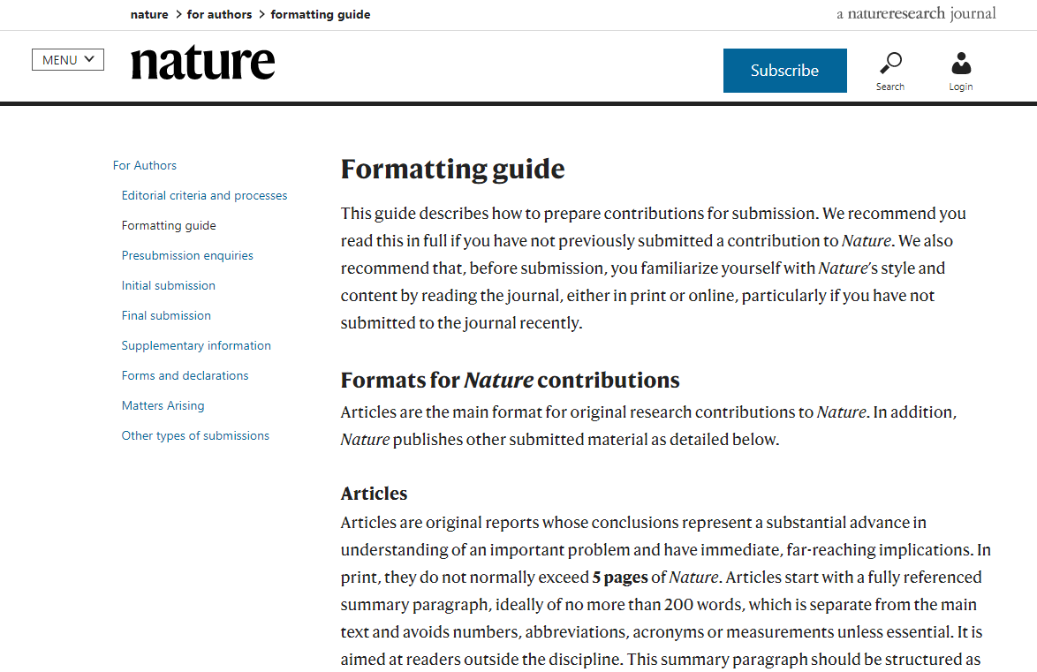
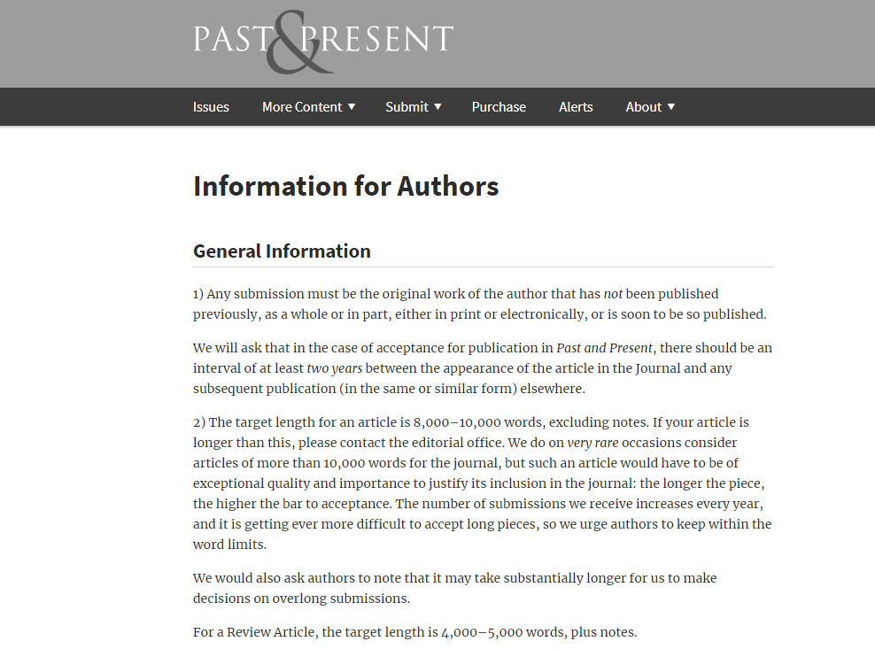
b. Submitting your manuscript
Here are examples of journals’ guidelines for authors, from the journals Nature and Past & Present.
You can find this page here.
The screenshot was taken in Jan 2020.
You can find this page here.
The screenshot was taken in Jan 2020.

Slide 22
c. Revising your manuscript
If your manuscript needs revisions, or if it is rejected, it is important to take into account the reviewers’ comments on your work. These could include comments about: the methodology, your use of sources, the construction of your argument, the clarity of your tables and illustrations, etc.
Make sure you revise your manuscript according to the reviews before submitting it again.
However, if you disagree with peer reviewers, and feel that it would be appropriate to defend your work, you can get back to the editor to let them know about the situation.

Slide 23
III. Reviewers
How to efficiently review a manuscript.

Slide 24
a. Getting started
Get involved in peer review to:
Contribute to the academic community.
Enhance your reputation or career, and distinguish yourself as an expert in your field.
Stay up-to-date with emerging research in your field.
Ways to get involved in peer review
Ask your supervisor to co-review with them on a review
Contact the editor of the relevant journal(s)
Get involved in post-publication commenting online
Network with editors at conferences

Slide 25
b. Receiving a review invitation
Are you able to respect the deadline?
The average review takes a few hours to complete.
These are important elements to consider before accepting a review invitation.
Tell the editor about any doubts you may have regarding these questions.
Do you have the appropriate knowledge and expertise?
The editor is looking for an expert’s opinion.
Do you understand the focus of the journal?
The reviewers’ guidelines are found on the journal’s site, or invitation email.
Are there any conflicts of interest?
Do you work in the same institution as the author, or have collaborated before, etc.
Accept or decline the invitation as promptly as you can, so as to not slow down the publication process! When declining, you may suggest alternative reviewers, if possible.
The correspondence about the manuscript should remain confidential before, during, and after the peer review process.

Slide 26
c. Reviewing the manuscript
It is essential to read through the whole manuscript before writing any review.
You may want to focus on the following aspects of the article:
The topic
Is it appropriate for the journal?
Does it contribute and add to the knowledge of its academic field?
Does it answer a relevant question?
The sources and methodology
Has the author used relevant sources?
Is the methodology appropriate for the research question?
Is the methodology well-described?
The content and structure
Are the arguments clear?
Do the title and abstract reflect the content of the article?
Are the tables/figures/images relevant and clear?
Does the evidence support the conclusions?
Do NOT correct typos or spelling mistakes! It is time-consuming,
and is the task of the journal’s copy editors.
You could address spelling problems in one or two sentences in your review.

Slide 27
d. Writing the review
Reviews can be structured in different ways. However, here are some important considerations:
1. Overview
How do you interpret the points made in the paper?
How does it contribute to your academic field?
Main strengths and weaknesses?
2. Major comments
These are problems that affect the understanding of the paper.
Be precise! Refer to specific extracts and suggest ways to improve the paper.
3. Minor comments
These can include: confusing sentences, unclear figures, incorrect references, etc.
Similarly, being precise will facilitate the author’s revisions.
Remember that your goal is to help improve the paper, so it is important to keep a constructive tone.
You can find more information on this in this webinar from Zoë Mullan, founding editor of The Lancet Global Health, published by Elsevier.

Slide 28
e. Recommendation to the editor
You can recommend one of four choices to the editor:
REJECT the manuscript
REVISE with MAJOR revisions needed.
The revised manuscript goes through you and the editor before being published.
ACCEPT with no revisions.
REVISE with MINOR revisions needed.
The revised manuscript will only go through the editor before being published.
Your recommendation should reflect your comments to the author.
Keep in mind that the editor makes the final decision, and it may not match your recommendation.

Slide 29
Summary and Resources

Slide 30
Summary
Peer review is a way to ensure the quality and credibility of academic publishing.
The authors’ articles go through a process of verification by editors and reviewers before being published.
Authors are encouraged to consult and follow the journal’s guidelines before submitting. If revisions to their manuscript are needed, it is important to take into account the comments from the reviewers.
Getting engaged in peer review is a good way to enhance your career and contribute to the academic community.
The reviewer’s punctuality and feedback are essential to an effective peer review process.
In the end the decision regarding the publication of the paper belongs to the editor, after evaluating the manuscript and its reviews.

Slide 31
Resources
Electv, Introduction to academic publishing: A guide for researchers.
Elsevier’s Researcher Academy, Certified Peer Reviewer Course. You can take the course here: https://researcheracademy.elsevier.com/navigating-peer-review/certified-peer-reviewer-course
University of Manchester Library, My Research Essentials: Peer review. You can take the course here: https://www.escholar.manchester.ac.uk/learning-objects/mre/peer-review/story_html5.html

