Slide 1
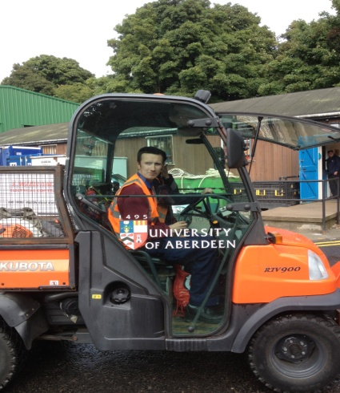
2018 marks the ‘Year of Young People’ in
Scotland, and the theme for Learning Disability
Week reflects that. ‘My Generation’ will focus the
country’s attention on the experiences of young
people with learning disabilities in Scotland.

Slide 2
We are faced with a once in a lifetime policy opportunity as a first generation of young adults with learning disabilities come of age, never having experienced institutional care.
They are the first to have the opportunity to live transformed lives.

Slide 3
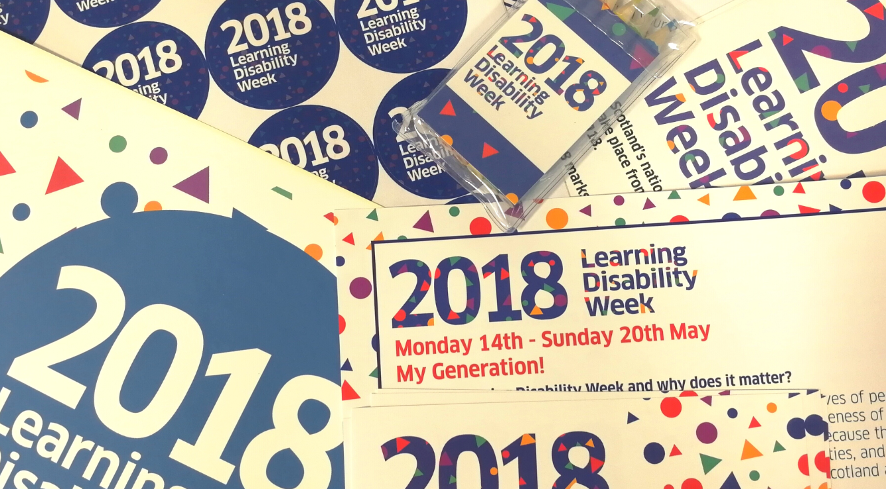

Slide 4
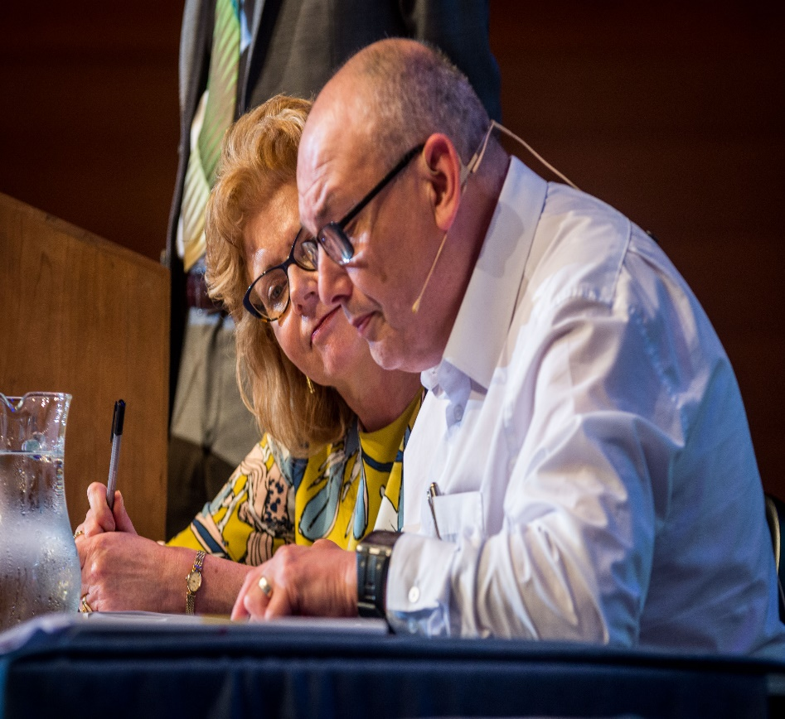
The ‘My Generation’ theme is also a great way
for older people with learning disabilities to
highlight how much Scotland has changed during
their lifetime. We will be encouraging people with
learning disabilities of all ages to reflect on the
things that summed up their younger lives.
Find out how you can get involved at scld.org.uk
Twitter: @SCLDNews
Facebook: facebook.com/ScotCommission
Instagram: instagram.com/scldnews

Slide 5
Young people with a learning disability have only a 7% chance of being in employment. National average in Scotland is 82%.
In Aberdeen City youth employment between 2009 to 2017 – fell from 75.6% to 54.6%

Slide 6
At 16 years old young people with a learning disability have the same career aspirations as all other 16 year olds.
At 24 years old a young person with a learning disability or autism is 4 times more likely to be unemployed than a young person who does not have a disability.
Wood Commission –June 2014

Slide 7
In the Scottish Government’s Disability Delivery Plan 2016, there is a commitment to “…more than half the Disability Employment Gap”
“We will explore opportunities to promote the Project SEARCH model” Action 31

Slide 8
Project SEARCH in Scotland
Started in 2010, by 2017…..
356 young people started
316 completed
219 full time jobs 69.3% success rate
UK Work Programme full time employment rate for people with a disability is 15.9%

Slide 9
What next: School leavers with a learning disability in Scotland
2013/14 | 994
2014/15 | 1116
2015/16 | 1266

Slide 10
School leaver destination | 2013/14 | 2014/15
Higher Education | 36 | 33
Further Education | 521 | 600
Employment | 105 | 129

Slide 11
“Employing disabled people drives innovation” Channel 4
“86% of businesses ranked attitude to work as the most important factor when recruiting school and college leavers”
“One of the key ways of improving young people’s readiness in the workplace is allowing them to experience the world of work much earlier”
C.B.I. Confederation of British Industry

Slide 12
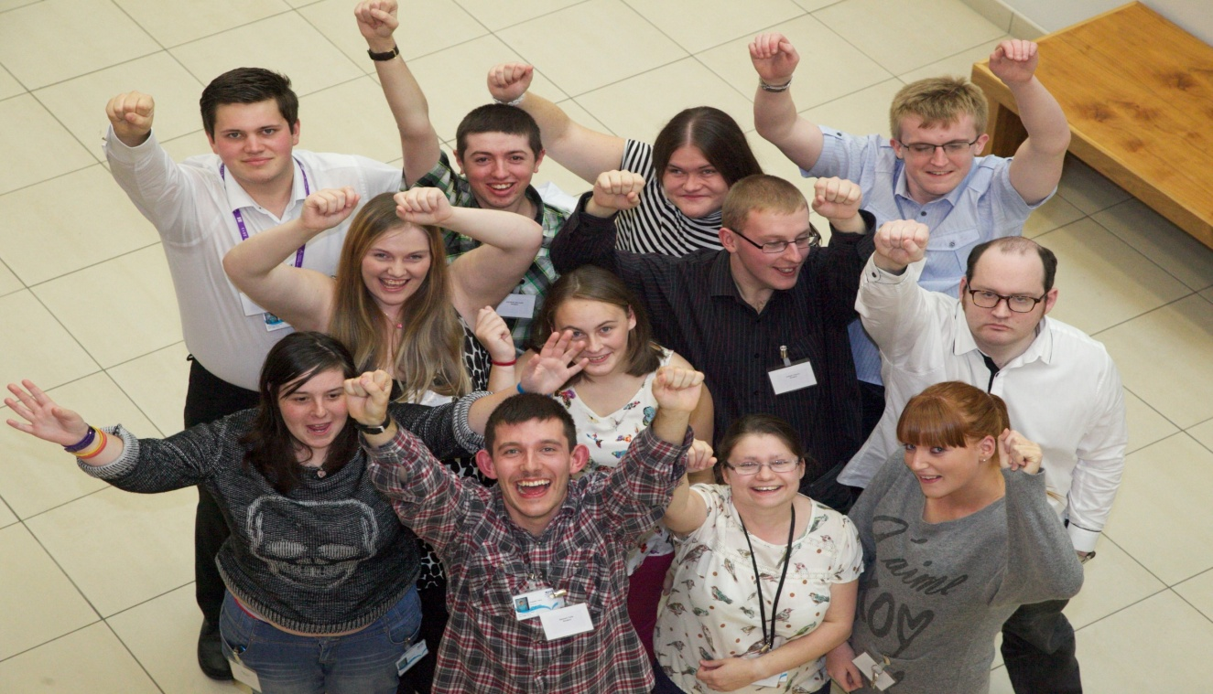
What can you do to help develop Project SEARCH in Scotland?
How can you get involved in Learning Disability Week in the Year of Young People.
#LDWeek2018
https://www.scld.org.uk/learning-disability-week-2018-generation/

