Slide 1
ITN Grant Writing Workshop
Research & Innovation – November 2017
Aberdeen
Grants
Academy
Research &
Innovation
Follow us on Twitter
@UoAResInnov

Slide 2
Overview of Session
Breakdown of each section of the proposal
Excellence
Impact
Implementation
Contributions from colleagues
Current Grant Holder & Programme Evaluator – General observations
PERU – Public Engagement
Centre for Academic Development – Transferable skills training
DIT Relationship Manager – Data Management Strategy
Equality & Diversity Advisor – Gender Aspects
Common Weaknesses and advice to avoid them
Innovative Training Network Workshop
Follow us on Twitter
@UoAResInnov

Slide 3
Goals of the ITN Scheme
Operates on a ‘bottom-up’ basis
For any research and innovation at any TRL
Mobility is a key requirement – border/sectors
Aim to enhance skills of people in research
Strong participation and synergy across sectors
Dissemination and pubic engagement crucial
Gender balance – equal opportunities for all
Career development of ESRs should be the central focus of the network
Research
International
Intersectoral
Interdisciplinary
Innovation
Education
Innovative Training Network Workshop
Follow us on Twitter
@UoAResInnov

Slide 4
The University of Aberdeen’s ITN story
Scheme launched in December 2013 as part of the Horizon 2020 Work Programme, having previously been the Initial Training Network (ITN)
We have appeared in over 100 applications to the ITN schemes with only 8 successes in the 4 years the programme has operated.
Success rates are usually in the mid-high 90s – proposals need to be perfect!
Year | Submitted | Awarded | ABDN S/R | Scheme S/R
2014 | 22 | 2 | 9.1% | 9%
2015 | 31 | 3 | 9.6% | 6.8%
2016 | 28 | 2 | 7.1% | 7%
2017 | 21 | 1 | 4.7% | 7.4%
Innovative Training Network Workshop
Follow us on Twitter
@UoAResInnov

Slide 5
Professor Matteo Zanda Grant Holder; Pet3D (Coordinator) & MOGLYNET (Partner) Evaluator for Marie Curie
Innovative Training Network Workshop
Follow us on Twitter
@UoAResInnov

Slide 6
Being Coordinator of an ITN
Play according to the EU rules: get very familiar with the guidelines, be sure to understand VERY WELL what an ITN is and what isn’t
Give yourself plenty of time to plan Consortium & Project in detail: at least 4 months are needed!
This is not an RCUK or Wellcome Trust or ERC project: originality and ground-breaking nature of research is important, but training, consortium and dissemination are even more so!
The Consortium needs to be functional for the project but most importantly it must tick the EU/Evaluators boxes: you need the right balance of academic/non-academic partners depending on ETN/EJD/EID. Partner institutions are not necessary. Avoid over-complicated structures!!!!
All the ESRs should be enrolled in a PhD: in theory it is not mandatory but in practice it is!!
Don’t be greedy with ESRs: the Coordinator is not automatically entitled to have more ESRs than the other Consortium members!
Listen to the partners, be receptive to their ideas, but at the end of the day be prepared to decide! This is not about democracy, it’s about getting the grant!
Be prepared to do most of the work, the application needs to be homogeneous in style, not a Frankenstein monster assembled from 10 or 20 different people with different languages…
The devil is in the details: aim at perfection, otherwise it’s not worth wasting 4 months or longer as you won’t be able to recycle the application for another type of grant! Use figures and a punchy style, your application needs to catch the (tired) eye of the Evaluator: think like an EU Evaluator!
Prof Matteo Zanda - Institute of Medical Sciences

Slide 7
Being a Beneficiary in an ITN
Even if you are not coordinating you can/should be pro-active in setting up a new ITN application: use your EU connections!
Be prepared to do as much as you can to support/advise the Coordinator and improve the consortium/proposal
Be a good team player, be responsive when asked by the Coordinator to provide information and material
This is a much lighter task than being a coordinator, it will take 2 to 4 weeks of your time to contribute to the application
However be sure you really want to be involved because – if granted – the ITN will suck up quite a lot of your time for the next 4 years!!
Prof Matteo Zanda - Institute of Medical Sciences

Slide 8
Being an Evaluator of the ITN call
The procedure of the Marie Curie Projects evaluations changes constantly.
In ITNs there are 4 Evaluators for each proposal, one of them acts as Rapporteur and writes the final evaluation report which has to be approved by the other 3. Then a vice-chair reviews the report and finally another vice-chair cross checks the report one last time for consistency.
Evaluators are bound to follow the call criteria very strictly, their work is closely supervised by vice-chairs and REA Project Officers.
There is no such thing as EU mafia or bias, certainly not in Marie Curie grants, as the process is highly transparent. The final ranking list is approved by all the Evaluators and Vice-Chairs.
However, not all the Evaluators are always truly competent in a specific subject, quality varies and most importantly: Evaluators can make mistakes as they are human beings!
Evaluators tend to have heavy workloads, so they will start getting tired and cutting corners when evaluating. If they can’t find the information they are looking for they will think it’s not there and give a lower score!!!
BREXIT does matter, even though Evaluators are instructed not to penalise UK applicants. REA’s advice is: “No different treatment whatsoever should be applied to proposals having a UK applicant/beneficiary/researcher. Furthermore, IERs and CRs must not include any mention of – nor comments about – Brexit.” But trust me: a BREXIT bias does exist!!!!
Prof Matteo Zanda - Institute of Medical Sciences

Slide 9
Excellence – Section worth 50%
Common Weaknesses
The quality of the training programme is insufficiently detailed. The large number of training events, their range of themes and duration are not sufficiently justified
The content and objectives of the training programme are not sufficiently described. In particular the innovative aspects of the training programme are not adequately presented
The section on research methodology does not sufficiently elaborate on the specific methods to be used in the proposed research
Supervision scheme is not fully developed, given the demanding nature of the ITN ESR research programs
The state-of-the-art, the coherence and the innovative aspects of the planned research and training activities are not convincingly presented
Innovative Training Network Workshop
Follow us on Twitter
@UoAResInnov

Slide 10
Excellence
REFER TO THE OFFICIAL ITN GUIDE FOR APPLICANTS AND THE UoA WRITING GUIDE FOR FULL EXPLANATIONS OF EACH SECTION
Key Issues
Imbue a sense of urgency; that post graduate research in this area needs better investment in order to address current concerns and develop new researchers
If there is a skills gap in this area – how can you evidence this assertion?
Identify the skills ESRs will gain during their training and how these align with the state of the art innovations and research challenges
Demonstrate that you are working with partners who can enable training in cutting edge techniques relevant to the ESRs future career pursuits
Innovative Training Network Workshop
Follow us on Twitter
@UoAResInnov

Slide 11
Excellence
Key Issues Cont.
Secondments will enable each ESR to gain exposure to both academic and non-academic environments
Interactions between sectors shouldn’t be restricted to ESR secondment – use other examples of how the sectors will come together
Non-academic partners should be able to demonstrate previous supervision of Early Stage Researchers to ensure the ESRs have consistent support
Training modules will be provided by a variety of partners and will equip ESRs with the practical skills they will need in their future careers
Consult with all partners on the provision of training and highlight modules that have ECTS credits attached to them to reflect quality
Ensure training packages for each ESR covers a mixture of transferable skills (grant writing, social media, project management) and technical applications/research skills – keep them relevant to the career objectives of the network’s ESRs
Innovative Training Network Workshop
Follow us on Twitter
@UoAResInnov

Slide 12
Impact – Section worth 30%
Common Weaknesses
Contribution of the programme to strengthening European innovation capacity is weakly explained
The communication and public engagement strategy of the project, in particular regarding the addressing the general public, is not explained in adequate detail
The proposal does not clearly document the consortium’s capability to enhance skills and working conditions for involving the researchers in the relevant field and the manner in which new career prospects will be accommodated. Only general terms are listed
The contribution of the non-academic sector is not described in sufficient detail and it is not clear how it will be integrated in the work plan
Innovative Training Network Workshop
Follow us on Twitter
@UoAResInnov

Slide 13
Impact
Key Issues
This project will contribute meaningfully to the outcomes of several EU Mobility & Innovation Policies & Agendas
Read the Marie Curie 2018-20 Work Programme to understand the motivation for committing funding to this scheme
Research specific examples and cite them in your proposal; European Researchers’ Charter & Code, EURAXESS Doctoral Training Principles, EU Policy ‘Towards a circular economy’ – many others related to your area of science/job creation
This project aligns with the principles of the Responsible Research & Innovation (RRI) approach
RRI implies that societal actors (researchers, citizens, policy makers, business, third sector organisations, etc.) work together during the whole research and innovation process in order to better align both the process and its outcomes with the values, needs and expectations of society – demonstrate clearly how this will be enacted
Innovative Training Network Workshop
Follow us on Twitter
@UoAResInnov

Slide 14
Impact
Key Issues Cont.
ESRs will engage in Commercialisation & Entrepreneurship training to enable them to take forward exploitation of their research results
Training best facilitated by non-academic partners in practical settings
Transferable skill – IP and Licensing of research – crosses academic/non-academic boundaries
What events or competitions can ESRs take part in, either at network level or externally to pitch their innovations?
ESRs will be just as likely and capable of pursuing a non-academic career path upon completion of their projects/PhD
All members of the network are responsible for facilitating opportunities to bring ESRs in touch with future employers
Innovative Training Network Workshop
Follow us on Twitter
@UoAResInnov

Slide 15
Implementation – Section worth 20%
Common Weaknesses
Considering the overall work load of the ESRs (including training, presentations, policy briefings, phd) the targeted output of 3 peer reviewed papers is too ambitious
There is limited description of the academic background expected from each of the ESRs given the content of their respective projects
Almost none of the beneficiaries make statements about their commitment in terms of FTE to the programme
There are too many tasks and responsibilities for the supervisory board. It is not clear how all this will be managed
The major technical risks associated with the research are not appropriately addressed
Innovative Training Network Workshop
Follow us on Twitter
@UoAResInnov

Slide 16
Implementation
Key Issues
The ESR workload has been devised to be both practically achievable and personally ambitious
With training, secondments and exposure to teaching to be factored in, demonstrate that ESRs’ PhD projects will still be given priority and that all surrounding activities complement their project
Recruitment of ESRs will be rigorous, fair and transparent, ensuring all ESRs are held to the same high standards and opportunities are awarded to the best candidates
Explain clearly what the network’s recruitment strategy will be – will a network panel be assembled to recruit ESRs or will it be up to individual institutions to reach these decisions?
Demonstrate clearly how equality and diversity will both affect this process and the project at large
Athena Swan & HR Badge of Excellence – examples of OUR recognitions in this area – ask the same of other partners
Innovative Training Network Workshop
Follow us on Twitter
@UoAResInnov

Slide 17
Implementation
Key Issues
The Supervisors’ are equally committed to the success of the network
Provide a description of the time that will be spent by Supervisors with their ESR, developing & conducting network-wide activities and participating in the Supervisory Board
There should be parity within the network as to how much time the Supervisor spends with their ESR – set a network-wide standard that can be monitored and documented
The risks this project presents will be monitored consistently and clear mitigation plans will be enacted
A well-developed risk register should take into account practical obstacles (recruitment not complete on time, beneficiary drops out, etc.) and research specific set-backs (failed experiments, changes in governance, etc.)
This demonstrates a competent coordinator who will guarantee project deliverables in spite of a changing landscape
Innovative Training Network Workshop
Follow us on Twitter
@UoAResInnov

Slide 18
Public Engagement Guidance
Speaker:
Heather Doran – Public Engagement with Research Unit (PERU)
Innovative Training Network Workshop
Follow us on Twitter
@UoAResInnov

Slide 19
Heather Doran – Public Engagement with Research Unit (PERU)
Who are your public?
Create a timeline of engagement that follows the project milestones and meetings
Integrate training with follow-up opportunities
Draw on expertise locally and from your network
European Science Events Association
Aberdeen City Council
Association of Research Managers and Administrators
PERU
National Co-ordinating Centre for Public Engagement
Public Communication of Science and Technology Network
Understanding Animal Research
Ecsite European Network of Science Centres and Museums
British Science Association
Aberdeen Science Centre
Innovative Training Network Workshop
Follow us on Twitter
@UoAResInnov

Slide 20
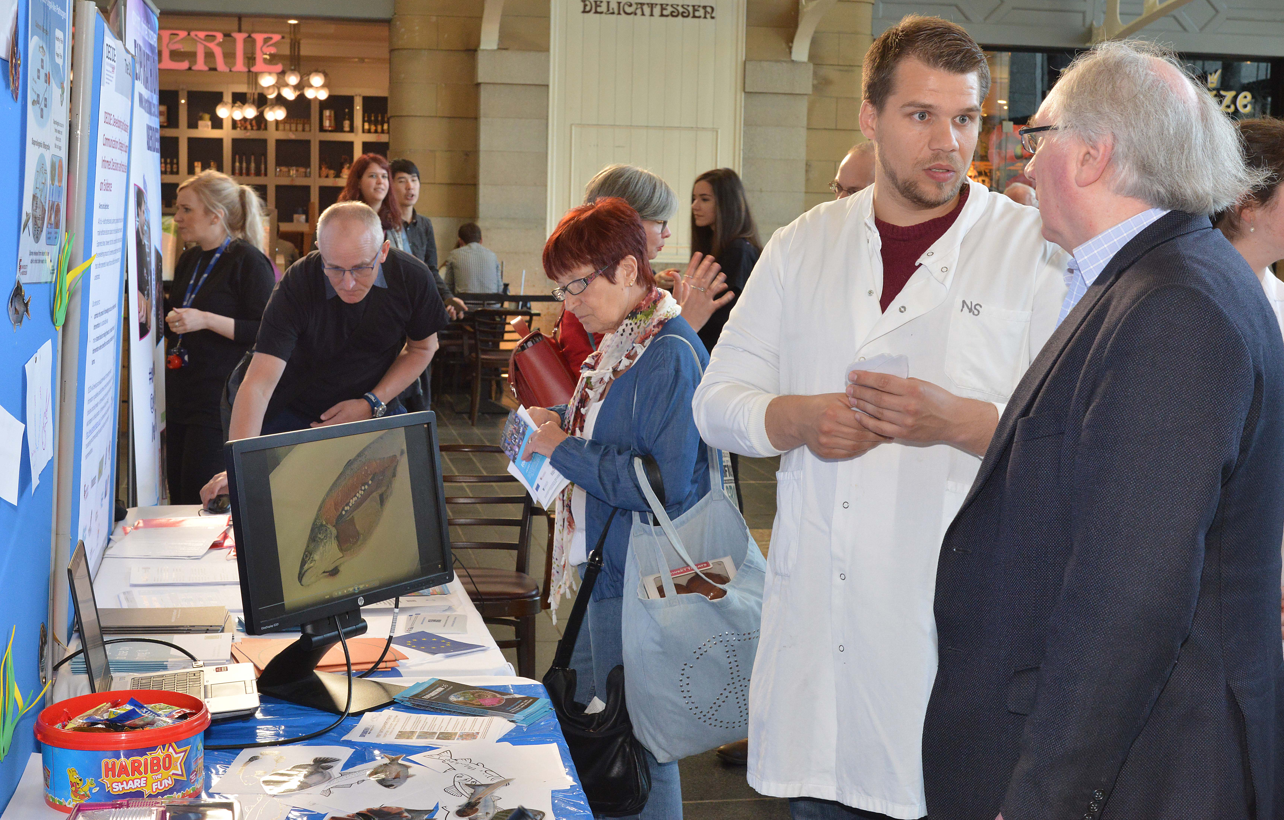
Heather Doran – Public Engagement with Research Unit (PERU)
Example Opportunities:
European Researchers’ Night
May Festival (Public and schools)
British Science Week (National programme for public and schools) - March
Festival of Social Science – November
Being Human Festival - November
Science Festivals around the UK and Europe
Local community radio
Café Scientifique, Café MED, PechaKucha…
Social media
What will you do? Who is it aimed at? How much will it cost?
Innovative Training Network Workshop
Follow us on Twitter
@UoAResInnov

Slide 21
Recruitment & Supervisory Guidance
Speaker:
Lucy Leiper – Centre for Academic Development & Postgraduate Research School
Innovative Training Network Workshop
Follow us on Twitter
@UoAResInnov

Slide 22
UoA Postgraduate Research School
PGRS since July 2017
PSR 2015 recommended creation of single graduate School
GS steering group June 2016- Feb 2017
PSR board approval May 2017
Senior Management Team approval July 2017
Innovative Training Network Workshop

Slide 23
UoA Postgraduate Research School
PGRS since July 2017
9 members of PGRS staff
Approx 815.2 FTE PGRS (snapshot 1)
PhD, MPhil, MRes, Mlitt, EdD, DEng
Supervisors
Innovative Training Network Workshop

Slide 24
UoA Postgraduate Research School
Recruitment & Admissions
Recruitment/Admissions for some schools
Cross University recruitment campaigns
Elphinstone
Aberdeen-Curtin
SGSAH, SGSS
Development and implementation of admissions policies, processes and systems
Monitoring & Progression
Routine Progress Review (administer)
Progress Assessment (audit)
Revise and Standardise policies/practices for assessment
Scholarships, Partnerships & Strategic Reporting
Administer institutional large scale programmes e.g. SGSAH, SGSSS, DTPs, EU, Curtin, Elphinstone
Joint/double degrees
Facilitate development of external partnerships
PGR data – review and standardise
Facilitate external scholarship funding (Development Trust)
Benchmarking and Reporting (PRES/ELIR)
Researcher Development
Researcher Development Programme
Flexible learning, online, face to ace, PT/Distance
Induction programmes
Supervisor Development

Slide 25
ITN Studentships – things to consider
Dual degrees
Co-supervision
IELTS- evidence of English language within timescale (ESRs are employed as staff, there is no HR requirement for English, but is required for admission to PGR study)
Innovative Training Network Workshop

Slide 26
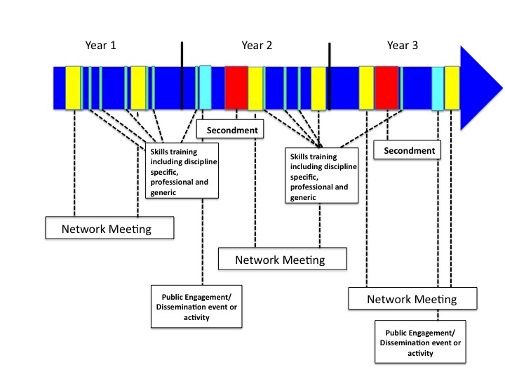
ITN – Training and Development
Core Research skills
Generic / transferrable in own institution
Cohort meetings – embed generic into network meetings – Public engagement for example
Innovative Training Network Workshop

Slide 27
ITN – Training and Development
Postgraduate Research School
Researcher Development programme – open programme for personal, professional and career development
Centre for Academic Development
Teaching development
Networks
SGSAH, SGSSS, SUPA, SULSA, MASTS etc
Innovative Training Network Workshop

Slide 28
Example
Description | Project month (estimate) | ECTs (If applicable)
Research Skills (examples)
Imaging
Health and Safety
Research Ethics and Governance | 1-3
Generic Skills (examples)
Statistics | 6
Introduction to teaching | 16
Academic Writing | 9
Cohort Network Meeting | Project month | Generic Skill focus
e.g. Aberdeen | 10 | Public Engagement/Communication skills
 | 16 | Leadership
 | 24 | Policy Engagement
 | 30 | Enterprise/Entrepreneurship
Innovative Training Network Workshop

Slide 29
IT Guidance
Speaker:
Gail Smillie – Directorate of Digital and Information Services
IT Relationships Manager
Innovative Training Network Workshop
Follow us on Twitter
@UoAResInnov

Slide 30
Research data management plans
UoA Guidance on ITN Applications:
A data management plan must be developed by the Coordinator to govern how the project will approach the storage, curation, and disposal of data throughout the project duration and thereafter.
UoA Guidance:
Most research councils and other major funders require a data management plan as part of the funding application. The Business Development Officers in Research and Innovation and the Data Management team within IT Services can provide
support and advice in the completion of these.
Please see here for further info from R & I, and
ask for help!

Slide 31
Data Security
UoA Guidance on ITN Applications:
Explain how each partner will contribute to the overall data security of the project by adhering to their institutional rules. In lieu of a partner having their own internal policy, advice will be provided by the Project Coordinator.
UoA Guidance on IT elements:
Staffnet (Data Storage and Archiving)
Learners Toolkit - Data Storage UoA Guidance on IT elements:
for Researchers
Information Security Policy
Include details in DMP
Compulsory online security training for all staff
Research Governance Handbook etc…
GDPR (General Data Protection Regulations)
Procurement

Slide 32
Monitoring
UoA Guidance on ITN Applications:
Describe how data management will be routinely monitored
in accordance with the funder’s policies on open data.
Explain that all outputs from the project will comply with the Horizon 2020 Open Access policies.
Refer to R & I but….
Likely that Data Management Plan will be the starting point for compliance monitoring.

Slide 33
IT Support
UoA Guidance on ITN Applications:
Where appropriate, cite the University of Aberdeen's (IT) Relationship Managers as a source of support for data management
UoA Support for IT elements:
Dedicated IT staff/advice and guidance, can give technical input to projects, HPC, RITSG, Learners Toolkit, Technical descriptions, Courses, Service Desk

Slide 34
Gender & Equality Guidance
Speaker:
Janine Chalmers – HR Equality & Diversity Advisor
Innovative Training Network Workshop
Follow us on Twitter
@UoAResInnov

Slide 35
A Supportive Culture Equality Charter Marks Recruitment Process

Slide 36
A Supportive Culture
Equality and Diversity Policy Statement and Strategy
Mental Health and Wellbeing Strategy – staff and students
PAMAssist, Wellbeing events, Mental Health Adviser, Staff Wellbeing Coordinators, Mental Health Champions, Sc Mental Health First Aid (147 staff trained)
Staff Equality Networks
Training – online and face-to-face
Employee Engagement Strategy - A respectful and inclusive community, built on communication, trust and integrity
Brexit – reassurance and practical support

Slide 37
Charter Marks
Athena SWAN
Stonewall Diversity Champion
Stonewall Workplace Equality Index
Disability Confident
Working towards Race Equality Charter Mark
Excellence in Diversity Awards 2016
Healthy Working Lives Silver Award

Slide 38
Recruitment and Selection
Where and how will the posts be advertised?
Be mindful of balance on the recruitment panel
Gender balance doesn’t guarantee a fair process – unconscious bias training
Promote Charter Marks
HR can assist with good practice

Slide 39
Further Information
Further information is available from:
Susie Hastings & Karim Mahmoud,
European Business Development Officers, Research & Innovation europe-rg@abdn.ac.uk
Professor Matteo Zanda
Pet3D Principal Investigator, IMS m.zanda@abdn.ac.uk
Dr Lucy Leiper
Manager, Post Graduate Research School l.lieper@abdn.ac.uk
Dr Heather Doran & Dr Jen Scott
Public Engagement with Research Unit peru@abdn.ac.uk
Gail Smillie
DIT Relationships Manager gail.Smillie@abdn.ac.uk
Janine Chalmers
Equality & Diversity Advisor janine.chalmers@abdn.ac.uk
Innovative Training Network Workshop
Follow us on Twitter
@UoAResInnov

Slide 40
Thank you for attending!
Any Questions?
Innovative Training Network Workshop
Follow us on Twitter
@UoAResInnov

