Slide 1
Our journeys to National Teaching Fellowship
Professor Debbie Holley
Professor Sally Everett

Slide 2
National Teaching Fellowship
An ongoing journey travelled with fabulous colleagues, peers and students…
Mythbusting:
You have to be at a Russell Group (no)
You have to be a Professor (no – but it helped me get there)
No-one gets it first time (some do – it took me 4 goes!)
You have to be a single discipline expert (see my checkered career – I did 10 years in industry before I came into HE)
My National Teaching Fellowship opened doors – some of which took a deep breath to step through..
Gives me a HUGE supportive community – post your question one afternoon, and by the next morning you have an evidence base shared by experts
And confidence to articulate my value (and my values) in what can be a tick box culture in HE
Debbie Holley, Professor of Learning Innovation, PFHEA and NTF Bournemouth University. Proud to be elected to the ANTF Committee in 2019
@NTF_Tweet @debbieholley1

Slide 3
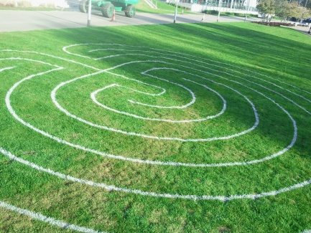
Individual excellence
Have a philosophy, set of values or framework
Mine was underpinned by access to, and induction through, HE
I framed my space as the digital divide and strategies overcoming this – and articulated the IMPACT
Raising the profile of excellence
I drew upon my work with the Reusable Learning Object CETL, which had student co-design at the centre
Most of this was un-funded, just workload time allocated, but got me onto a national project.
I highlighted my own IMPACT within the project as well as the impact of the project
Developing excellence
I articulated my work conceptualising different learning spaces for students – both physical and virtual.
Labyrinths (this is one I made earlier!)
Drawing upon a research body of work on first year students at 3 Universities – (none of it funded – all on goodwill between colleagues at LondonMet, Westminster and Queen Mary)

Slide 4
“I had a difficult third year .. appreciate your patience .. really sorry …. I wasn't as professional as I should have been. …So it was a huge relief when I realised that your support had dragged me kicking and screaming over the finish line!!” Unit evaluation Student A
‘In terms of the esteem in which Debbie is held by her peers, she has gained an impressive number of awards during her membership.’
Professional Development Director
Chartered Institute of Logistics and Transport (CILT)
The power of the quote
Illustrate your application – show your contribution through the lens of peers, students, collaborators
be upfront and ask for feedback!
‘Just watched your pep talk and thought it was great. Precise, concise and innovative. I liked the visual and audio together, much better than a written text which can be interpreted in many ways... and much more personable…….This technology should be used in ALL modules, so all students know what is expected, to decrease the stress levels...
(OFSTED Impact study, April 2012)
“I found Dr Holley’s session inspirational – I had no idea research could be so revealing ...” workshop participant feedback

Slide 5
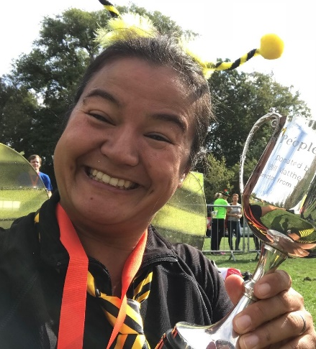
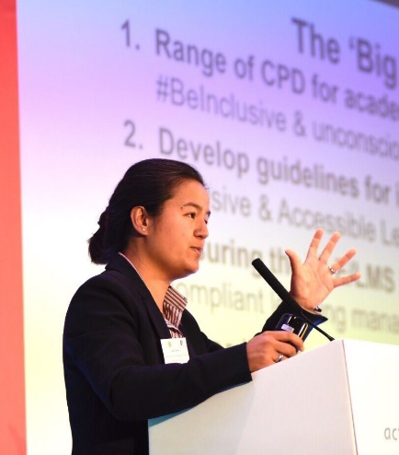
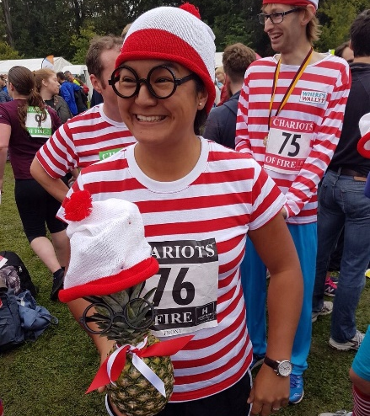
Professor Sally Everett
Proud NTF and CATE
Professor of Business Education (NTF also helped me get this!)
Inclusive Education Lead (KCL)
Previously a Deputy Dean (Quality and Student Experience) and Head of Department (Tourism & Marketing)
Equality and Diversity Officer, NTF committee and Chartered Association of Business Schools
PFHEA
Dog lover and ‘fun’ runner

Slide 6
Mentors and role models

Slide 7
‘In the mix’

Slide 8
Subject ‘leaping’: Tourism to learning and teaching

Slide 9
‘Do it anyway’: risk and innovation

Slide 10
One page summary of the application
Criterion 1: Individual excellence
Active learning in my own teaching
Develop curricula e.g. new online work-based degree for travel industry
Criterion 2: Raising the profile of excellence
Leadership impact (rankings)
Organised learning conferences
Criterion 3: Developing excellence
Lead by example - PFHEA
Team Based Learning and adoption
Assessment and Feedback projects
Employability – panels, strategy, assessment days, career module, intern scheme (CATE)
Textbook/papers
Innovation research centre
Chair Disability/ Inclusive Education Working Group – reversed gap
Funding for inclusive media labs (Human Library)
Organise and lead staff networks/events
Vision visits (USA and UK)
Approval events
CPD
Conference presentations and dissemination
Lots of lovely quotes and data!
Lots of lovely quotes and data!
Lots of lovely quotes and data!

Slide 11
Write it all down. Keep the evidence safe! Plaudits file!
“I enjoyed Sally’s lectures as it’s so interesting and linked to articles and our own stories” (2010), “best unit by far” (2010), “Sally’s the best – passion and great use of information” (2011), “she seems to put a lot of effort into planning lessons” (2012).
“Sally, we are all very clear that the exceptional progress on the NSS is due in large part to you. Every bit of your hard work and determination to sort this, through thick and thin, is both recognised and much appreciated.” (Prof Thorne, Vice Chancellor, 2014).
, “Just a quick note to say a huge thank you for today. It was thought provoking, inspiring, and was well organised. The student input was powerful”.
The SU’s Education Officer, "Sally's impact on the inclusivity of teaching at ARU has really been felt by students regardless of disability and has significantly improved the learning experience. Sally really has pioneered our inclusive practices through the DWG and has always involved students and the Students' Union in this work which has been fantastic."
“So proud, congrats on the amazing transformation you brought to our school!”

Slide 12
Thinking about applying for a National Teaching Fellowship (NTF) Award?
Notes:
This is intended to be an interactive session where you encourage potential applicants to start reflecting or get your view on their reflections so far ( making no promises of course)
Also break any mis conceptions eg :
NTF is only for experienced professionals (it is open to early career)
To be successful you need to have published (you can evidence impact without having done so)
An NTF need to evidence that their practice is innovative or creative (some practices are indeed innovative in a particular context but assessing outstanding impact, doesn’t depend on an individual being innovative or indeed creative)
It is easier to get an NTF if you are using technology enhanced learning (some nominees are using TEL but others are not and having TEL doesn’t enhance a nominees chance of being successful)
NTF need to have had international reach and impact (nominees can evidence high impact locally to be successful).

Slide 13
The plan
Introductions
Introduce the NTF 2020 scheme
Illustrate personal and institutional benefits
Discuss the NTF 2020 application process
Give practical guidance from current NTFs
Notes:
Presentors introduce themselves and applicants to each other. Encourage collaborative supportive session. We ve all been through it!
Please ensure that good time in advance you call local HEIs and from the list FE Colleges to advertise your workshop so we assist as many and diverse applicants as possible .
Do request attendees to watch out for and complete emailed feedback forms .Complete in the session if time allows.

Slide 14
Background to NTFS
NTFS recognises, rewards and celebrates individuals who make an outstanding impact on student outcomes and the teaching profession
The scheme is organised by Advance HE
The UK Teaching Excellence Awards Advisory Panel (senior representatives form four UK nations) advises on the criteria, QA of assessment process and the selection of the winners
Guidance for individuals and institutions is available on the Advance HE website – important to read this
Short informal videos

Slide 15
Key things to note for 2020
Closing date Wednesday 18 March 2020 by 12:00 (GMT)
Nominations must be submitted by NTFS Institutional Contact
Embargoed announcement to winners w/c 13 July 2020 – w/c 3 August public announcement
email NTFS@advance-he.ac.uk for any queries
ANTF advice: don’t leave submission to the last minute. Speak to your IC now for all the process requirements and get all their help eg VC’s support, mentor for you
Notes:
Some IC will ask around for quotes for other institutional support and certainly should provide a 1 to 1 mentor.
This presentation is kept light on the Process as this is on Advance HE website and applicants should engage early with their IC. Note the emphasis on R,V I as a way to evaluate the 3 criteria
Some times we get Ics attending who may be new in role and unfamiliar with the process so should be invited to contact Duncan Cross at Bolton who chairs the IC Network

Slide 16
What are the benefits to individuals?
It is widely recognised in HE in the UK and internationally as an accolade that is difficult to achieve and is a mark of quality
It opens doors: many NTFs find they can use the award as a springboard to progress their careers
You join a national community of like-minded professionals who are passionate about teaching
The ANTF network is a fantastically supportive community of learning
“Being a National Teacher Fellow has changed my life,
my career, everything”
Notes:
Past experience leads to cross boundary collaboration, publications, national and international collaboration, discussion for professional development. Link to other networks eg Professors in Preparation

Slide 17
What are the benefits for institutions?
The scheme is increasingly used as a model to develop and extend university-wide schemes, aiming to raise the status of teaching and instil pride in the profession and student learning, and enhance universities’ reputations
It can be a focal point for discussions about professional development
It can enable staff to cross boundaries, collaborating with colleagues in other disciplines and forging links with universities nationally and internationally

Slide 18
Review process
Independent, external peer reviewers all experienced in criteria-based assessment
Reviewers receive nominee Claim and supporting statement only and score part B of the Claim against the three awards criteria
All nominations are reviewed by three reviewers
Fourth reviewer used for any ‘discrepant’ scores and closest three scores used in ranking

Slide 19
Nomination documents
Claim for National Teaching Fellowship: a statement written by the individual of how they demonstrate impact relevant to each of the three award criteria:
maximum 1500 words per criterion (4500 in total)
plus Context Statement (max 300 words) and Reference List
Signed Statement of Support from the institution’s Vice-Chancellor or equivalent (maximum 1000 words).
Nomination Form (see Advance HE website)
Supported and submitted by your Institutional Contact
Notes:
Need to find out who your IC is and start discussion if not already.Some Ics may gather quotes from fellow staff for you.

Slide 20
Context statement
Provides a ‘frame’ for the Claim and enables reviewers to orientate themselves into the evidence provided against each of the award criteria
Not scored
Explain the context of your institution and your professional role(s) and responsibilities within it
Write in the first person (use ‘I’)
Maximum 300 words
Examples in the Advance HE guidance
Notes:
Most recent and thus queried part so do it first

Slide 21
Three NTFS award criteria
Criterion 1: Individual excellence:
Evidence of enhancing and transforming student outcomes and/or the teaching profession: demonstrating impact commensurate with the individual’s context and the opportunities afforded by it.
Criterion 2: Raising the profile of excellence:
Evidence of supporting colleagues and influencing support for student learning and/or the teaching profession; demonstrating impact and engagement beyond the nominee’s immediate academic or professional role.
Criterion 3: Developing excellence:
Evidence of the nominee’s commitment to and impact of ongoing professional development with regard to teaching and learning and/or learning support.

Slide 22
Reach, Value and Impact
Within each of the Criteria, reviewers will be looking for evidence of Reach, Value and Impact
Each of the three award criteria above is given equal consideration in the assessment process and weighted equally in the overall score
Evidence is key , can be both qualitative and quantitative for all criteria and RVI
Examples to follow are not cumulative but do include all you can

Slide 23
How will you evidence your ‘Reach’?
Reach - The scale of your influence:
Examples
National and International impact
Width across your institution eg department/ faculty
Across different groups of students, individuals and/or organisations e.g. academic levels, commuter students, BAME students, online learners etc

Slide 24
How will you evidence your ‘Value’?
Value
Examples
A change in approach to learning among students or staff e.g. expanding the student experience or teaching practice.
Positive impact on wider issues in education e.g. ethical issues

Slide 25
How will you evidence your ‘Impact’?
Impact - the difference that has been made to policy, practice and/or student outcomes
Example
Change in teaching practice
Change in professional support practice
New policy or organisational unit adopted

Slide 26
Where is your impact felt?
Department?
Faculty?
Institution?
Regional?
National?
International?
Discipline/cross-discipline?
Professional bodies/wider sector?
And in these contexts, how does it explicitly relate to teaching and student learning?
How are you measuring/evaluating impact?

Slide 27
What types of evidence do you have that show impact?
Longitudinal?
Quantitative?
Qualitative?
Short, concise quotes from students, colleagues, others?
Scholarly, pedagogic evidence?
Improved student attainment results?
Improved student outcomes (e.g. retention, employability, etc.)?
Evidence of the impact of your practice/research/publications on the teaching and learning practices of others leading to enhanced student learning?

Slide 28
What kind of Evidence? Open your heart
Who are you as an excellent practitioner?
What is special about you and what you do? And how do you know that it works well?
What is your story?
Notes:
Do mention personal examples that you know of without names
Its not a job interview or a CV

Slide 29
What kinds of evidence are convincing? (ANTF advice)
Anything that gives external validation to your claim, so that it is supported rather than being mere assertion
This is likely to involve raiding your ‘plaudits file’ for verbatim quotes demonstrating your excellence
These can be from module evaluations, feedback forums, student comments, letters and emails
Aim to collect a range of quotes from current and past students at different levels, past and current colleagues, managers, employers who take your students on placement, external examiners etc.
You don’t need to provide full detail of each originator of quotes: ‘former 2nd-year student’ ‘previous line-manager’, ‘employer of our graduates’ etc is sufficient detail

Slide 30
Collecting and using evidence (ANTF advice)
Qualitative data can be really useful: it’s helpful to include statements such as ‘Over the past five years my student evaluations have averaged 80+ who said I was good or excellent, and this is higher than average within my department’
You are not expected (or allowed) to provide supporting documentation but your own HEI is expected to assure the validity of your application
You should aim to match your evidence with the three criteria, so you can add quotes and data to each section

Slide 31
You need to demonstrate scholarship and commitment to reflection (ANTF advice)
Your application should include reference to a handful of texts (books, journal articles etc) from which your educational philosophy and teaching approaches have derived
The application, however, is all about you, so you need to use the first person singular and refer to your achievements rather than your teams’,
It’s helpful to include examples of where you’ve changed your practices in the light of experience or where your scholarship has guided you to change

Slide 32
Features of successful past Claims (NB these are not a tick list!)
Clearly defined context
Structured narrative
Use of different sources of evidence, considering reach, value and impact
Use of publications
Selective use of scholarly references, relevant to the nominee’s context and claim
Plain English
Clearly expressed, reflective narrative
Balance of both qualitative and quantitative evidence
Use of cross-references within the claim.

Slide 33
ANTF advice for people thinking of applying in future years
If you are thinking of applying after 2020, it’s worth thinking about building your profile further over the next year or so
Start collecting positive feedback to meet the Criteria from a range of stakeholders including students, peers, colleagues, line managers, external examiners etc
Keep yourself up-to-date by regularly scrutinising the Advance HE website for information

Slide 34
Thank you! Any queries, please contact your institutional link or Advance HE

