Slide 1
AUA Aberdeen Branch Meeting
The Independence Debate and Scottish Higher Education:
What ifs, buts and maybes?
A Godfrey Brown (Public Affairs) and Bruce Purdon (Policy, Planning & Governance)

Slide 2
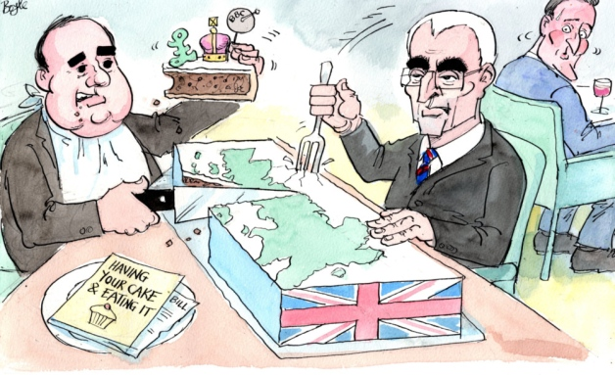
18 September 2014
"Should Scotland be an independent
country?"

Slide 3
Overview
What are the questions for HE?
What are the answers?
Plenty of “what ifs”, “buts” and “maybes”
Personal view of the issues
University has a neutral position on the debate but is planning for the possible implications of a Yes vote

Slide 4
The Library for the Independence Debate
The Yes Campaign
“Scotland’s Future” aka the Scottish Government’s White Paper – Nov 2013
611 pages
Chapter 5 - Education, Skills and Employment: “Supporting Scotland’s Universities” and Q&A section
The No Campaign
UK Government Briefings: “Science and Research” – Nov 2013
Universities Scotland
Universities Scotland: “Universities in A Dynamic Constitutional Environment: Policy Issues for Consideration” – Nov 2012

Slide 5
Main Issues
Fee Status of RUK Students and rest of EU Students
Research Funding and the Single UK Research Area
Immigration Policy
Global Branding

Slide 6
Students and Tuition Fees
Q Will the position for Scots students change?
SG Answer: No
Q Independent Scotland in the EU: Can we still charge £9k fees to RUK?
SG Answer: Yes
Q Would charging RUK students continue to be legal?
SG Answer: Yes
Q Will students from parts of the EU other than the rest of the UK pay tuition fees?
SG Answer: No change. They will pay the same as Scots domicile - £1820
Q Will the position for International students change– non-EU, non-RUK?
SG Answer: No

Slide 7
Students and Tuition Fees
BUT!
Debate as to whether the Scottish Government’s proposals will be legal.
Will Scottish Universities also need to charge rest of EU students the same fee, in order to “carry on charging RUK”?
What if…
…….Scotland is independent but is not a member of the EU?

Slide 8
Research Funding and the Single UK Research Area
What would happen to UK Research Councils?
Would there still be a common research area through which Scottish universities could collaborate in joint research grants with other UK universities, access shared facilities?
What about peer review and the REF?
SG Answers:
Maintain current UK Common Research area – access to shared facilities and peer review system
Retain UK Research Councils – Scotland would ‘buy in’
Scotland better placed to access EU funding

Slide 9
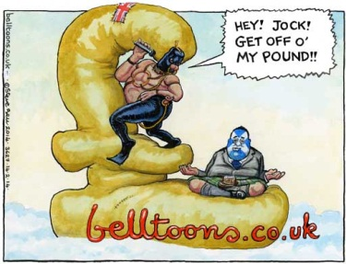
Research Funding and the Single UK Research Area

Slide 10
Research Funding and the Single UK Research Area
UK Government Position
National funding agencies/research councils only fund research carried out in their own nation.
The common research framework would diverge or be fragmented
Scottish participation in any future REF is not guaranteed and there is no international precedent for two independent nations holding a joint peer review exercise

Slide 11
Immigration Policy
Independence would result in a new immigration system
Scottish Government would reintroduce the post-study work visa
Opportunities to address the perceived problems that current UK Government immigration policy causes for international student

Slide 12
Global Branding
What impact would Independence have on the global reputation and profile of Scotland’s universities?
How far do international students differentiate between British and Scottish higher education, English or Scottish institutions or is it down to individual institution or course reputation?
To what extent would loss of access to UK established networks – Embassies, British Council – be an issue?

Slide 13
Further Issues
Other Public Funding Streams: Will core SFC funding levels continue?
UK Charities: Will the major UK based Charities continue to make awards to Scottish universities?
Tax Incentives and Industry/Philanthropic: Potentially UK Registered companies would need to relocate and register in Scotland rather than Companies House UK to receive tax relief on activities in Scotland
UCAS: The White Paper states Scottish Universities would be free to continue to use UCAS as the route for applicants.
Student ‘Customer Choice’ Data Sets: Opportunity to replace data sets such as ‘Key Information Sets’ with ones which better reflect the Scottish context.
Pay and Conditions of Staff: Will national pay bargaining arrangements continue at pan-UK level or Scottish level?

Slide 14
Further Issues
Currency and Interest Rates: A range of financial implications depending on which currency an independent Scotland has and who sets interest rates.
Procurement: Loss of access to collaborative purchasing schemes such as UK Government Procurement Services.
Pensions: Will Scottish universities continue in USS or will a new scheme be required with Scottish share of USS assets and liabilities?
Character of Scottish Higher Education?

Slide 15
What if it’s a ‘No’ Vote
Further reductions in UK Government Spending
Abolition of the Barnett Funding formula?
Further tightening of immigration controls?
A UK referendum on membership of the EU in next Parliament?

