Slide 1

THE LATEST ON THE 2020 USS VALUATION
September 2021
Notes:
This presentation is to update scheme members on the latest with the 2020 USS valuation.

Slide 2
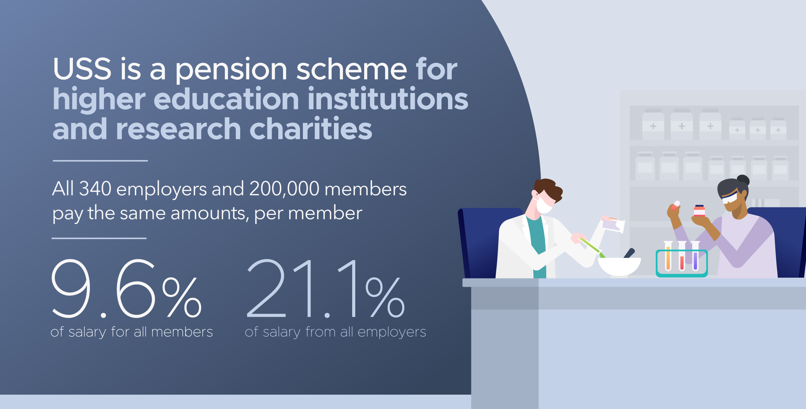
Notes:
USS is the main pension scheme for university staff and the largest private pension scheme in the country. There are 340 scheme employers and 200,000 active members.
A pension is a great way to save for your future. USS pensions are funded by money taken from the salaries of members and payments made by employers.
All scheme members currently contribute 9.6% of their salary (before tax).
All employers pay in 21.1% of salary for each employee within the scheme - whether the employer is a large university or one of the smaller research based charities, which form part of the scheme (the Overseas Development Institute, for example).
USS offers a mix of defined benefit (DB) and defined contribution (DC) pensions.

Slide 3
USS offers DB and DC pensions – what’s the difference?
Defined benefit (DB) pensions
Members are promised a set amount of pension benefits, based on their salary and length of service, which are (broadly) inflation-proofed.
Defined contribution (DC) pensions
Members are not promised a set amount of pension benefits. The total amount of benefits members receive will depend on how much they and their employers contribute, the level of charges applied, and how well the pension scheme's investments perform in the global money markets.
USS currently offers DB pensions for all up to the salary of £59,883.65 and DC pensions on salary above this. This gives members the best of both worlds.
DB benefits provide certainty whereas DC benefits provide flexibility and more choice.
Notes:
A DB pension offers a set amount of benefits based on how long you’re a member and your salary
With DC pensions member and employer contributions are both invested and the proceeds used to buy a pension and/or other benefits on retirement.
Everyone in USS currently gets a defined benefit pension up to the salary threshold of £59,883.65 with salary above this on a defined contribution basis.
DB benefits provide certainty whereas DC offers better choice and flexibility for members. As a member, you can choose to pay in higher or lower amounts depending on your own stage of life, and financial circumstances.
You can access and use your pension pot in any way you wish from age 55. DC pensions are also easier to take with you when you move to a different employer. You also have choice over how your money is invested, which is increasingly important to many people who want to know that industries and companies with strong ethics benefit from their money.
So through the mix of DC and DB pensions, USS members have certainty, flexibility and choice.

Slide 4
Why join USS?
USS offers a secure monthly payment in retirement for the rest of your life.
You also get a tax-free lump sum on retirement (x3 annual pension)
Payments to your partner and children if you die before retiring (x3 annual income as lump sum and pension for life to your spouse or civil partner)
Notes:
USS offers a secure monthly payment in retirement for the rest of your life. It could help towards paying off your mortgage, planning getaways and get you the standard of living you’d like.
That’s why the opt-out rate of around 20% – members of staff deciding not to be part of the scheme – is concerning. Even if opting-out is a temporary measure, it can have negative consequences for people later in life.
You may receive the State Pension when you retire, but it might not be enough. Putting some income now into a pension scheme means you’ll have a bigger income in the future. Plus, your employer will be contributing too – making up a big chunk of your pension.
You get tax relief on your contributions and there’s life cover of three-times your annual salary to look after your loved ones in case you die while paying into the scheme.
With the DC part of the scheme, members can make additional voluntary contributions and transfer money in – tax efficient ways of saving on top of the hugely valuable employer contributions.
Staff should keep in mind the importance of joining a pension scheme, continuing to save, and benefit from the contributions employers make. This is especially important during difficult times when members may be more tempted to withdraw from the scheme.

Slide 5
What is a valuation?
A valuation is an assessment of a pension scheme’s financial health.
It is a legal requirement for all defined benefit (DB) pension schemes to carry out a valuation at least once every three years.
USS estimates that the current deficit is as high as £17 billion.
When a scheme has a deficit, additional contributions are needed to get the funding back on track or the benefits on offer need to change.
Notes:
A valuation provides a snapshot at a point in time, to show whether a scheme is expected to have enough money to pay the benefits already promised to members. It also shows whether the combined member and employer contribution rate will be sufficient to fund the level of benefits currently provided to members.
The 2020 USS valuation is based on a snapshot of the scheme’s funding position on 31 March 2020, but the process itself will run well into 2021, as there’s a number of different steps.
A deficit means additional contributions will be needed to get the funding back on track or the benefits on offer need to change. USS estimates that the current deficit is as high as £17 billion – that kind of money would be sufficient to pay for the hosting of the London 2021 Olympics, twice.
If UCU, representing scheme members, and UUK representing employers, don’t reach an agreement on increased contributions, it would be necessary to consider reducing future benefits to make the scheme affordable.
Members’ pensions built up before the valuation date are protected by law and won’t be affected by any changes.

Slide 6
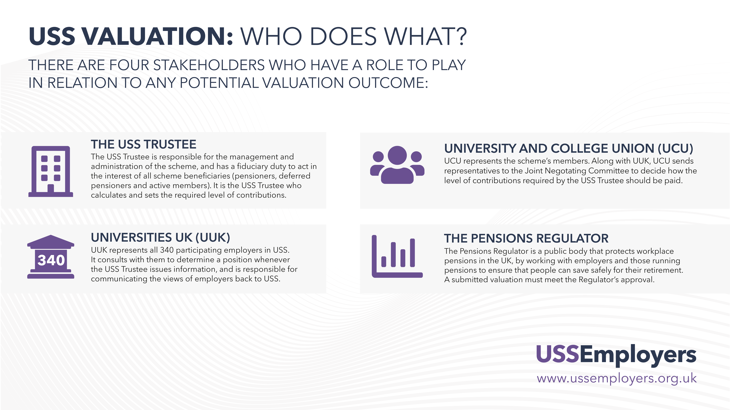
Notes:
There are four main stakeholders involved in the valuation:
The USS Trustee has legal responsibility for the running of the scheme and ensuring that pension promises are paid as they should be.
UUK represents all 340 employers in the scheme.
UCU represents all scheme members, even those who aren’t members of UCU.
The Pensions Regulator is the public body responsible for regulating workplace pensions in the UK. All valuations must be submitted to the Regulator for approval, to satisfy it that the scheme is on a secure and sustainable footing.

Slide 7
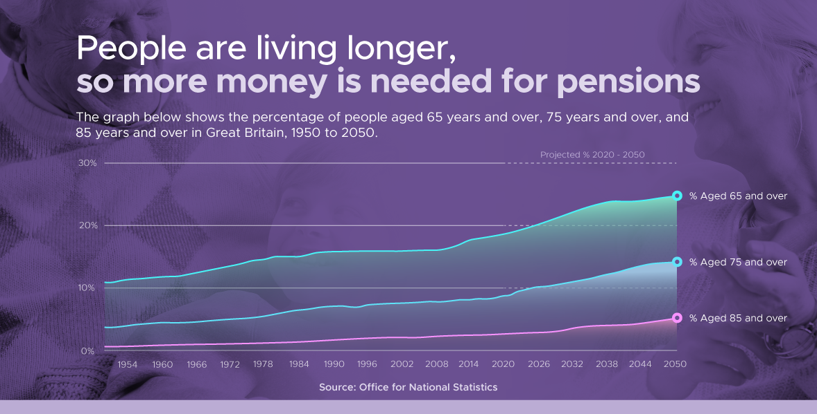
Notes:
In recent years, the cost of providing all defined benefit pensions in the UK has risen because people are living longer, and the economic environment has been challenging with long-term low interest rates and a weak outlook for investments, generally, in the future.
This has impacted all defined benefit pension schemes in the UK. The average cost has gone up by a quarter in six years. As a result, many defined benefit schemes have already closed.
The number of private sector schemes in the UK has reduced from 3,500 to less than 800 in the past 15 years.
USS is one of those to continue to offer DB pensions to new members of staff.

Slide 8

Financial impact of Covid-19
Notes:
Covid-19 has made the financial outlook worse for pension schemes.
The money markets have been hit hard and the value of investments has decreased. This means that more money has to be found to meet pension promises in the future.
The Institute of Fiscal Studies estimates that Covid could cost higher education sector institutions £10 billion in lost income.
Universities face several risks to their finances, including reduced income from accommodation, conferences and catering, and universities have spent much more compared to a ‘normal’ year on Covid-19 safety measures, enhanced digital learning platforms, and putting additional learning and wellbeing support in place.
Covid financial challenges come on top of the long-term decline in student financing across the UK and in England there is uncertainty over future tuition fee levels, with the UK Government considering a fee cut.

Slide 9
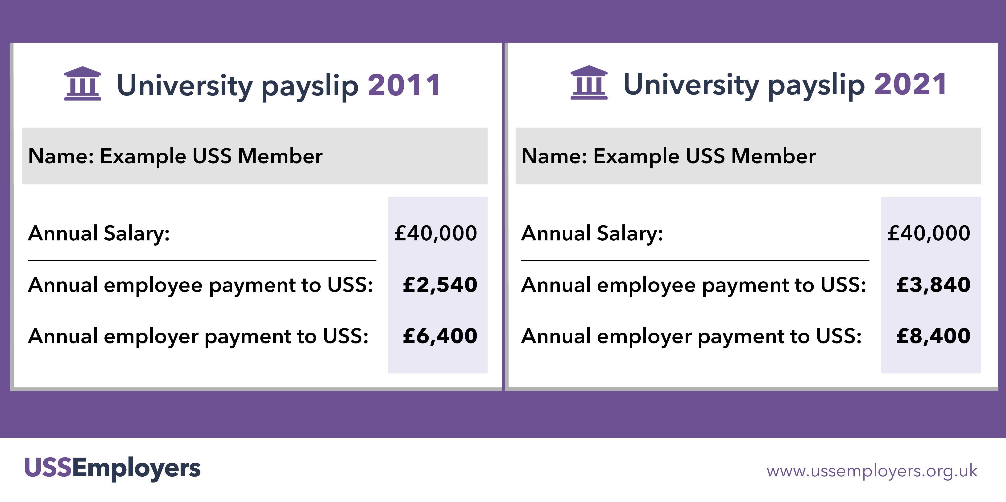
Contribution levels
Notes:
While the cost of providing pensions has gone up, so have the contributions of employers and you, scheme members, in order to keep the same level of benefits.
USS employers are currently paying in 21.1% of salary for each member. This is far higher than other private sector schemes – the average is 13% of salary for the combined employer and employee payments.

Slide 10
What’s new with this valuation?
Constructive talks involving UCU, UUK and USS have led to closer working including:
A new scheme purpose and shared valuation principles.
New valuation methodology.
Commitments to greater transparency from all.
Increased levels of engagement and visibility from USS Trustees.
Notes:
Since the start of 2020 there has been closer working between USS, UCU, UUK leading to changes to the scheme.
Together, they have developed shared valuation principles, and defined the purpose of the scheme, as:
‘To provide a financially secure future and retirement for scheme members and their families, and support the long-term needs of the HE sector.’
New methodology was agreed for use with the 2020 valuation – this means the old methodology (Test 1) has gone, with the new approach following the recommendation of a Joint Expert Panel, established in 2018 by UUK and UCU to consider the valuation approach.
There has also been a commitment from all involved in the valuations to greater transparency, to increase confidence and trust in the process.
At a local level, PLEASE ADD IN EXAMPLES OF CLOSER WORKING WITH STAFF/UNIONS

Slide 11
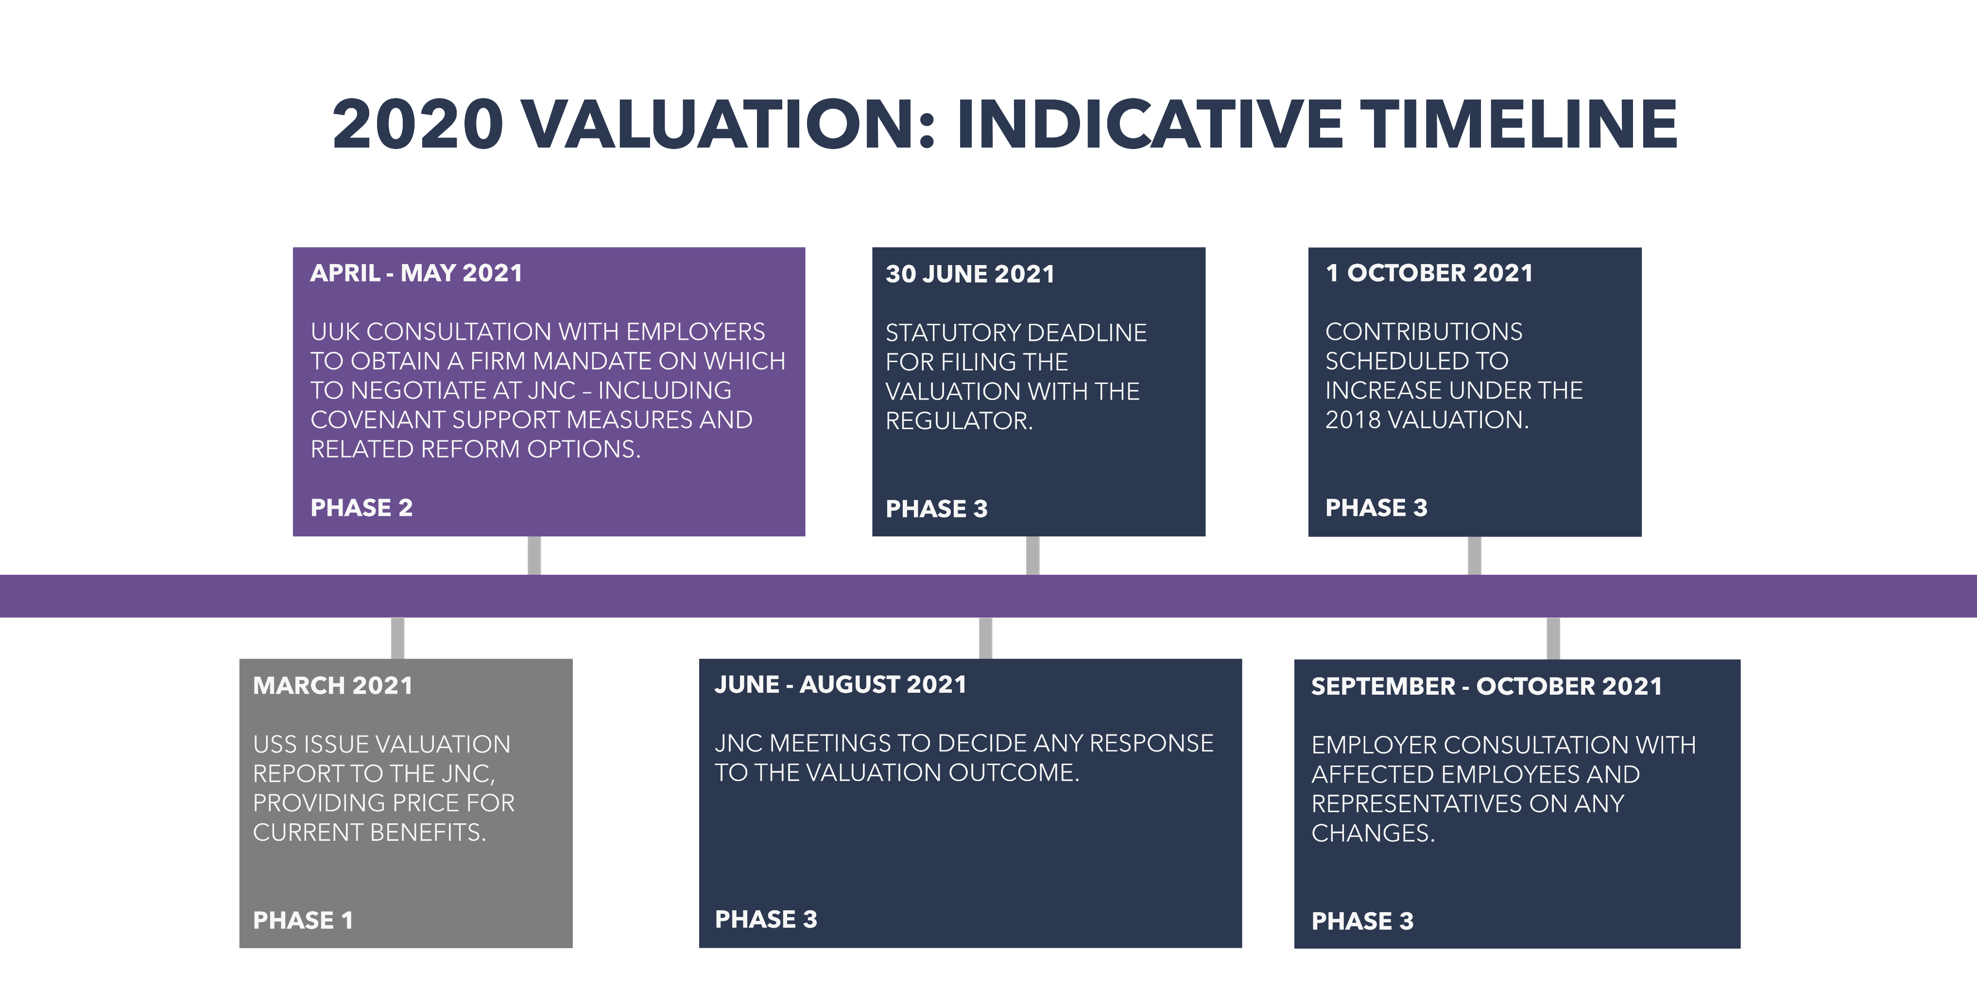
Notes:
So what’s the current state of play with the valuation?
In March 2021, the USS Trustee published a series of prices for providing the current benefits – based upon different views of covenant support (the financial strength of employers sponsoring the scheme and their commitment to the scheme).
During April and May, UUK consulted all employers on the issued raised, and as part of that many employers sought the views of all their staff eligible for USS. Over the summer, discussions have taken place between UUK, UCU and USS at the JNC. The JNC is made up of an equal number of representatives from UUK and member representatives from the University and College Union (UCU). It has an independent Chair. The JNC decides how any increase to the overall contribution rate should be shared between members and employers and whether any changes should be made to benefits or the structure of the scheme.
On 26 August 2021, the JNC made a decision to support a Universities UK proposal to change the benefits – but keep contributions close to current levels. There will now be an important and open consultation with scheme members, lasting a minimum of 60 days, and it is possible that the UUK proposal could change following this to reflect the priorities of members providing it doesn’t lead to higher contribution rates for members or employers.
On 3 September 2021 the USS Trustee board agreed to take forward the Joint Negotiating Committee’s (JNC) recommendations for concluding the 2020 USS valuation, saving university employers and hundreds of thousands of scheme members from steep contribution increases from 1 October 2021. With the USS Trustee board’s approval of the JNC’s decision to modify benefits, and agreement to proceed with a dual schedule of contributions, new rates of 21.4% for employers and 9.8% for members will apply instead – subject to consultation with both employers and members.

Slide 12
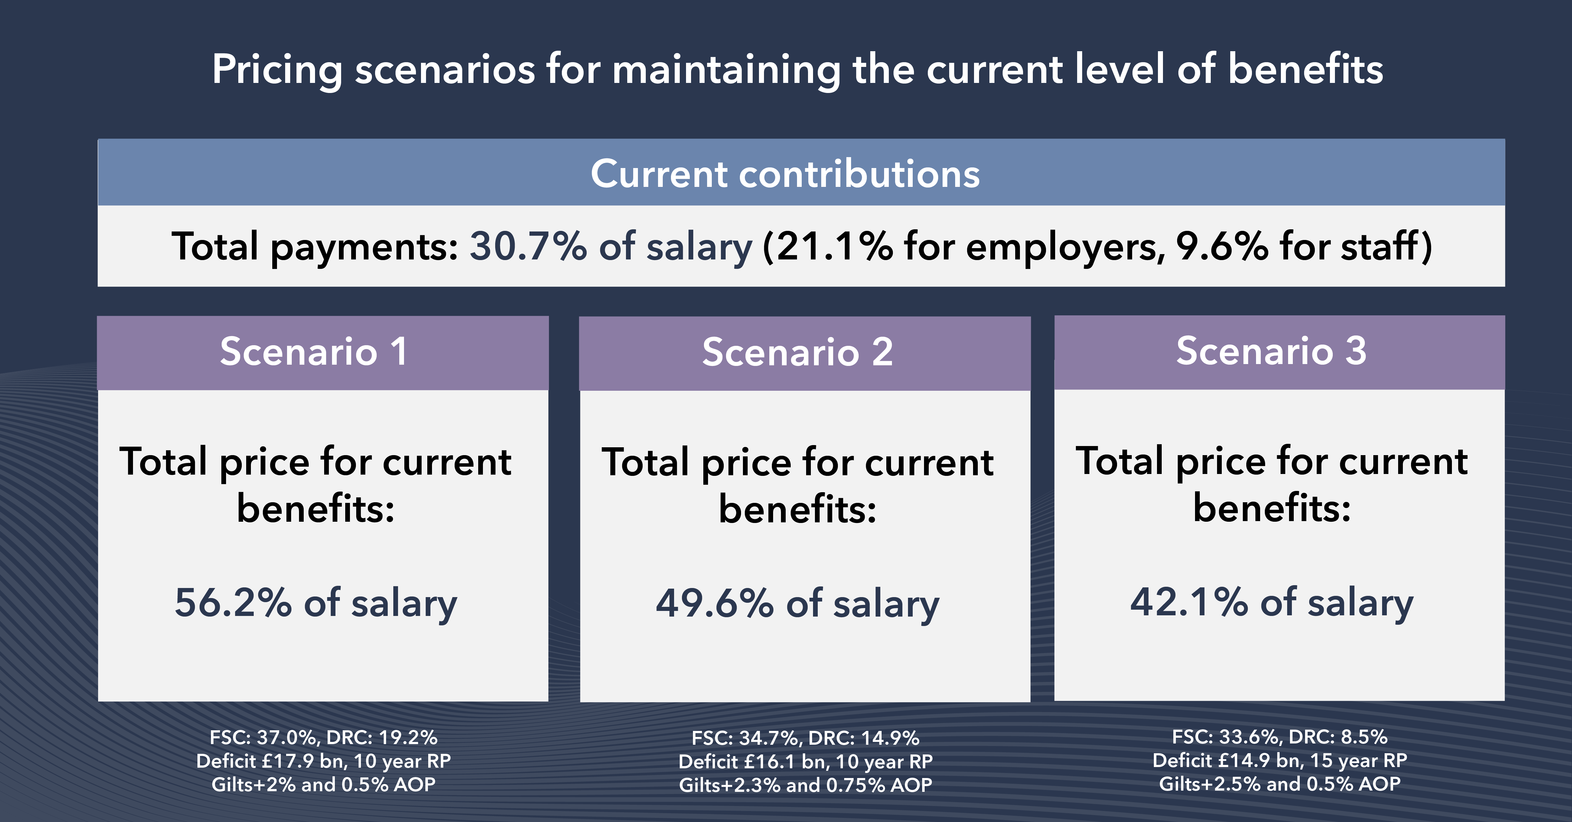
Notes:
In its announcement at the start of March 2021, the USS Trustee said it calculated the pension scheme faced a deficit of up to £17bn and that contributions to the scheme would need to increase from 30.7% (total current contributions for employers and employees) to at least 42.1% of salary to maintain the current level of benefits. This is the lowest price to keep benefits the same – 42.1% of salary – which is unaffordable for employers and members alike and made changes to the scheme inevitable. In the pricing put forward by USS there were three scenarios, which depended on the outcome of discussions about covenant support – the financial backing and commitment of employers to the scheme.
In response, employers said the very high prices for current benefits put forward by the USS Trustee would be unaffordable for employers, risked pricing even more staff out of the scheme, and undervalued the collective and enduring financial strength of the participating employers. UUK, on behalf of employers, continues to probe the USS Trustee about its approach to the valuation and is questioning the role of The Pensions Regulator. You can see copies of their letters to the Pensions Regulator and the USS Trustee on the USS Employers website.
Employers did not argue that the scheme’s status quo can be maintained – instead, they pushed the USS Trustee to consider a revised approach and assumptions to bring down the headline costs down and ensure that reform is proportionate, justified, and in the best interests of the scheme members.​

Slide 13
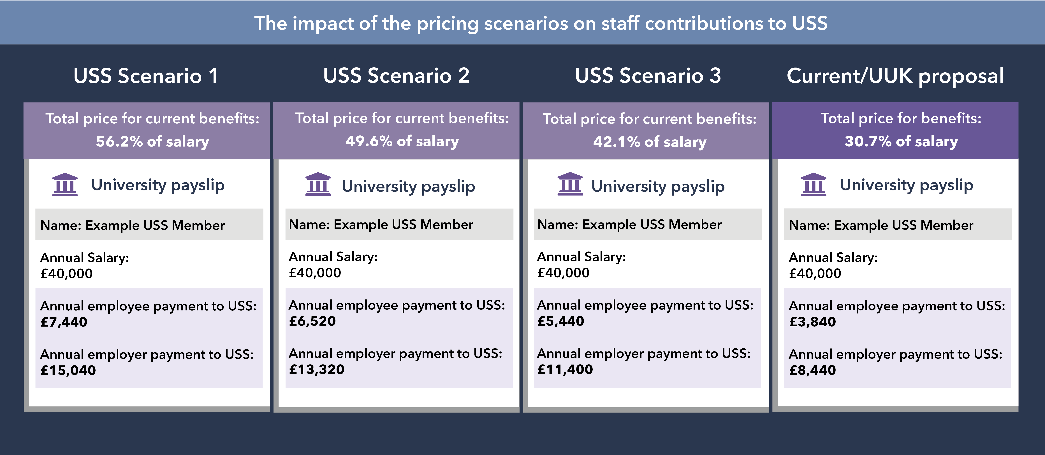
Notes:
This shows how the various scenarios from the USS Trustee and a proposal from Universities UK would impact on you, scheme members (contribution payments featured assume the scheme’s default cost-share arrangements – the split of costs between members and employers – are applied. The ratio is 65% for employers, 35% for members). The proposed level of contributions required are unrealistic and would be completely unaffordable for both members and employers.
Even under Scenario 3 – with an employer commitment to significant covenant support measures – members and employers would be required to pay unacceptably high levels for the SAME benefits.
It is also possible that USS may impose these levels of contributions, which, even if for only a short time, we anticipate would lead to even more people dropping out of the scheme and missing out on savings for their pensions.

Slide 14
Employers’ objectives
A valuable pension scheme for staff including a defined benefit element.
Fair valuation assumptions, leading to fair pricing by the USS Trustee.
Affordable contributions levels for members and employers.
Reducing the number of people priced out of the scheme by introducing an optional low-cost entry route for members.
Notes:
We recognised that the USS Trustee’s options were unpalatable to members and employers, but we agreed with the USS Trustee that the scheme is facing a deficit – a shortfall in funding – which means more money has to go into the scheme or the pension benefits promised in the future would need to be adjusted. Universities UK, which represents employers, set out four objectives as it tried to find a solution.
Firstly, employers recognise that scheme members value the defined benefits part of the scheme and want to retain this, if possible and affordable.
Secondly, Universities UK has kept up the pressure on the USS Trustee to reconsider its approach to the valuation.
Thirdly, Universities UK developed its own proposal, which is based on employers and scheme members’ contributions staying at the same level – 21.1% and 9.6% of salary – or as close to it as possible rather than the much higher totals required under the USS Trustee’s three scenarios.
Finally, employers also want to find ways of making USS appeal more to the generation of university staff being priced out of the scheme and left with no savings towards their pensions.

Slide 15
UUK’s alternative path
Employers agreed to give even more valuable employer support measures to save the Defined Benefit part of the scheme.
USS Trustee values this additional level of covenant support at around £1.3 billion per annum.
Employer support for fully investigating the feasibility of conditional indexation, a major governance review of the scheme, and a new flexible cost option for scheme members.
The scheme’s Joint Negotiating Committee (JNC) decided to adopt a UUK proposal for changes to benefits to tackle the rising costs, and the USS Trustee subsequently agreed to modify its approach to the valuation in line with these recommendations.
The Pensions Regulator is concerned that the UUK proposal could carry too much risk.
Employers would be very willing to consider other feasible and affordable proposals from the UCU. During JNC discussions they made suggestions but did not put forward a formal proposal.
UUK made one change to their proposal at UCU’s request, to enhance the benefits provided to staff who leave the scheme with less than two years’ service.
Notes:
UUK proposed an alternative path to the 2020 valuation, which gained the support of employers in the recent consultation.
As part of this, employers agreed even more valuable covenant support measures. These commitments are substantial and go beyond the level of support USS has asked for in its scenarios and would allow Defined Benefits to still be offered as part of the DC/DB mix. Without covenant support measures from employers, the USS Trustee has said it would price current benefits at 56% of salary, 80% more than the current contribution rate – and it values this additional level of covenant support at around £1.3 billion per annum.
This level of proposed employer covenant support could limit employers’ ability to borrow money in the future and/or lead to higher borrowing costs, and be a barrier to improving courses, facilities and services to students and staff. It will likely be the financially weaker employers that will be most severely impacted, since they rely on secured borrowing the most and have the thinnest reserves, so increases in cost could feed immediately through to cost-cutting.
The UUK proposal adjusts the balance of benefits between DB and DC so that less guaranteed benefit is provided. Another way of looking at this is acknowledging that we will all have to work a little longer to get the same level of guaranteed pension as before (in a similar manner to the state pension) to reflect that on average we are living a little longer and guaranteed pensions have become much more expensive, but of course, this could be offset by good investment returns and flexibilities provided for those members also contributing to the Defined Contribution part of the scheme.
Employers also gave their support for giving members the choice of opting for a new lower contribution rate for different benefits, a major governance review, and fully developing a potential move to conditional indexation – which pegs a part of annual pension provision to the performance of scheme funds – and consulting with members on this possibility. This may take many months or years to implement so it is not a solution to this valuation.
Following the employer consultation, the USS Trustee agreed to modify its approach to the 2020 valuation in line with many of the points put forward by UUK and outlined in the consultation. The USS Trustee has been willing to adjust its assumptions to lower scheme costs, to offer the level of Defined Benefits for the covenant support proposed by UUK – at close to current contribution levels.
This has reduced the headline costs, proposed by the USS Trustee which will give scheme members a better level of benefits for current contribution levels than possible under the USS Trustee’s original proposal although discussion continues over the USS Trustee’s decision to price the UUK proposal 0.5% of salary higher than current levels – whether this is justified and necessary and who should pay this, if it is.
The USS Trustee has also published a letter from The Pensions Regulator which makes clear the regulator’s concerns that the UUK proposal cannot be afforded without higher contributions. However, it is for the USS Trustee to make its own decisions and we, as of yet, see no evidenced reason why the UUK package put forward shouldn’t be acceptable to both The Pensions Regulator and the USS Trustee at current contribution levels.
On 31 August 2021 the scheme’s Joint Negotiating Committee (JNC), made up of an equal number of representatives from UCU and UUK, with an independent chair, voted to formally adopt the UUK proposal. The USS Trustee accepted this, and confirmed that the 2020 valuation could be concluded with a total contribution rate of 31.2%. UUK will continue to challenge this 0.5% difference, but for the time being it is proposed that it will be split 65:35 between employers and members, resulting in rates of 21.4% and 9.8% of salary respectively.
Employers have consistently said that they would be happy to explore viable alternatives from the University and College Union (UCU) in a spirit of compromise. While the UUK package proposes a particular set of changes to the future pensions earned from USS’s defined benefit and defined contribution sections, the upcoming consultation on the changes is important and open. We will still consider alternative benefit structures and formulations, provided they are viable and implementable.

Slide 16
UUK’s alternative path
Retaining current contributions of 30.7% (21.1% for employers and 9.6% for members) means that benefits would have to change.
Alternative hybrid:
Illustration | Accrual rate | DB salary threshold | Inflation proofing 2.5% cap? | DC section contributions | Cost
Trustee | 1/75 | c.£60,000 | No | 20% | 42.1-56.2%
Trustee | 1/100 | £40,000 | Yes | 16% | 30.7%
UUK | 1/85 | £40,000 | Yes | 20% | 30.7%
Notes:
PLEASE NOTE THIS SLIDE MAY BE TOO TECHNICAL - please remove if you feel it is not appropriate for your audience, or have it available in case of questions
Here we see the alternative UUK proposal in more detail and comparisons to the Trustee’s illustrative examples.
The JNC has now made a decision in favour of the UUK proposal, and the USS Trustee board has agreed to take it forward formally. Consultation will now follow from employers with employees and their representatives.
There are other variations to the UUK proposal meaning different trade-offs between the salary threshold for Defined Benefits and the accrual rate, for example it may be possible to keep a 1/75th accrual rate if the salary threshold was brought down to £30k. There could also be adjustments to other parts of the benefits package, for example reducing death or ill-health benefits; or changing the pension age.
Remember that pensions built up to date are safe and can’t be changed retrospectively.
Accrual rate: The proportion of salary a member receives annually as a pension in retirement (eg 1/75th) under the defined benefit section of USS.

Slide 17
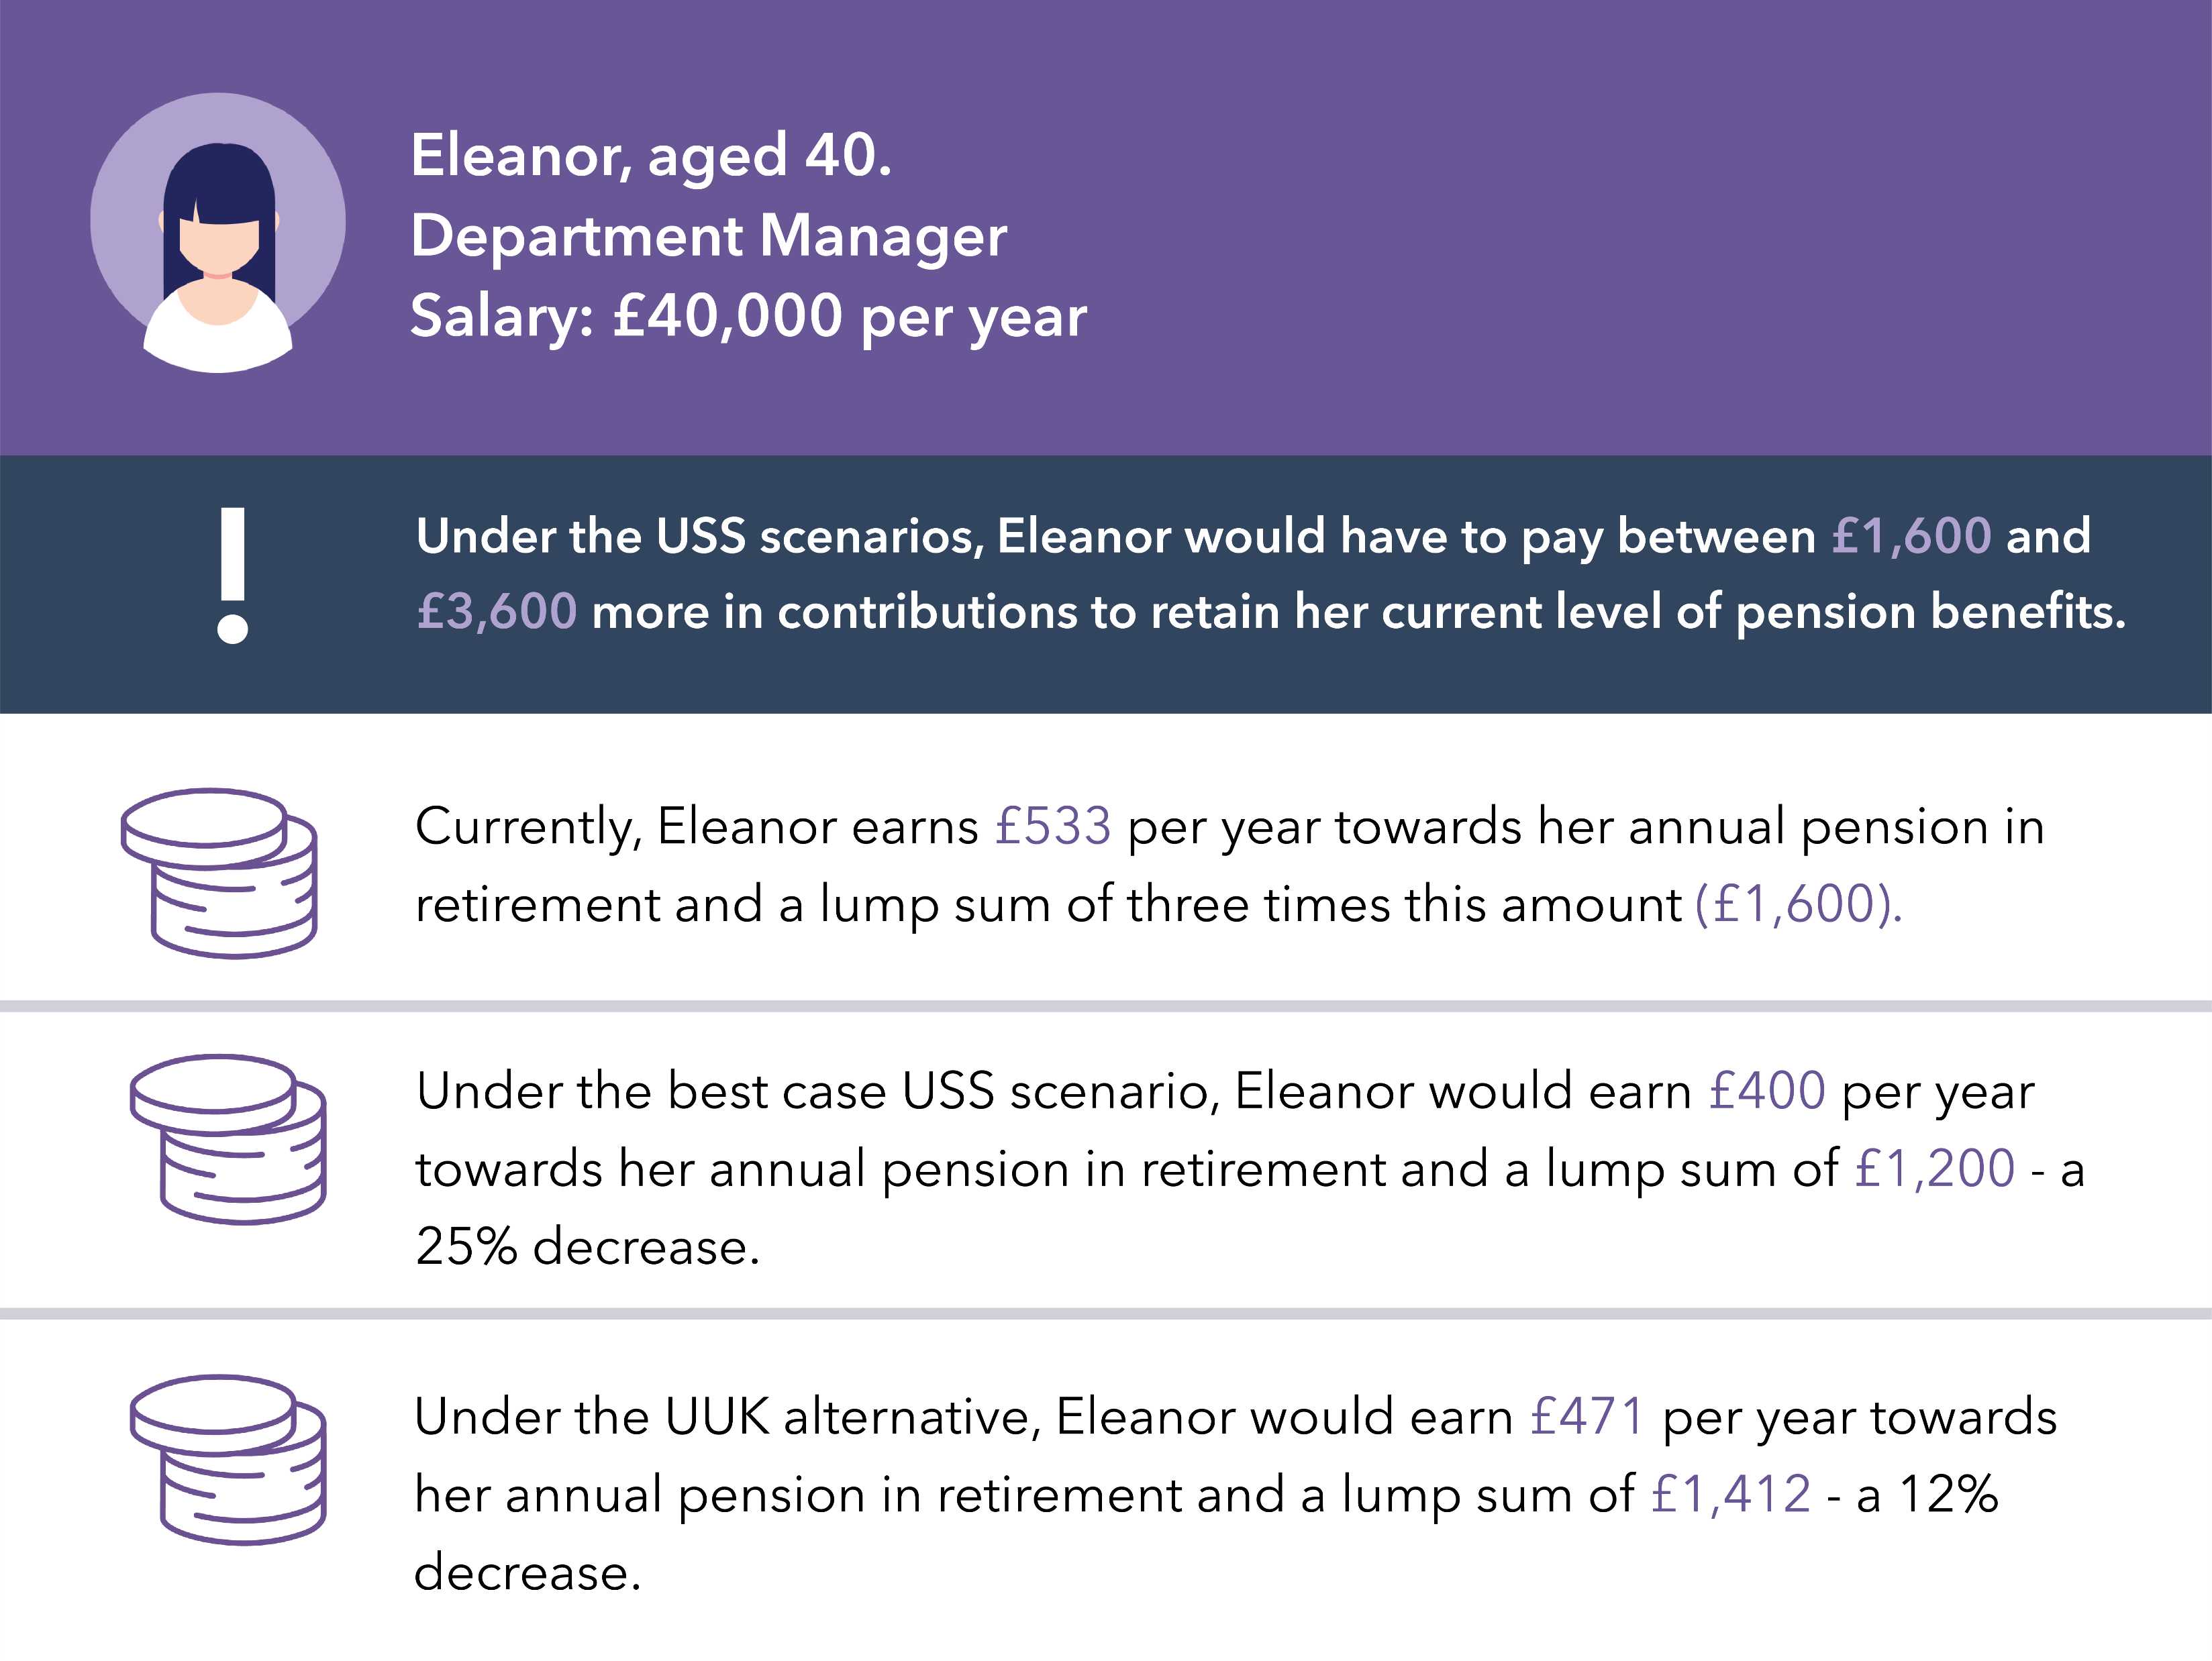
How might benefits change if contributions remain the same?
Notes:
To give an indication of how the UUK proposal could affect benefits:
As you can see with the example of Eleanor, the USS Trustee’s current best case scenario (Scenario 3) would see a reduction in her pension benefits of about 25%. UUK’s alternative approach would see a 12% reduction (contribution payments featured assume the scheme’s default cost-share arrangements - this is the way that contribution increases are shared if no other decision is made on the split of costs. The ratio is 65% for employers, 35% for members).

Slide 18
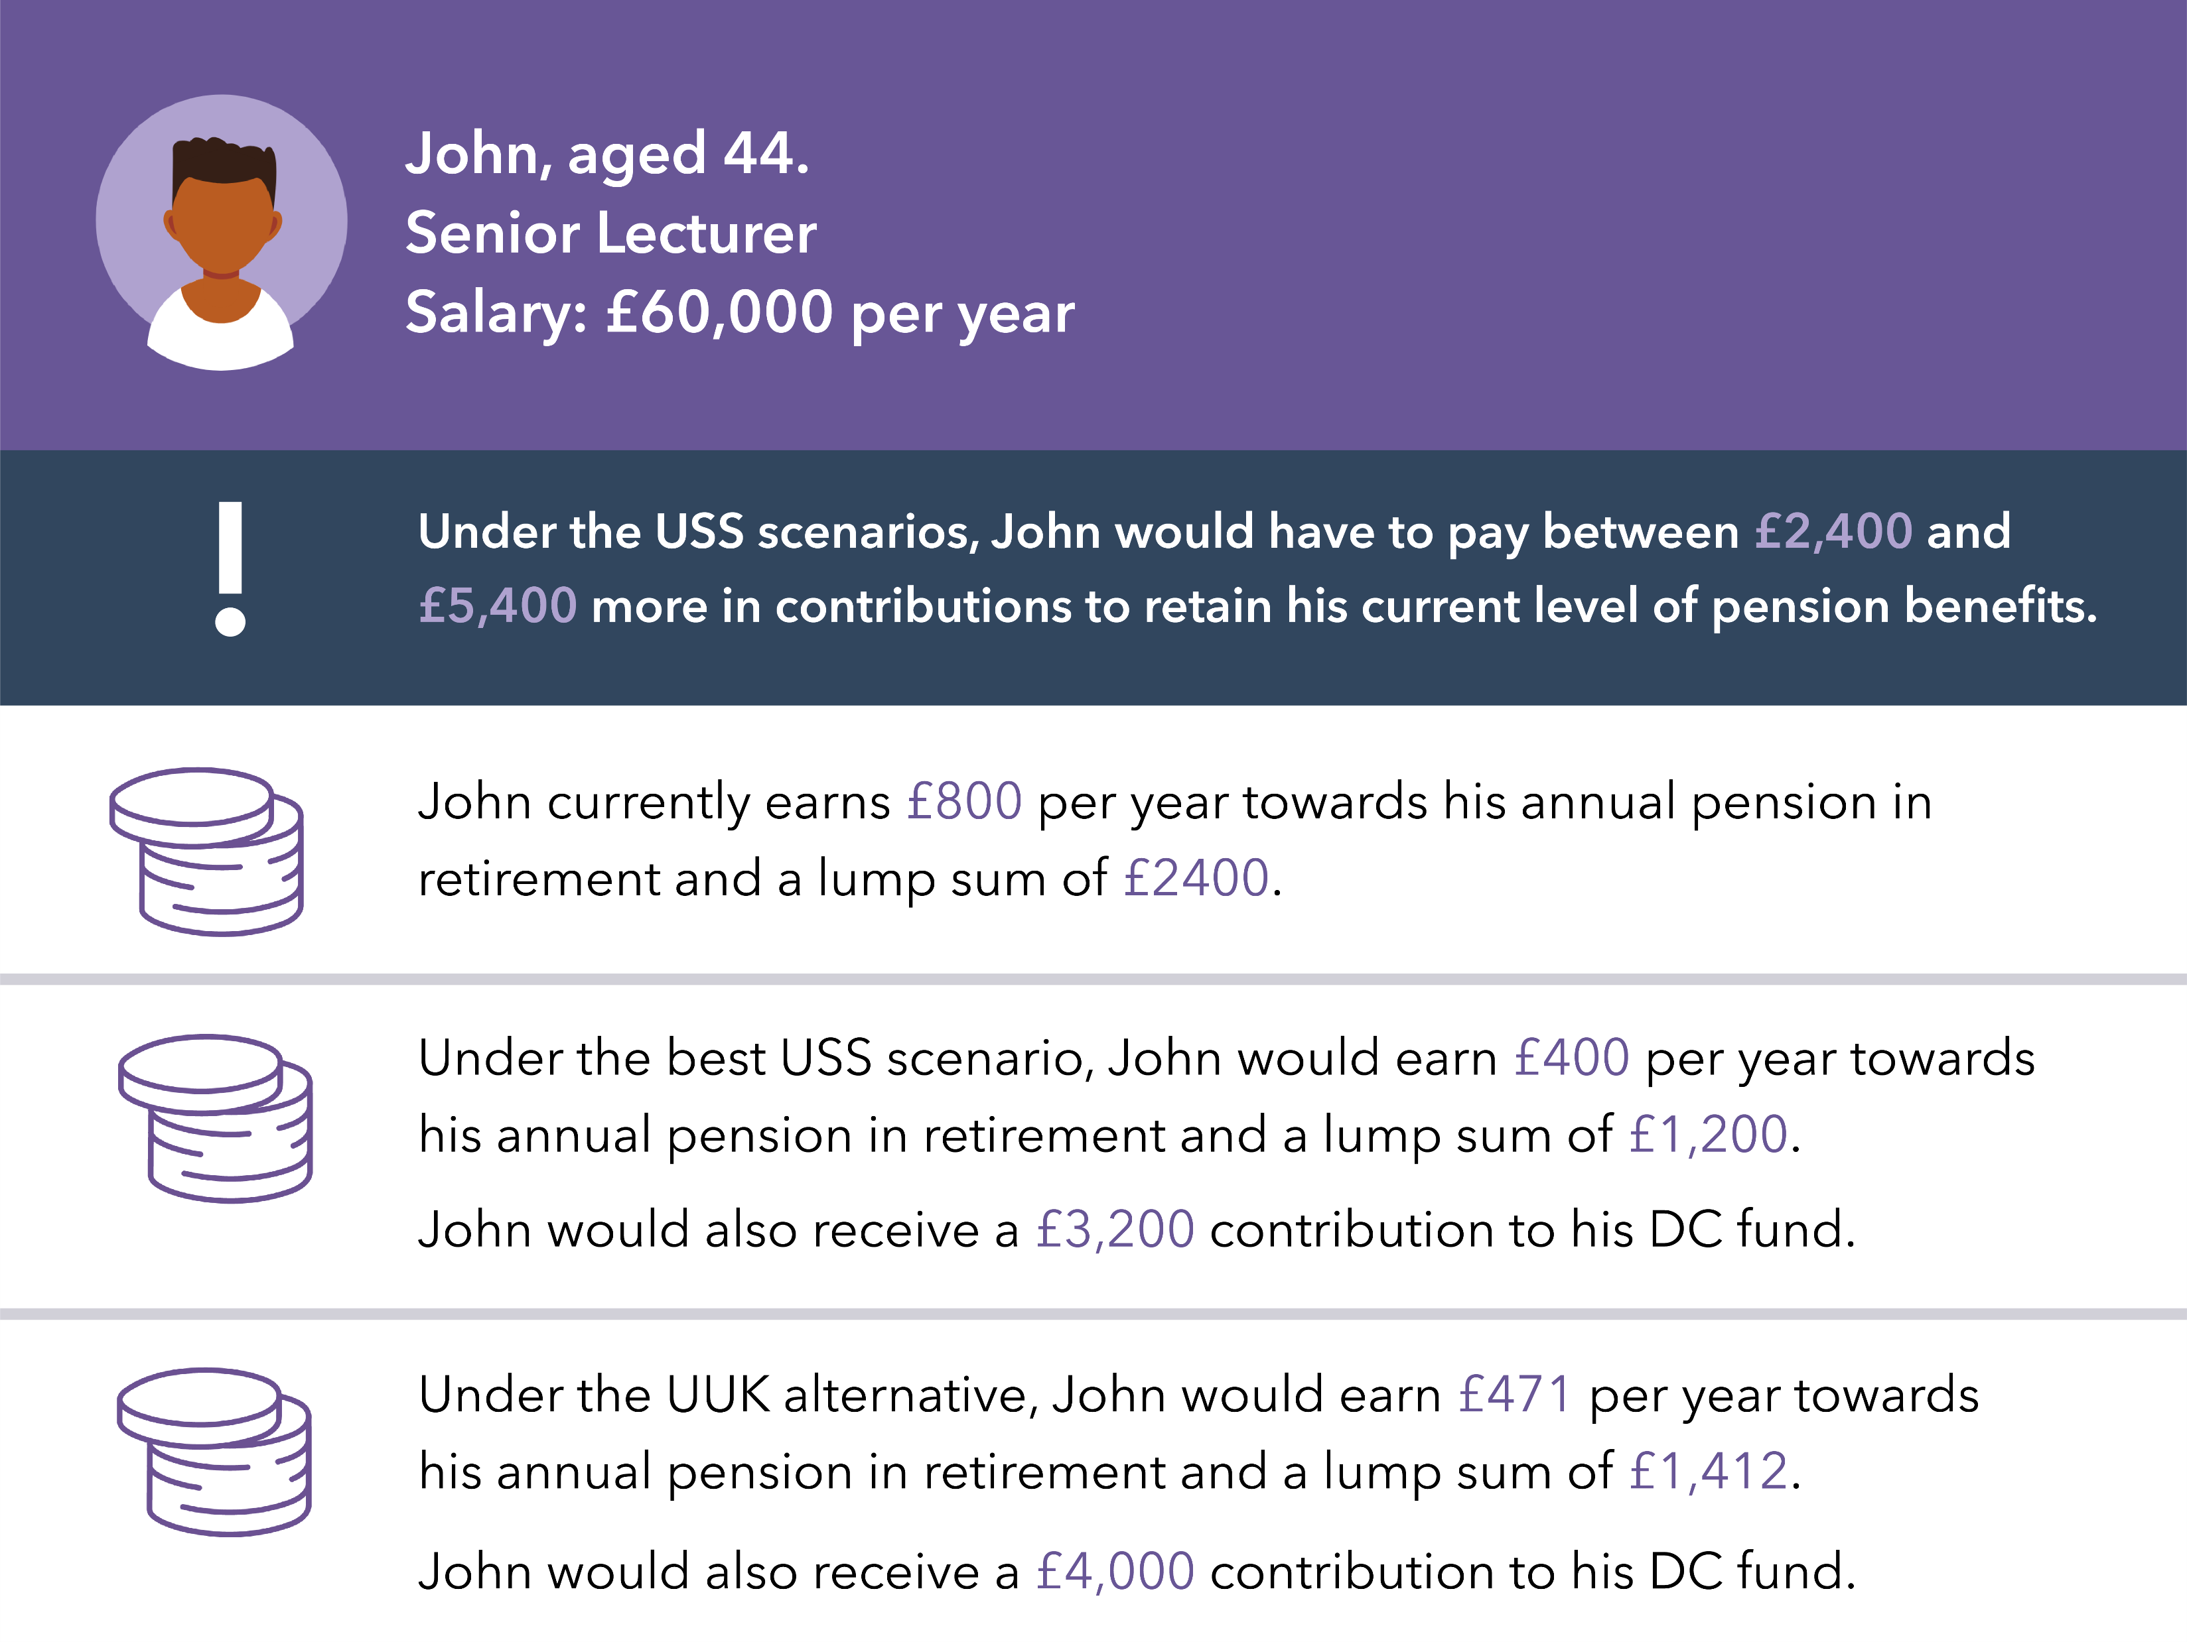
How might benefits change if contributions remain the same?
Notes:
You can also see the impact of the USS Trustee’s proposals on pay, which would be costly, unwelcome and unaffordable (contribution payments featured assume the scheme’s default cost-share arrangements are applied).
Under the UUK proposal USS would remain a valuable pension. However, it is important to stress that these figures are indicative at this stage and it would need compromise from all sides, including the USS Trustee, to be able to offer this sort of level of benefits.

Slide 19
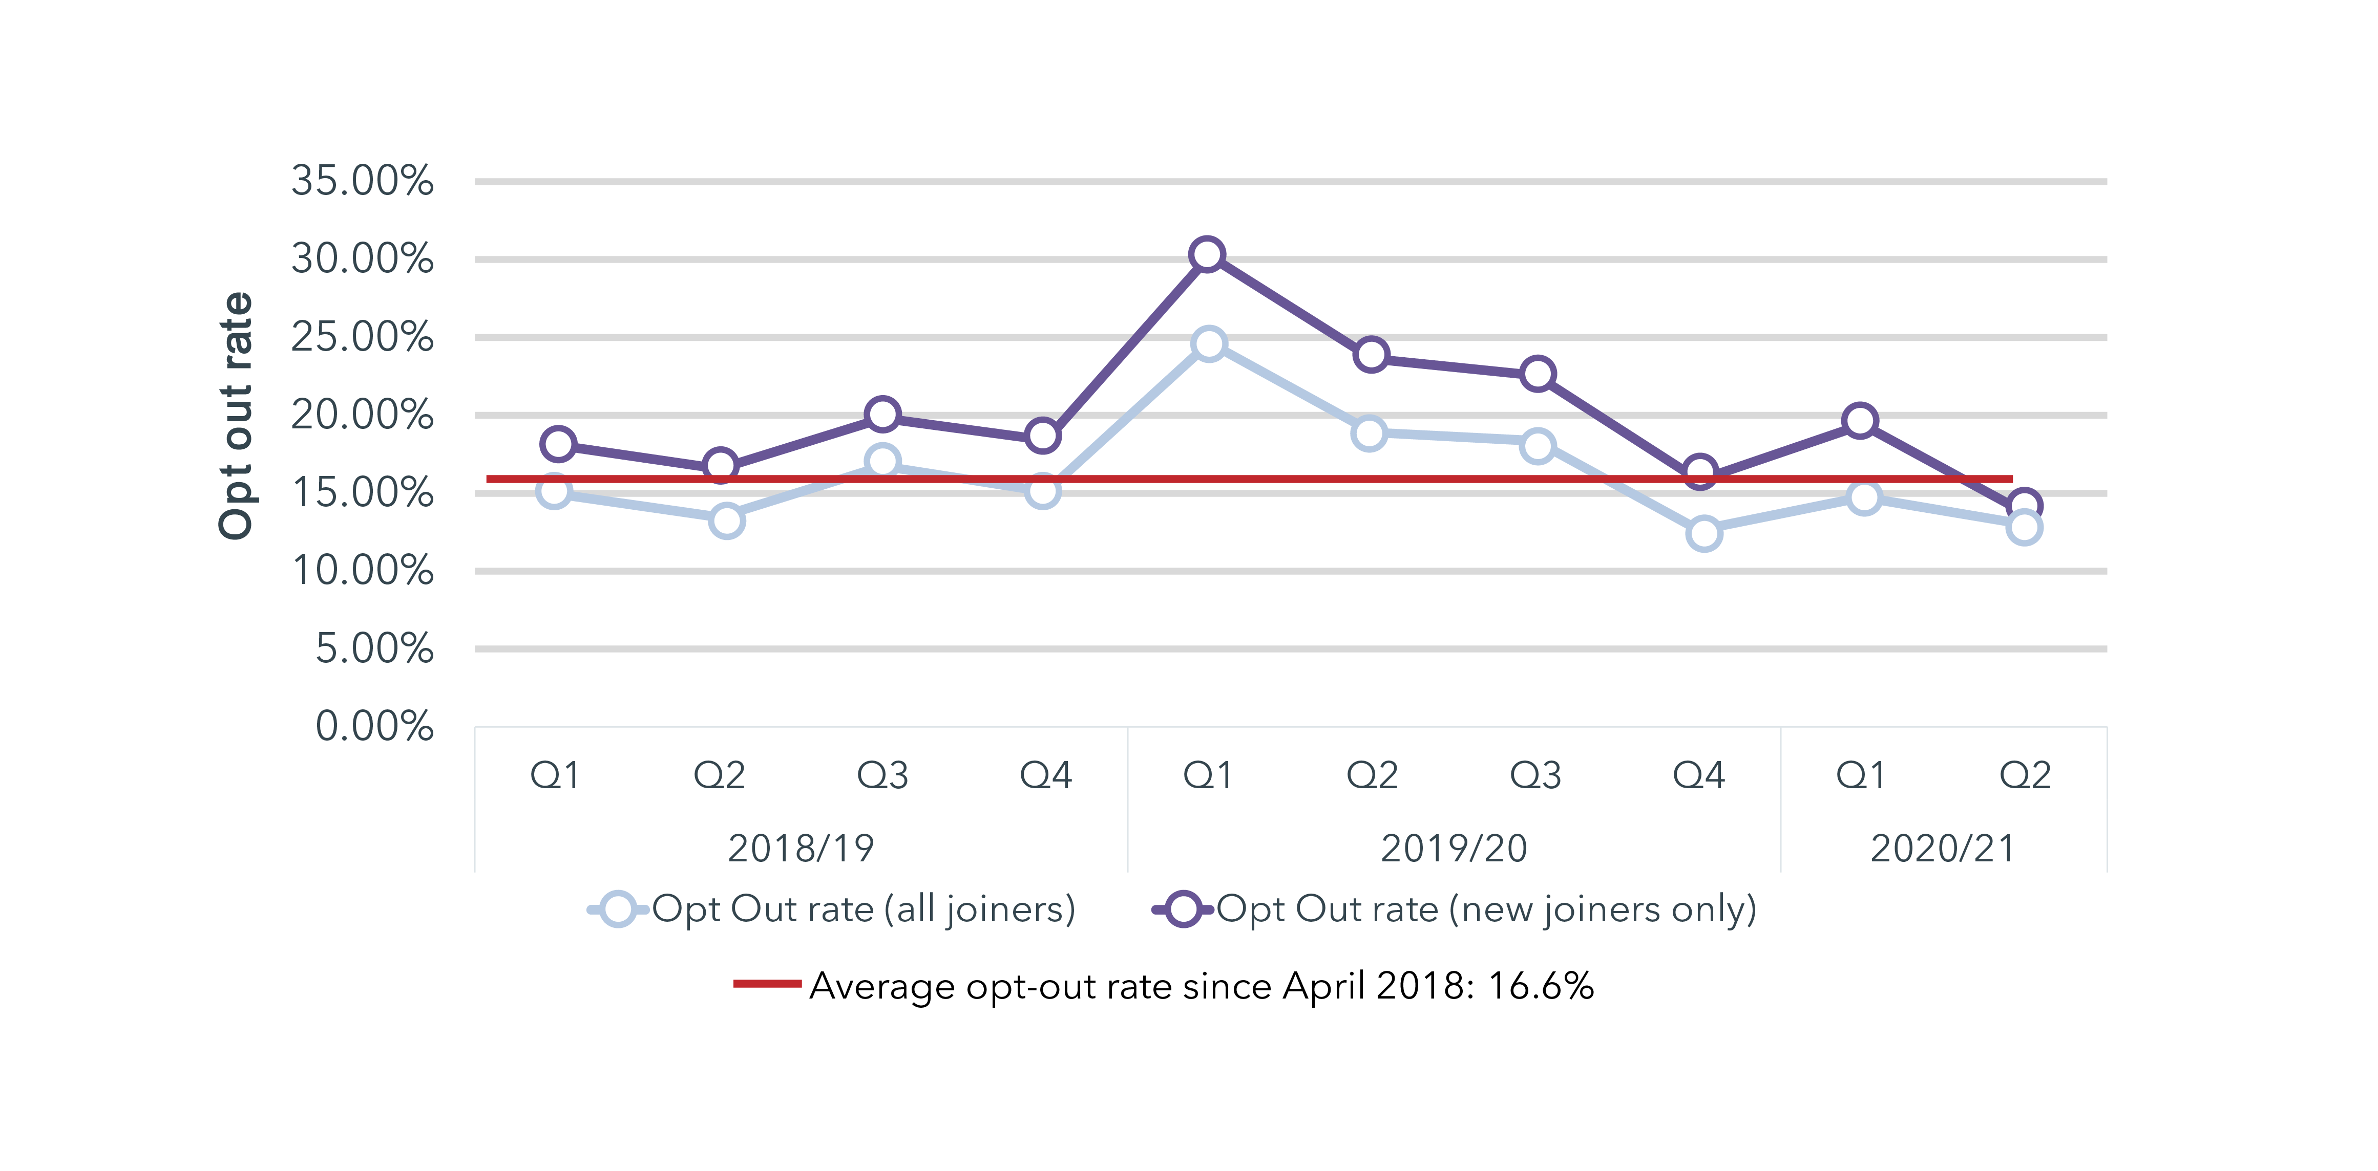
Opt-out rate
Notes:
Moving on to the issue of staff members choosing not to stay with the scheme.
The opt-out rate is around 20% - that’s one in five of eligible scheme members – and it tends to be higher for those joining the scheme rather than those already in it and moving from another job within the higher education sector.

Slide 20
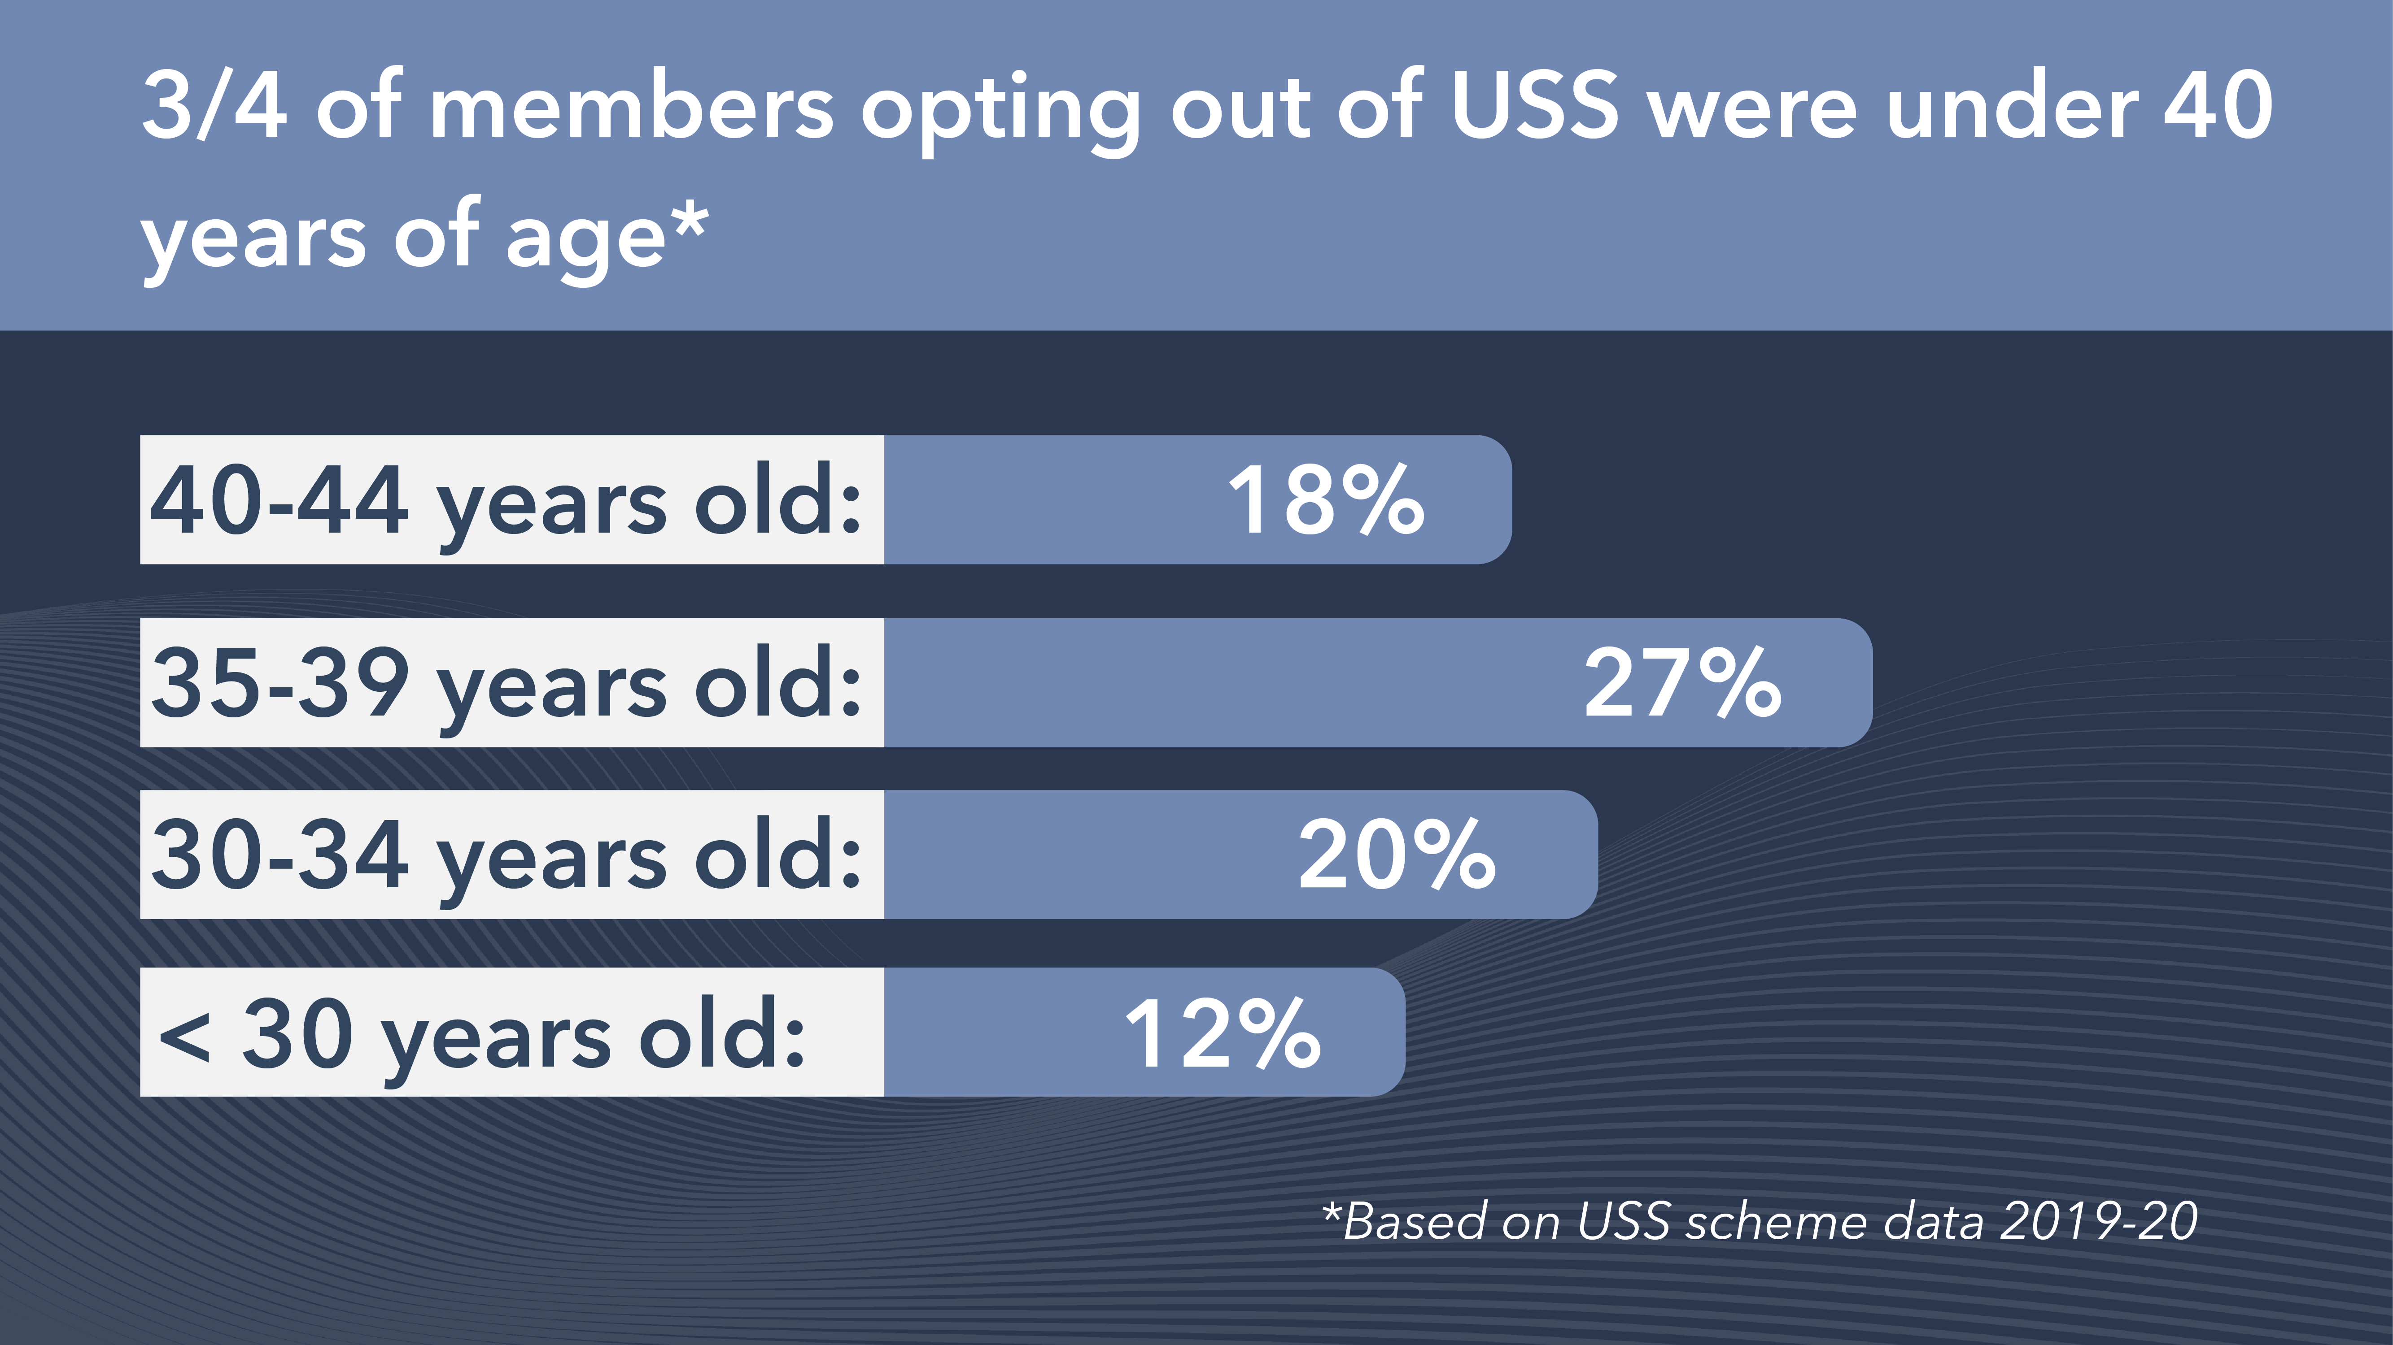
Opt-outs by age
Notes:
As you can see most of those opting out are younger colleagues. This means they are missing out on money from their employers, not saving for their future and not getting life cover or the other scheme benefits. The fact that this is more likely to impact on younger members of staff, adds to a sense of intergenerational unfairness in wider society.

Slide 21
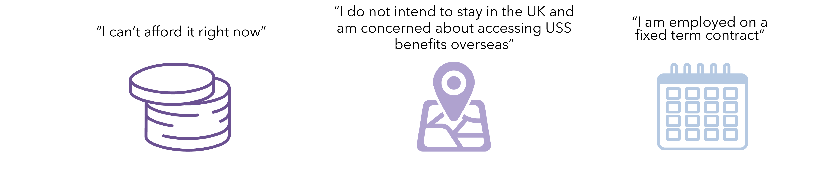
Reasons for opting out
Notes:
The main reason given by those opting out is the high contribution level.
USS is currently a one-size fits all scheme, so people can only be part of it if they are able to contribute 9.6% of their salary.
One suggestion in the consultation is that an optional lower cost flexible pension payment could be introduced to help people at different stages in their lives. It would allow colleagues to choose to pay in less for a period but still benefit from a valuable employer contribution.
This wouldn’t be a replacement for the main USS Scheme - it would be an optional short-term alternative for those who are currently unfairly priced out of the scheme. Employers would be willing to support this flexible option being offered on a DB or DC basis.

Slide 22
In summary
USS is a valuable pension scheme.
Long-term challenging environment for pension schemes and real terms fall in income from students. Made worse by financial impact of Covid-19.
USS has set very high prices to maintain current benefits in the 2020 valuation.
UUK proposal – passed by the JNC and accepted by USS – now progresses to an important and open consultation with members.
It retains a significant element of defined benefit within the future pensions earned by members at close to current contribution levels. Pensions built up to date are secure and can’t be changed.
Notes:
In summary,
USS is facing long-term challenges created by rising life expectancy and low interest rates.
Employers and you, scheme members, have had to pay in increasing amounts of money to the scheme in recent years and the USS Trustee says even more money is needed to keep current benefits, at unaffordable levels for employers and scheme members alike.
We want USS to continue to be an excellent pension scheme which rewards and recognises your hard work – but the scheme needs to be sustainable and within the boundaries of the money available.
We know that talking about pension changes is unsettling, especially after the year everyone has had with Coronavirus. We want to reassure you that your USS pensions built up to date are secure and can’t be changed.
The decision by the Joint Negotiating Committee to support the UUK proposal means there is a viable and implementable solution to the 2020 valuation, which sees a significant element of defined benefit retained within the future pensions earned by members at close to current contribution levels.
The UUK proposal is now subject to a full, important and open consultation with you, scheme members, and the UCU, other unions and representative bodies. Please do have your say on the proposal – it could change yet.

Slide 23
And finally – doing nothing isn’t an option
Without any changes to the scheme, employers and scheme members could still have escalating contribution rates being imposed on them by the USS Trustee: for employers, from the current level – 21.1% of salary – to 23.7% in October 2021.
Similarly, members would see their payments rise from 9.6% of salary, to 11% in October 2021.
The USS Trustee board’s decision to proceed with the UUK proposal means these rates have been avoided, subject to consultation. But any enforced contribution rises would risk pricing more and more members out of pensions savings, and lead to cuts in teaching, research, and jobs at many institutions as employers would be forced to pay extraordinarily high pension costs and have to find this money from elsewhere in their budgets.
In partnership with the UCU, we look forward to progressing a major governance review of USS, jointly exploring future options for scheme design including Conditional Indexation, and shaping a lower-cost option so staff on lower salaries are no longer priced out of retirement saving.
Notes:
And finally this is why doing nothing isn’t an option – the Trustee can impose much higher contributions without the agreement of employers and the union.
The UUK proposal avoids escalating and ruinous contribution increases, and we look forward to working with the University and College Union to jointly explore longer-term changes such as the governance review of USS, alternative scheme design including Conditional Indexation, and shaping a lower-cost option so staff are no longer priced out of the scheme.
By working together, we can make sure that USS remains a valuable, inclusive, and sustainable pension scheme for the future.
You can read more on the valuation on the USS Employers website: www.ussemployers.org.uk

