Slide 1
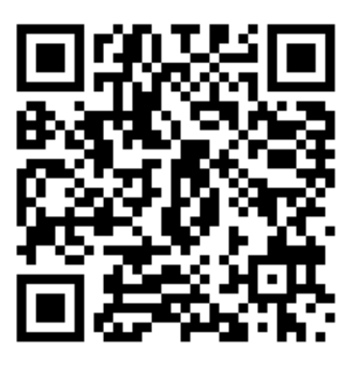
Equality, Diversity, and Inclusion
The School of Social Science is committed to creating an inclusive and supportive environment for all students and staff.
We are committed to safeguarding the protected characteristics under the Equality Act 2010: age, disability, gender reassignment, marriage and civil partnership, pregnancy and maternity, race, religion and belief, sex, and sexual orientation. But we also go beyond this to protect and embrace the many manifestations of diversity within our Community.
The School EDI Committee is actively working to promote EDI across all aspects of university life. You are encouraged to reach out with any EDI related concerns or questions.
School EDI Leads:
Dr Kathrin Thomas: kathrin.thomas@abdn.ac.uk
Dr Sone Erikainen: s.erikainen@abdn.ac.uk
EDI Drop-in session: Thursdays, 12:00-13:00, F18, Edward Wright Building
School EDI Homepage: https://www.abdn.ac.uk/socsci/EDI

Slide 2
Race Equality
We recognize that racism in the everyday life of our racialised community members, and the institutional racism which they have to navigate, poses many challenges for our Black, Asian, and Other Minority Ethnic members.
As a School, we are committed to taking proactive action to create a learning, working and social environment, to foster a sense of safety and belonging for racialised members of our community.
Make classrooms, workspaces, and social spaces free from discrimination, micro-aggressions, and exclusion so that students and staff from racialised groups can thrive.
Avoid making presumptions about people’s ethnicities or race, and respect and embrace cultural, religious and racial differences.
Be an ally: proactively support people subject to racism; speak up if you witness discrimination.
Be an active bystander: speak up and challenge antisocial behaviour.
If you experience any issues around race and racism in the School, the Race Champion and the EDI committee is here to support you. You can also contact Student Support: student.support@abdn.ac.uk, or a member of the central EDI team: edi@abdn.ac.uk. To exchange ideas and resources, contact the Race Equality Network for staff and PGRs: racenetwork@abdn.ac.uk
School Race Champion: Ritu Vij: r.vij@abdn.ac.uk
School EDI Leads:
Kathrin Thomas: kathrin.thomas@abdn.ac.uk
Sone Erikainen: s.erikainen@abdn.ac.uk
EDI Drop-in session:
Thursdays, 12:00-13:00, F18, Edward Wright Building

Slide 3
Disability Inclusion
We are committed to fostering an environment that is safe, respectful and inclusive of all disabled members in our School community. Everyone should play their part in this.
Educate yourself on issues affecting people with disabilities
Make classrooms, workspaces, and social spaces free from discrimination, harassment and exclusion
Avoid making presumptions about people’s disabilities, and respect and embrace differences. Remember that many disabilities are invisible.
Be an ally: proactively support disabled people; speak up if you witness discrimination
If you have a disability or think you might have, and would like support with your studies, contact Student Support student.support@abdn.ac.uk
If you experience any issues around disability inclusion in the School, the EDI committee is here to support you:
School Inclusion Officer:
Andrew Whitehouse: a.whitehouse@abn.ac.uk
School EDI Leads:
Kathrin Thomas: kathrin.thomas@abdn.ac.uk
Sone Erikainen: s.erikainen@abdn.ac.uk
EDI Drop-in session:
Thursdays, 12:00-13:00, F18, Edward Wright Building

Slide 4
LGBTIQ+ Inclusion
We are committed to fostering an environment that is safe, respectful and inclusive of all LGBTIQ+ members in our School community. Everyone should do their part in this.
Educate yourself on issues affecting the LGBTIQ+ community
Use respectful and inclusive language: address people by their correct pronouns and names, use gender neutral terms, e.g., person, partner
Make classrooms, workspaces, and social spaces free from discrimination, harassment and exclusion
Avoid making presumptions about people’s gender or sexuality, and respect and embrace differences
Be an ally: proactively support the LGBTIQ+ community, speak up if you witness discrimination
If you experience any issues around LGBTIQ+ inclusion in the School, the EDI committee is here to support you
School EDI Leads:
Kathrin Thomas: kathrin.thomas@abdn.ac.uk
Sone Erikainen: s.erikainen@abdn.ac.uk
EDI Drop-in session:
Thursdays, 12:00-13:00, F18, Edward Wright

