Slide 1
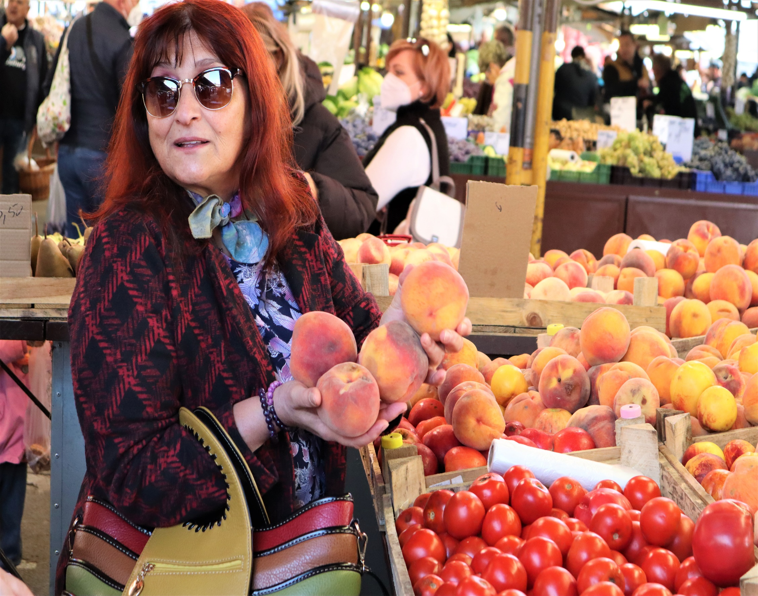
Transforming the UK Food System Programme Meeting
Dietary Inequalities/Food Insecurity Discussion Session
Organised by
Dr Charlotte Hardman and Dr Rachel Loopstra
Image: ECPO, Mikuláš Bartal
12th September 2022, Sheffield
Contact
The FIO Food Project
Website
Twitter: @FIOFood
Professor Alex Johnstone
alex.johnstone@abdn.ac.uk
University of Aberdeen

Slide 2
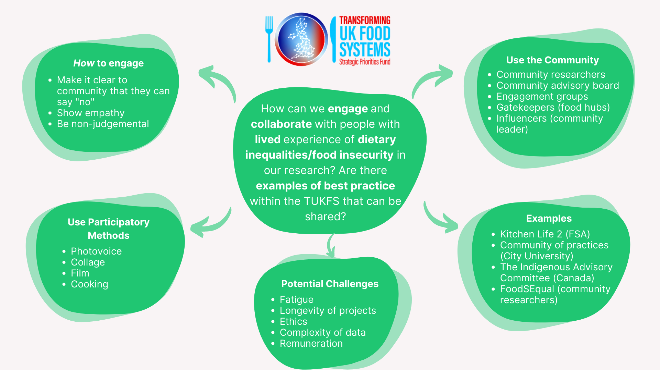
How to engage and collaborate with people with lived experience of food insecurity

Slide 3
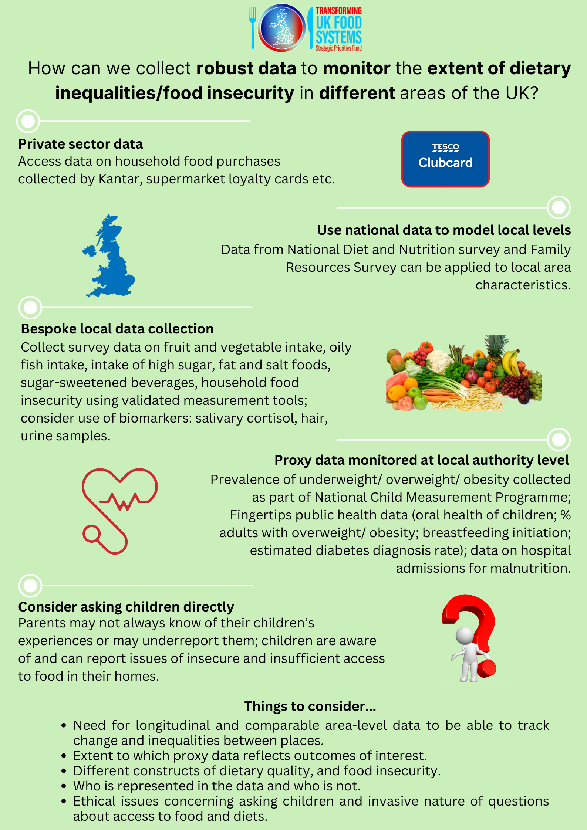
How to collect robust data to monitor the extent of dietary inequalities

Slide 4
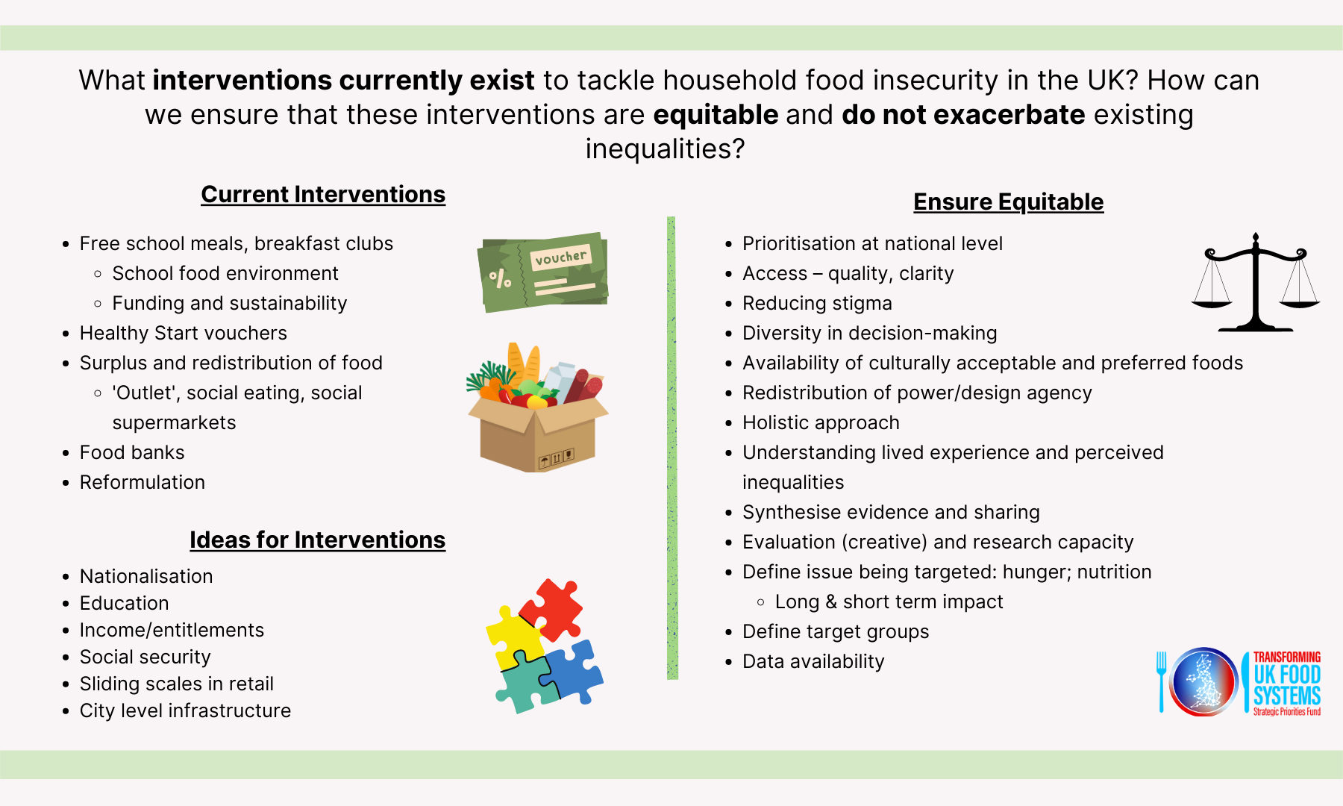
What interventions currently exist to tackle household food insecurity in the UK

Slide 5
How can the TUKFS projects best work together to create join up impact

