Slide 1


A Research Project about [BRIEF TITLE]
[optional photo of researcher
or picture]
[VERY BRIEF DESCRIPTION, VERY BRIEF DESCRIPTION, VERY BRIEF DESCRIPTION]
Who am I?
My name is [NAME]
I am [POSITION] at the University of Aberdeen
This project [DESCRIPTION].
I hope this project will help us understand [BRIEF DESCRIPTION OF WHY THE RESEARCH IS INTERESTING/ IMPORTANT].
Taking Part
Taking part will involve:
[DESCRIBE, E.G., PLAYING A GAME ON THE COMPUTER]
DESCRIBE, E.G., ANSWERING SOME QUESTIONS ABOUT…]
We all act in lots of different ways – there are no right or wrong answers.
It is up to you if you want to take part or not. If you start, but decide you don’t want to take part any more, just let me or your teacher know.
If you have any questions, please ask, or speak to your teacher who can help you get in touch.

Slide 2
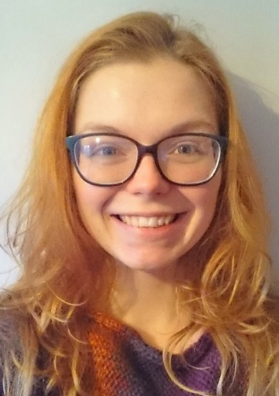

A Research Project about Classroom Learning
Exploring the different ways children think about and guide their own thinking
Who am I?
My name is Heather
I am a PhD researcher at the University of Stirling
We want to make sure you have a really good learning experience at primary school.
This project is trying to understand the different ways children think about their thinking, and how children guide thinking, for example what to do when you are ‘stuck’.
I hope this project will help us understand some ways we might make your learning experience at school better.
Taking Part
During my visits, I will be:
Visiting the class to watch some lessons
Talking about learning with some children
We all learn in lots of different ways – there are no right or wrong answers.
It is up to you if you want to take part or not. If you decide you don’t want to take part, just let me or your teacher know.
If you have any questions, speak to your teacher who can help you get in touch.

