Slide 1
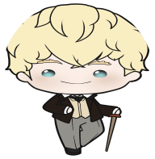
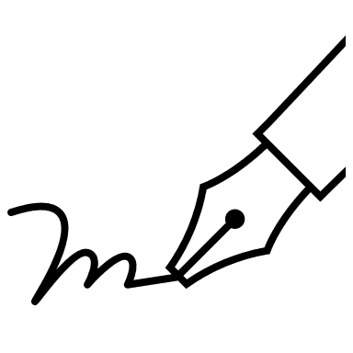
Letter Writing
with Walter Scott

Slide 2
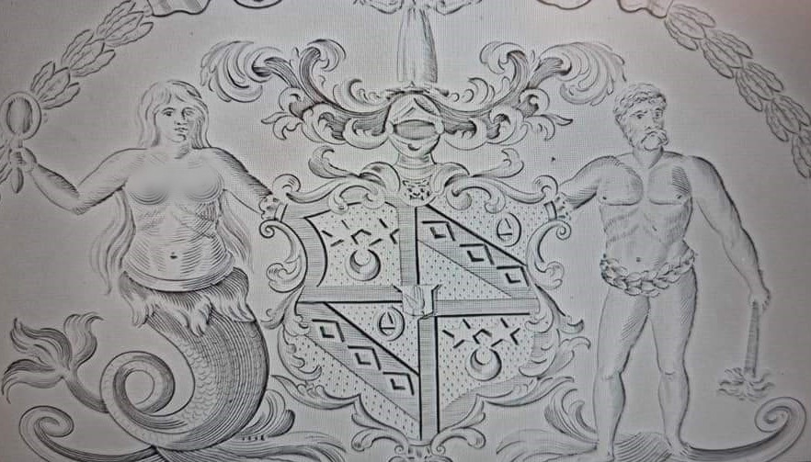
Walter Scott’s Crest

Slide 3
Who was Walter Scott?
Born in 1771
Loved dogs and cats
Famous writer
Lived in the Scottish Borders
Wrote novels, poems, and other texts

Slide 4
Your Crest
Crests tell us important things about a person or group of people. What important things would you put on your own crest?
Design your own crest.

Slide 5
Do you have a favourite poem?
On hiding in a cupboard Though tired of standing all this time I dare na stir a leg; Though wishing sair to stretch my arms I canna move a peg. | About a flower The violet, in her green-wood bower, Where birchen boughs with hazels mingle, May boast itself the fairest flower In glen, or copse, or forest dingle. [dingle = small wooded valley]
About a ghost and a human riding a horse Tramp! Tramp! Along the land they rode; Splash! Splash! Along the sea; The stead is wight, the spur is bright. The flashing pebbles flee. | A comment on lies: Oh what a tangled web we weave, When first we practice to deceive!

Slide 6
Time to write
Take a piece of paper and write a letter to your friend about the poem you have chosen. Answer these questions:
What is the poem about?
Why do you like the poem?
What would you ask the poet if you could?
Make sure you sign your name at the end.

Slide 7
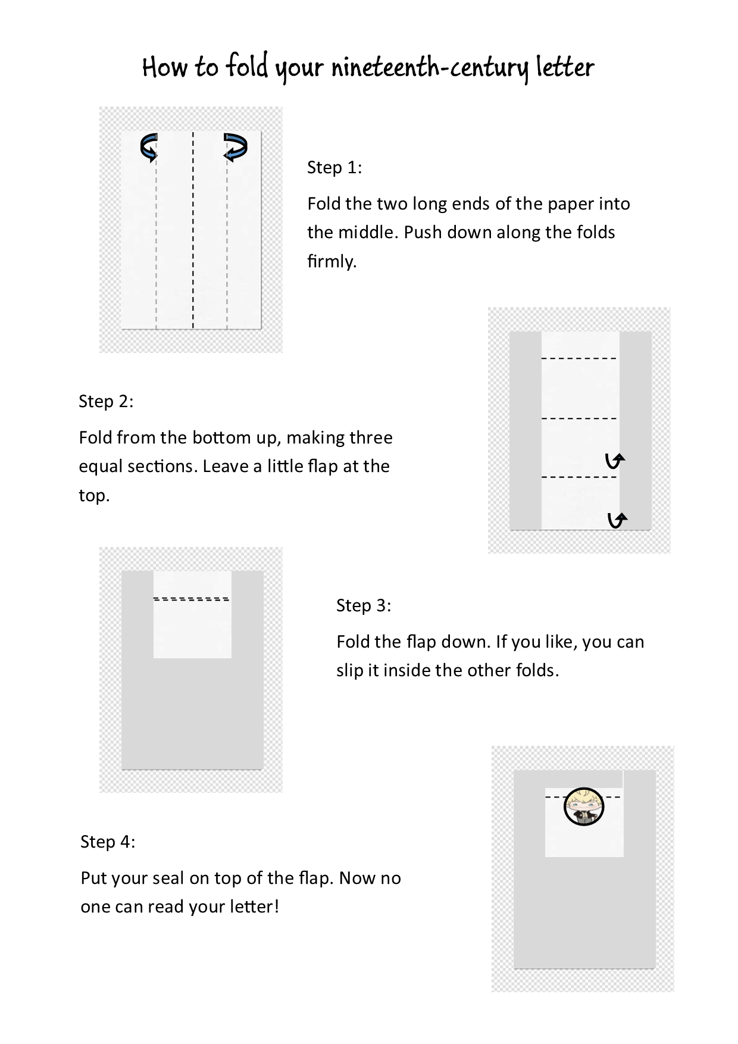
Fold your letter
Notes:
.

Slide 8
Read your classmate’s letter and poem
Do you like their poem?
Is it similar or different to your poem?
Do you like it?
What would you like to ask the poet?

Slide 9
Walter Scott’s letter part 1
The naturalists tell us that if you destroy the web which the spider has just made, the insect must spend many days in inactivity until he has assembled within his person the materials necessary to weave another.

Slide 10
Walter Scott’s letter part 2
Now after writing a work of imagination one feels [in] nearly the same exhausted state as the spider. I believe no man now alive writes more rapidly than I do (no great recommendation), but I never think of making verses till I have sufficient stock of poetical ideas to supply them.

Slide 11
Walter Scott’s letter part 3
I would as soon join the Israelites in Egypt in their heavy task of making bricks without clay.
Israelites in Egypt = this refers to a biblical story in which the enslaved Israelites had to make bricks without the material they needed.

Slide 12
Walter Scott’s letter part 4
Besides I know as a small farmer that good husbandry consists in not taking the same crop too frequently from the same soil and as turnips come after wheat according to the best rules of agriculture I take it that an edition of Swift will do well after such a scourging crop as Marmion.
Husbandry = looking after a small farm.
Scott had just finished writing a poem called Marmion and is now going to work on a non-fiction book about a writer called Swift.

Slide 13
Questions on Scott’s letter
The naturalists tell us that if you destroy the web which the spider has just made, the insect must spend many days in inactivity until he has assembled within his person the materials necessary to weave another. Now after writing a work of imagination one feels [in] nearly the same exhausted state as the spider. I believe no man now alive writes more rapidly than I do (no great recommendation), but I never think of making verses till I have sufficient stock of poetical ideas to supply them. I would as soon join the Israelites in Egypt in their heavy task of making bricks without clay. Besides I know as a small farmer that good husbandry consists in not taking the same crop too frequently from the same soil and as turnips come after wheat according to the best rules of agriculture I take it that an edition of Swift will do well after such a scourging crop as Marmion.
What animal does Scott compare himself to and why?
Do you think Scott is a careful writer?
Why does Scott say he will not write another poem right now?
Explain the comparison between writing and husbandry.
Would you like to receive a letter from Scott? Why?

