Slide 1
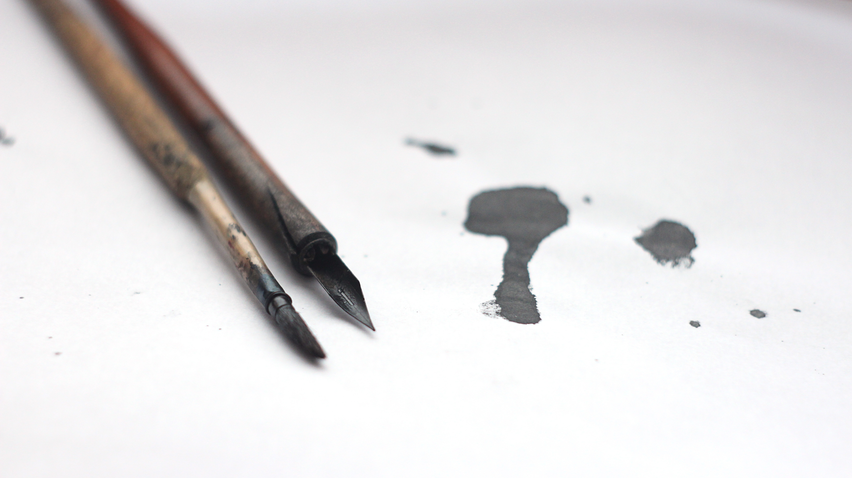
Editing Walter Scott’s Poetry

Slide 2
Editing Scott’s Poetry
Think of a time when you were in a hurry.
Where were you?
Where were you going?
Why did you have to hurry?

Slide 3
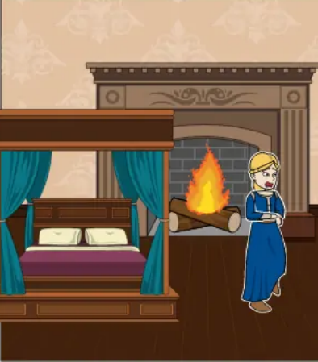
Poem 1
Why does fair Margaret so early awake?
And don her kirtle so hastily;
And the silken knots which in hurry she would make,
Why tremble her slender fingers to tie;
Create your own at Storyboardthat

Slide 4
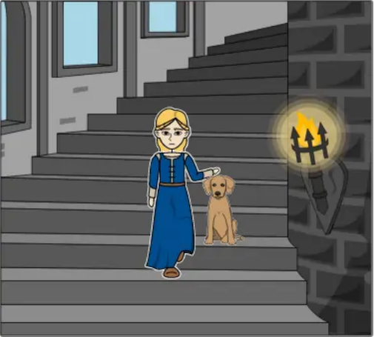
Poem 2
Why does she stop, and look often around,
As she glides down the secret stair;
And why does she pat the shaggy blood-hound,
As he rouses him up from his lair;
Create your own at Storyboardthat

Slide 5
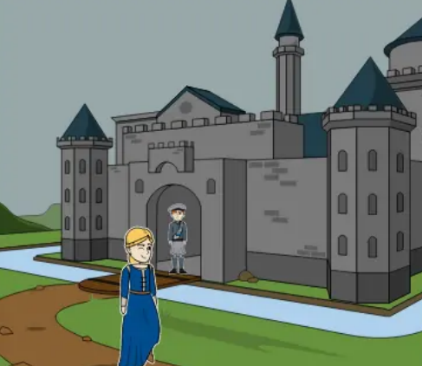
Poem 3
And though she passes the postern alone,
Why is not the watchman’s bugle blown?
Who is Margaret?
When do you think this poem is set?
What do you think will happen next?
Create your own at Storyboardthat

Slide 6

What happens next? Create your own story
Photo by Katerina Holmes from Pexels: https://www.pexels.com/photo/serious-ethnic-kid-with-pencil-and-copybook-5905868/
Why does fair Margaret so early awake?
And don her kirtle so hastily;
And the silken knots which in hurry she would make,
Why tremble her slender fingers to tie;
Why does she stop, and look often around,
As she glides down the secret stair;
And why does she pat the shaggy blood-hound,
As he rouses him up from his lair;
And though she passes the postern alone,
Why is not the watchman’s bugle blown?

Slide 7
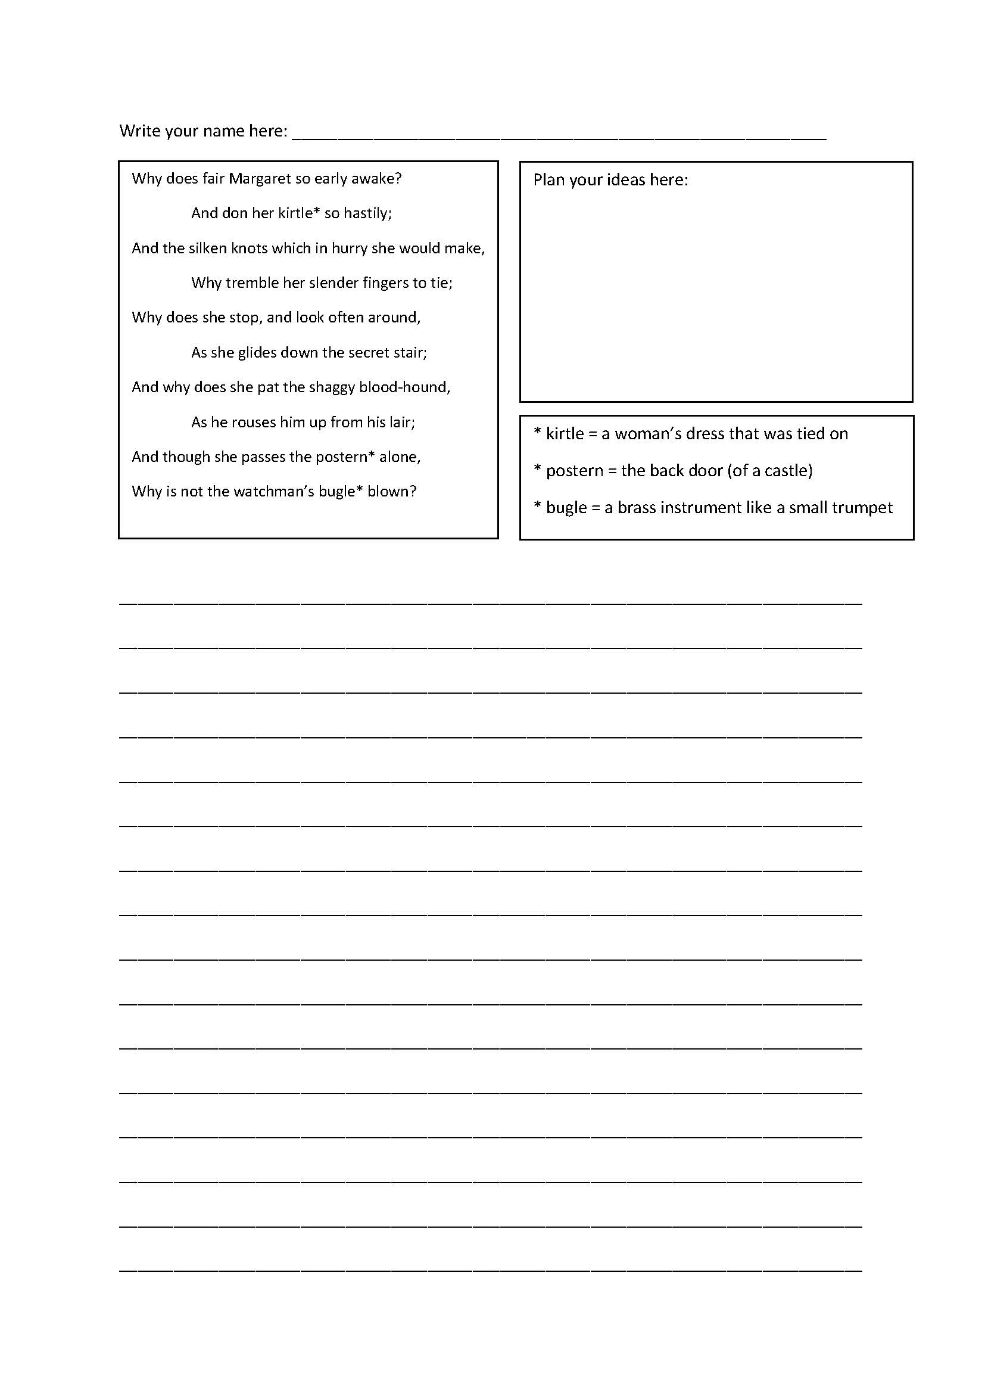
Instructions
Write your name at the top of the paper
Plan your story
Write your story
You have 10 minutes

Slide 8
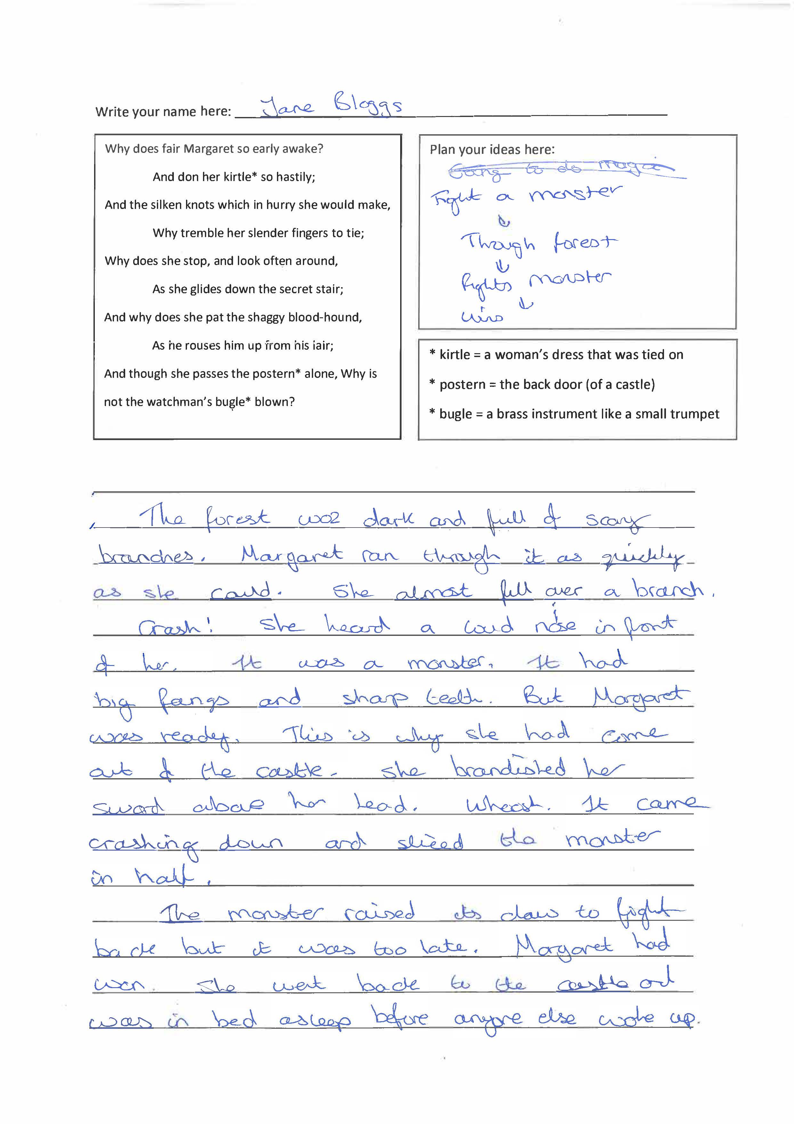
Example of a story

Slide 9
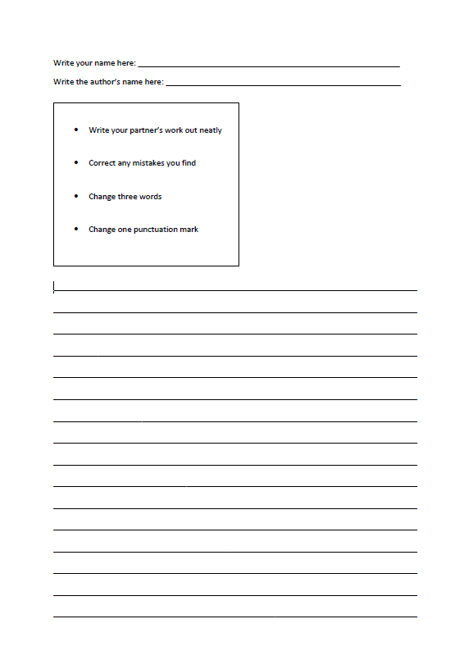
Instructions for editing

Slide 10
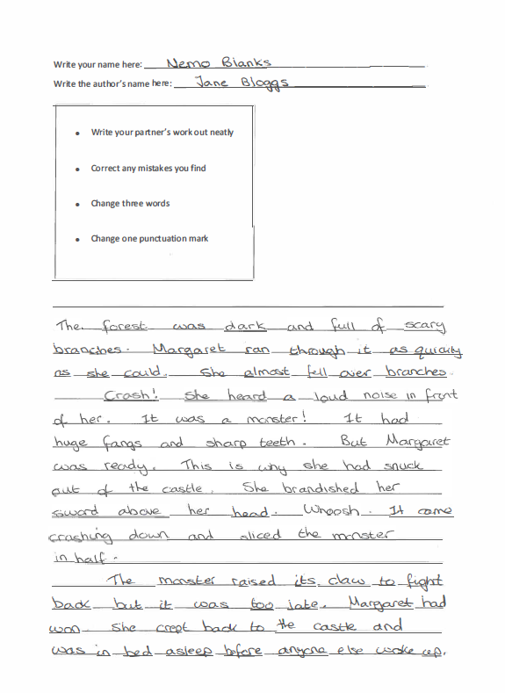
Examples of editing
Correct errors
Change one punctuation mark
Change three words

Slide 11
Editing Scott’s Poetry
What sort of changes did you make?
What effect did the time limit have?
Do you think you made any mistakes?

Slide 12
Examples of mistakes
Mistakes can creep in!
Correct errors
Change one punctuation mark
Change three words

Slide 13
Editing Walter Scott’s Poetry.
The Process

Slide 14

Final Instructions
Reread your work and the suggestions made by the editor.
Do you like any of the changes?
Read your story to two other people. Ask them for further suggestions.
Write up your story. Like Scott’s poems, it has been strengthened by the editing process.
Image source: Photo by SHVETS production from Pexels

Slide 15

Read
Read your final work to each other.
Image source: Photo by Kampus Production from Pexels

