Slide 1
ExplORe: Introduction to Pure Profiles
Nykohla Strong

Slide 2
Pure for Researchers
Compiled and validated view of research and research related data, from internal systems (HR, Student records, Worktribe) and external sources (Scopus, Web of Science, ORCID, etc.)
Central support to enter data into Pure, as well as automatic searches across multiple online publication sources
Customisable and discoverable online profile via the Pure Portal, enhanced discoverability and collaboration potential

Slide 3
Pure for Researchers
API links to share research information on staff pages, group pages, and external services
Easy to create customized CVs and reports for grant applications, annual review, promotion applications etc., with automatically updated data from Pure
Easy to move publication information between institutions; import or export data using ORCID, RIS or BibTeX files

Slide 4
Personal Overview / Researcher profiles
https://pure.abdn.ac.uk/admin/workspace/personal/overview/

Slide 5
Personal Overview / Researcher profiles

Slide 6
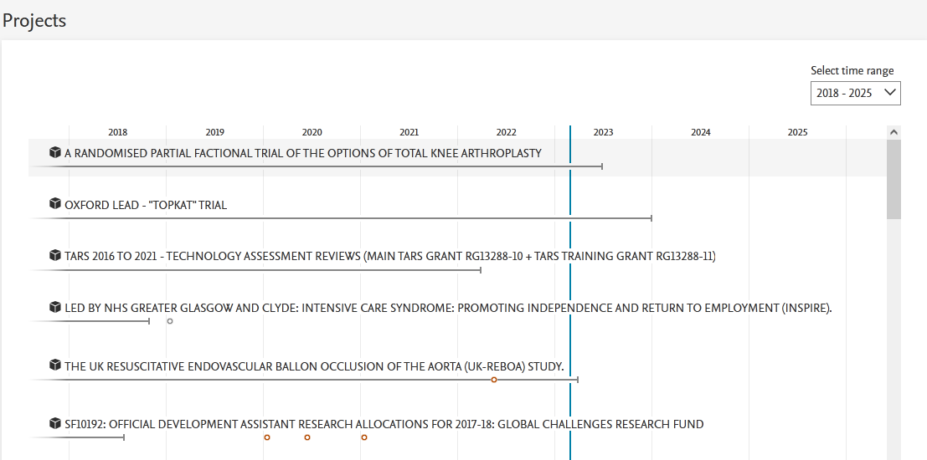
Personal Overview / Researcher profiles

Slide 7
Personal Overview / Researcher profiles

Slide 8
Personal Overview / Researcher profiles
Demonstration:

Slide 9
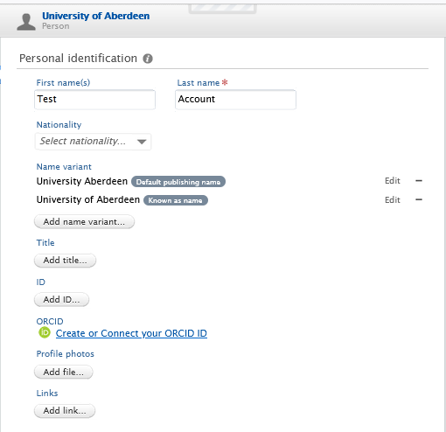
Personal Overview / Researcher profiles
Update your ‘known as’ or ‘publishing’ name
Add your Scopus ID to improve search results
Connect your ORCID account to pure; push and pull information between Pure and ORCID
Add a profile picture
Add links to your research websites

Slide 10
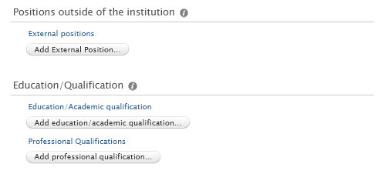
Personal Overview / Researcher profiles
Add details to enrich your biography
Add information on external positions or qualifications held
Add keywords to showcase the UN Sustainable Development goals you are engaged with or areas of expertise
Set your profile visibility to share or restrict your presence on the portal and Staff pages

Slide 11
Personal Overview / Researcher profiles
Demonstration:
Connect ORCIDs to Pure; import and export data to ORCID
Utilise ORCID connection to pre-populate annual Reseachfish reports
Add Scopus IDs to improve automated search results
Personalise profiles with research interests, and other information

Slide 12
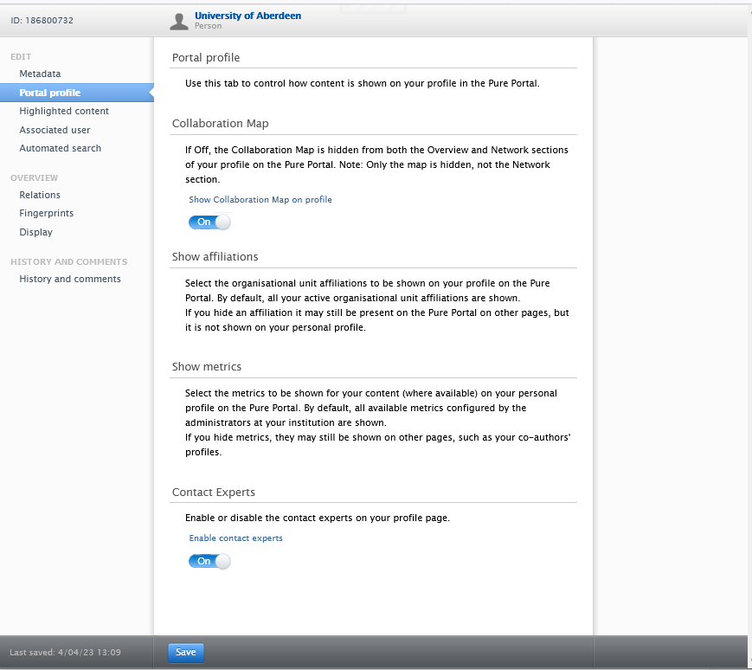
Personal Overview / Researcher profiles
Manage the information that Pure shares on the Pure Portal
Show or hide the collaboration map
Show or hide your affiliations
Show or hide if you can be contacted about your research expertise

Slide 13
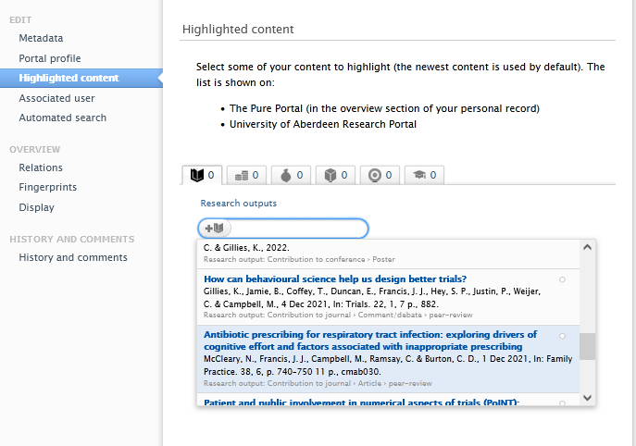
Personal Overview / Researcher profiles
Showcase up to five items that you want to highlight on the Pure Portal
Items need to be set to public in order to highlight them on the Portal

Slide 14
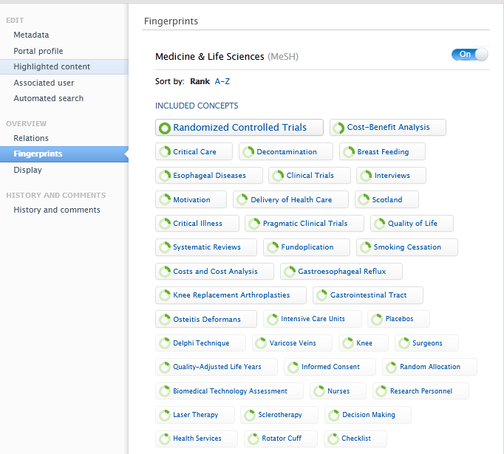
Personal Overview / Researcher profiles
Edit concepts and fingerprints to accurately reflect your research topics on the Pure portal

Slide 15
Personal Overview / Researcher profiles
Demonstration:
Update your Portal Profile
Highlight Content on the Portal
Edit concepts (fingerprints)

Slide 16
Personal Overview / Researcher profiles
Demonstration:
Viewing the Portal, AURA, and Staff Pages
https://abdn.pure.elsevier.com/en/
https://aura.abdn.ac.uk/
https://www.abdn.ac.uk/people/

Slide 17
Any Questions?

