Slide 1
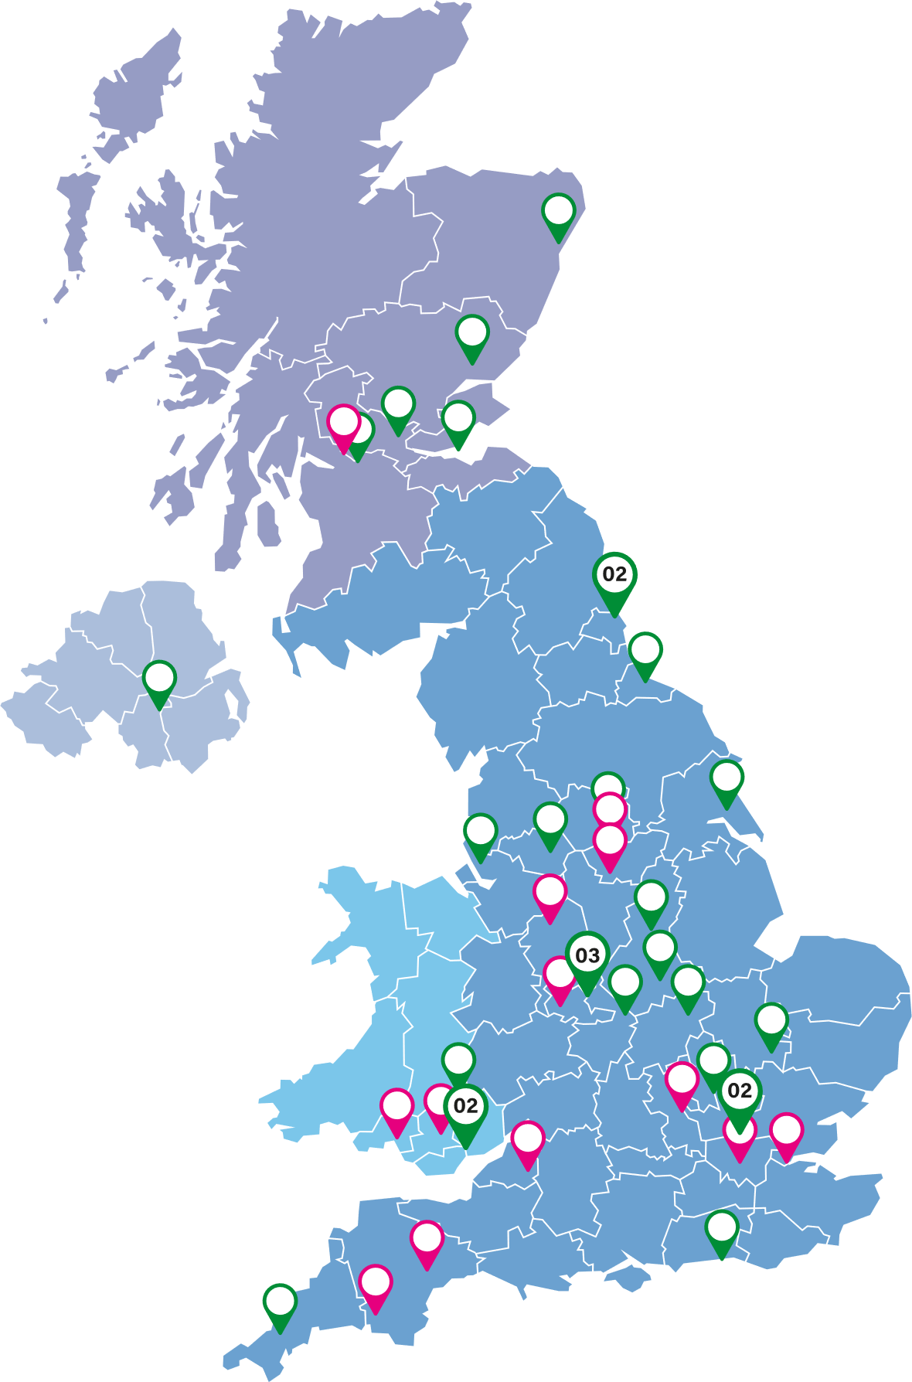
Rebecca Parr¹, Jay Woods¹, Gareth T Jones¹, Gary J Macfarlane¹, Jacqueline Sneddon², Laura J Moir¹ ¹Epidemiology Group, School of Medicine, Medical Sciences and Nutrition, University of Aberdeen, Aberdeen, UK. ²British Society for Antimicrobial Chemotherapy, Birmingham, UK
UK Antimicrobial Registry (UKAR) Study: Progress to date
UK Antimicrobial Registry
Drug registry coordinated by the University of Aberdeen on behalf of BSAC Supported by UKAR Steering Committee and industry partners (currently Menarini, Pfizer & Shionogi) Aims to provide data to describe effectiveness and safety of recently licensed antimicrobials Supports antimicrobial stewardship of new agents and contributes to NICE subscription model pilot for antimicrobials
#
Open for recruitment (28)
#
Sites in set-up (14)
Methods
Open to recruitment from May 2023 Relevant clinical data collected from patient notes; information about infection, microbiology lab results, use of eligible study drug(s) and other antimicrobials prescribed
Inclusion criteria | Exclusion criteria
Patient prescribed any eligible study drug during their current hospital stay. Person consenting (patient or proxy) able understand the consent process | Prescription of study drug was more than 60 days prior to recruitment. Patient was aged less than 18 years old on the first day of prescription with study drug.
#Number of NHS Health Trusts/Boards
in the area
Withdrawal criteria
Although prescribed a study drug, the patient does not start treatment. Treatment with the study drug is actively withdrawn after less than 24 hours
Progress to date*
Sites 28 sites open to recruitment 22 sites recruited > 1 participant 13 sites in set-up phase 8 sites in discussion about feasibility Participants 193 patients consented to participate 8 of 11 study drugs represented Dalbavancin accounts for 40% of the prescriptions (N = 78) Infections Lower Respiratory Tract infection(28%) Skin and subcutaneous tissue infection (24%) Bone and Joint infection (20%) *As of 03 April 2024 ^{ǂ}Total of 196 prescriptions
Study Drug | N^{ǂ} (%) | Median (range) age (years) | %Female
GRAM POSITIVE AGENTS
Ceftaroline | 4 (2) | 47 (35-75) | 50
Ceftobiprole | 2 (1) | 29 & 76 | 100
Dalbavancin | 78 (40) | 57 (22-90) | 46
Delafloxacin | - | - | -
Oritavancin | - | - | -
GRAM NEGATIVE AGENTS
Cefiderocol | 29 (15) | 51 (20-77) | 48
Ceftazidime/avibactam | 46 (23) | 63 (20-92) | 39
Ceftolozane/tazobactam | 28 (14) | 52 (20-81) | 43
Eravacycline | - | - | -
Imipenem/cilastatin/relebactam | 7 (4) | 32 (22-75) | 43
Meropenem/vaborbactam | 3 (2) | 67 (60-77) | 0
Discussion
Participant recruitment to the registry is on target – open to May 2026
We are keen to welcome new sites to the study
To learn more and register your interest, please contact the UKAR team: ukar@abdn.ac.uk

