Slide 1

Doing online remote interviews
DIPEx Meeting 2020
Lynn Laidlaw, Hanne Bruhn, Heidi Gardner and Avril Nicoll, with thanks to Eilidh Duncan

Slide 2
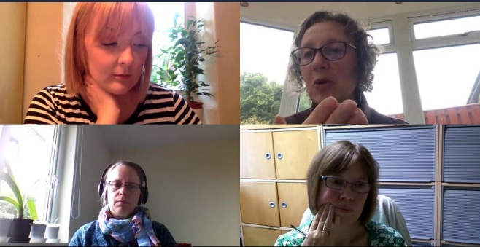
Our experiences
You’re listening to an edit of Lynn Laidlaw, Avril Nicoll, Hanne Bruhn and Heidi Gardner in conversation over Microsoft Teams.
They were reflecting on their experiences of online interviews.
Lynn is a lay advisor on a number of projects and a participant in the Healthtalk vasculitis module where Avril is Research Fellow.
Heidi
Lynn
Hanne
Avril

Slide 3
Things to consider
Data sufficiency
Logistics and feasibility
Interpersonal dynamics
What can I do to help participants feel safe?
What strategies will reduce awkwardness?
*Ref
What practical things can I do to prepare and support participants with the technology?
What opportunities does online offer for patient and public involvement?

Slide 4





The Healthtalk vasculitis module is part of the VOICES study
www.abdn.ac.uk/iahs/research/epidemiology/vasculitis-1616.php
Contacts for this presentation:
Avril Nicoll, email avril.nicoll@abdn.ac.uk
Lynn Laidlaw, twitter @lynn_laidlaw

