Slide 1
Webinar 2: The present-day environment of the surface of Mars and comparison with that of Earth
Miracle Israel Nazarious
20/10/2021

Slide 2
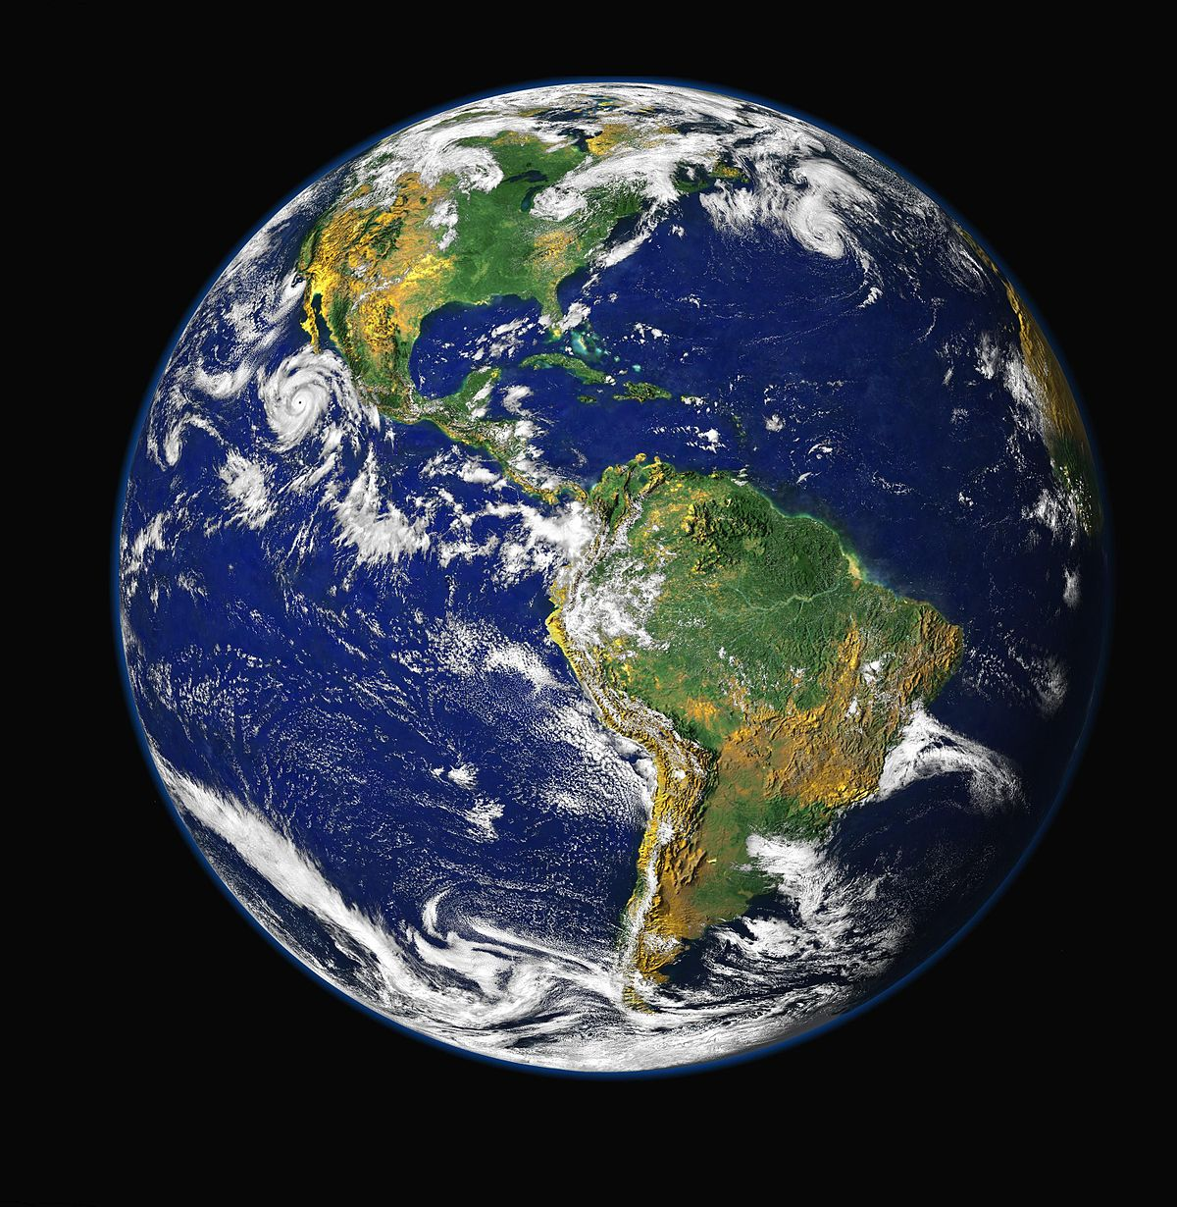
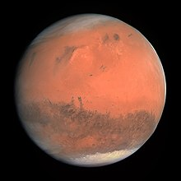
Earth and Mars
Similarities and differences
Notes:
A new representation of Mars than ever before…

Slide 3
@MarsWxReport
Average distance from the Sun | 149,597,891 km (1 AU) | 227,936,637 km (1.524 AU)
Equatorial Radius | 6378 km | 3397 km
Length of the day | 24 hours | 24 hours, 37 minutes
Length of the year | 687 Earth days (1.88 Earth years) | 365 days
Tilt of axis towards Sun | 23.45° | 25°
# of natural satellites | 1 (Moon) | 2 (Phobos = Fear, Deimos = Panic)
Gravity | Thanks to Newton! | 1/3rd of Earth
Mass and volume | 5.9722×10²⁴ kg | 1/10th of Earth and would need more than six Mars to fill Earth
Surface temperature | -89.2 °C (Vostok station, Antarctica) to 70.7 °C (Lut Desert, Iran) | -125 °C (at poles in winter) to 20 °C (near equator in summer)
Sea level atmospheric pressure | 1013 mbar | 7.5 mbar (100 times thinner atmosphere)

Slide 4
Credit: NASA

Slide 5
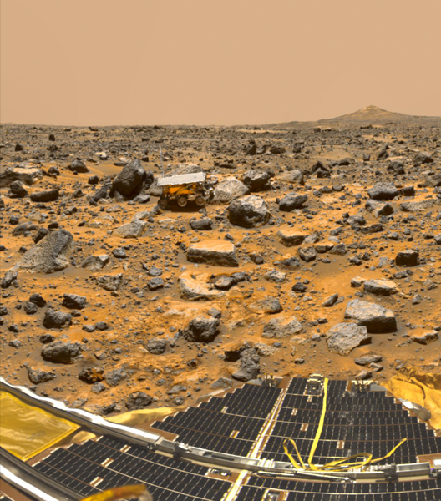
Credit: NASA
Surface features
Dry, dusty, and covered in iron oxide (rust). Regolith contains chloride, sulphates and perchlorate salts
Two faces of Mars. Surface is rocky and rugged covered by mountain ranges, volcanoes, impacts sandy plains, sand dunes, Olympus Mons (26 km tall), and the Valles Marineris (7 km deep and 4000 km wide).
About 70% of the surface is covered by liquid water
To know the rest about Earth, explore it!
Color: Blue vs Red
Sunrise and Sunset color: Red on Earth, Blue on Mars

Slide 6
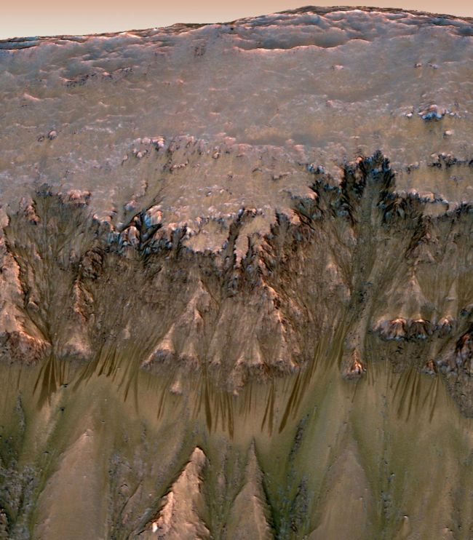
Does liquid water flow on Mars today?
Signs of wetter past which now are dried-up river channels and canyons
Recurring slope lineae, slope streaks
Radar observation of 20 km wide subsurface lake under south polar ice cap
Stays liquid due to concentrated briny nature
Briny water flow in warm seasons vs flow of dry dirt
HABIT / ExoMars 2022 will investigate at the formation of liquid brines on Martian surface (wet mechanism)
Credit: NASA/JPL-Caltech/Univ. of Arizona

Slide 7
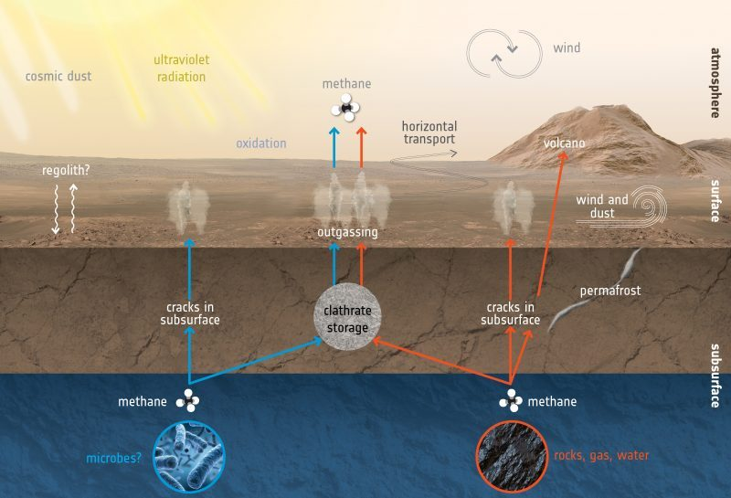
What does Methane on Mars implies?
Credit: ESA

Slide 8
Is dust on Mars the most important driver of weather?
Dusts on Mars fills the role of water on Earth in weather
Winds from 65 to 79 km/hr are needed to lift dust off the surface, that’s enough speed to damage structures on Earth
1 dust devil / sq. km / day (140 million / day)
Credit: NASA/JPL-Caltech/TAMU

Slide 9
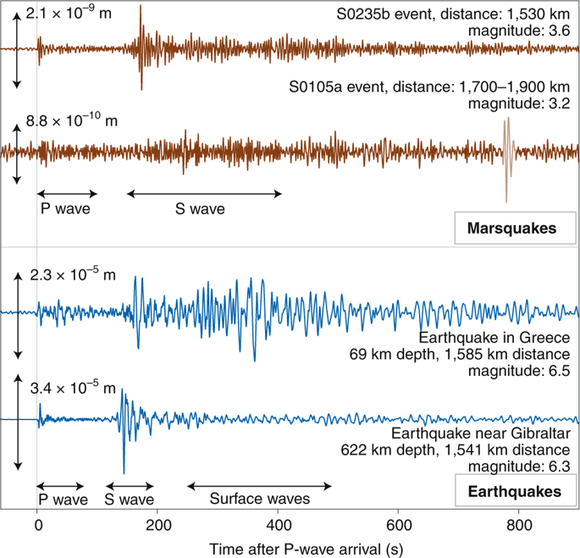
Are Marsquakes real?
Credit: : W. Bruce Banerdt et al., 2020
InSight lander detected more than 450 Marsquakes since April 2019
Magnitude of 3 or 4 in richter scale, originated deeper (30 to 50 km)

Slide 10
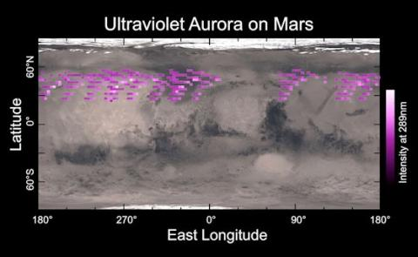
Can you see auroras on Mars?
Umbrella-shaped magnetic fields sprouting from ground like mushrooms
Remnants of ancient global magnetic field
Humans on Mars could see green auroras from excited Oxygen atoms
Credit: University of Colorado

Slide 11
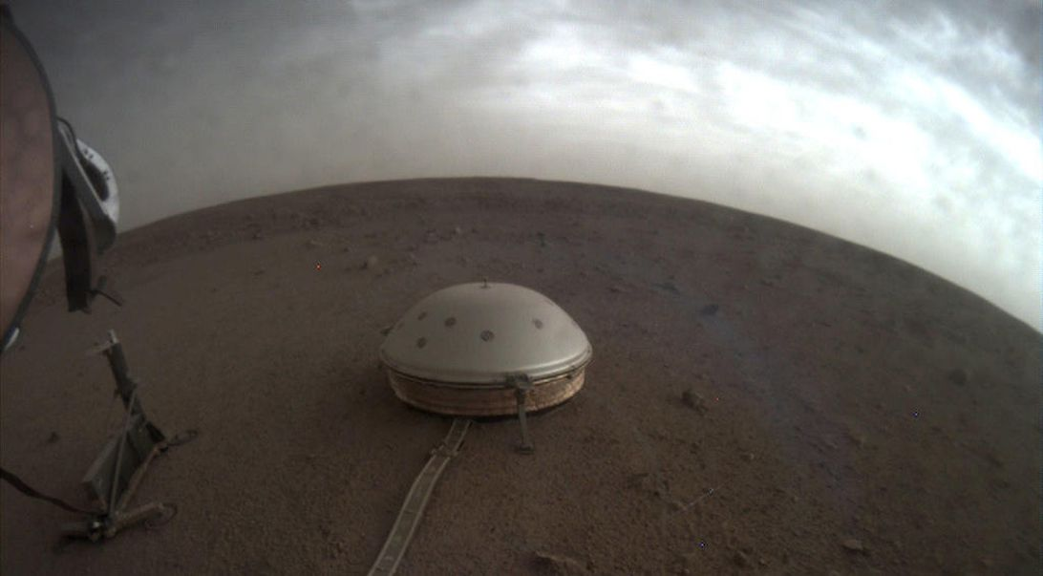
Does it rain on Mars?
Credit: NASA/JPL-Caltech
Less water vapor than Earth’s atmosphere, the Martian atmosphere hosts clouds.
But NO, it doesn’t rain because at low temperature and pressure water only exist as vapor or ice.
But frost and fog does occur in the form of water-ice and carbon dioxide ice (below -78.5 °C mostly at polar caps)

Slide 12
”A day on Mars” experience
sol
Notes:
More that 50 years of scientific discoveries in a one day experience.

Slide 13
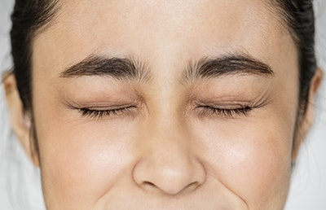
Please close your eyes!

Slide 14
Notes:
Landed near Equatorial Mars after cruising in Space for about 7 months. It’s summer on the northern hemisphere of Mars
Standing on the Martian surface and removing your spacesuit
Wind: 25 km/hr gusting upto 79 km/hr (over 65 km/hr wind gust required to lift dust off surface)
Surrounded by lots of Martian dust
Smells like burnt gunpowder, or a wet charcoal, similar to what astronauts smelled on the Moon
6:58 am – Blue twilight in the south-east
7:28 am – Sunrise in the south-east – blue sky around the Sun and the rest of the sky is from yellow to orange
Walking around a bit
Temperature is steadily increasing
A little bit away, a dust devil, about 1 km tall is whirling with a distant roar and passing through
12:55 pm – Solar noon
Temperature at feet: -10 C
Temperature at head: -35 C
2:30 pm: Lie down on the surface and touch it with your palms
Rocky and rugged surface containing fine grains of sand particles with salts
Turn sideways, put your ears on the Martian surface, feel a little shake on the ground and hear a steady rumble, that’s the Marsquake from deep inside Mars accompanied with a strong gust of wind along the surface
6:24 pm – Sunset in the south-west
6:54 pm - Blue twilight in the south-west
Temperature is decreasing
Surface begins to get wetter as water vapor precipitates under low temperature and low pressure
Pinch some wet Mars sand and smell, mix of rust, wet charcoal, and Sulphur's rotten egg smell, put in tongue, tastes salty, bitter and acidic but bad for stomach
8 pm - Several auroras appearing at various parts of the sky and enjoying the show
Stars are up, Earth appears as a tiny little dot
Projected lowest temperature at night: -100 C

Slide 15
Any questions?
Please email me at: miracle.nazarious@abdn.ac.uk

Slide 16
Up Next…
Webinar 3: Future of space exploration and In-Situ-Resource Utilization, comparison of MOXIE on board Perseverance and HABIT onboard ExoMars, producing O2 and H2O

