Slide 1
David R. Green UCEMM | University of Aberdeen
www.aapmproject.eu
Johannes Fahrentrapp | Lammert Kooistra | Irene Bühlmann | Jason J. Hagon | Peter Roosjen
SWD presentation – 24th January 2018

Slide 2
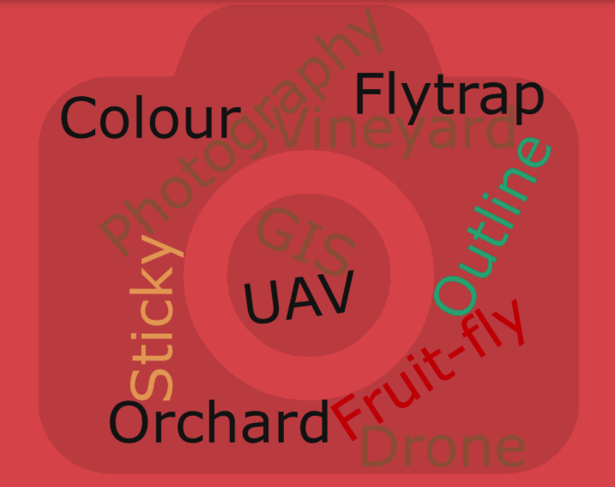
Outline
Introduction
Completed
UAV Platforms
Autonomous Flight
Coloured Fly Traps
Research References
Field Experiment
Autonomous Flight Test
Partner(s) (ZHAW/WUR)
Plans (UoA)
SWD presentation – 24th January 2018

Slide 3
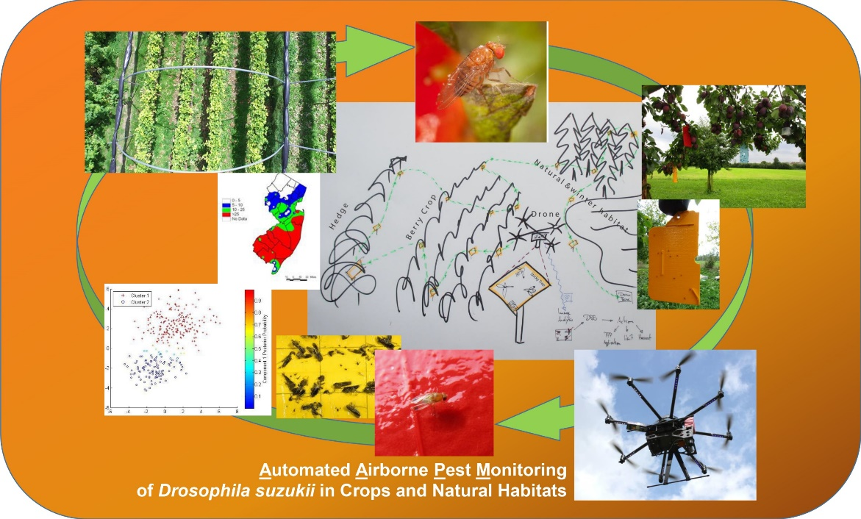
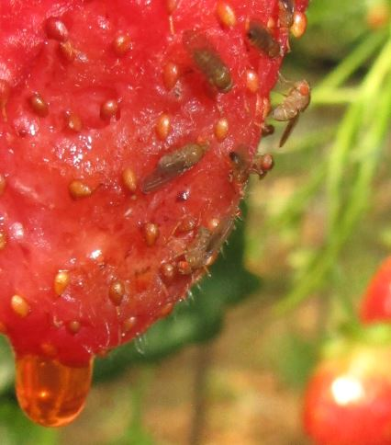
Completed
Website – up-to-date
Facebook Page
Twitter Page
Press Release(s)
Two SKYPE meetings (with Both Partners)
Email correspondence (daily/weekly)
Acquisition of some Fruit Fly Traps (ZHAW)
Discussions with AHDB
DEFRA presentation – 20th November 2017
SWD presentation – 24th January 2018

Slide 4
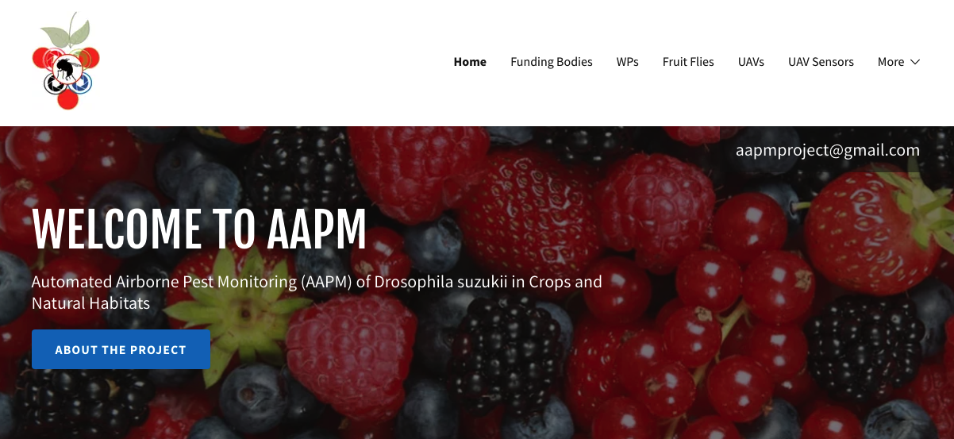
Website
www.aapmproject.eu
DEFRA presentation – 20th November 2017
SWD presentation – 24th January 2018

Slide 5
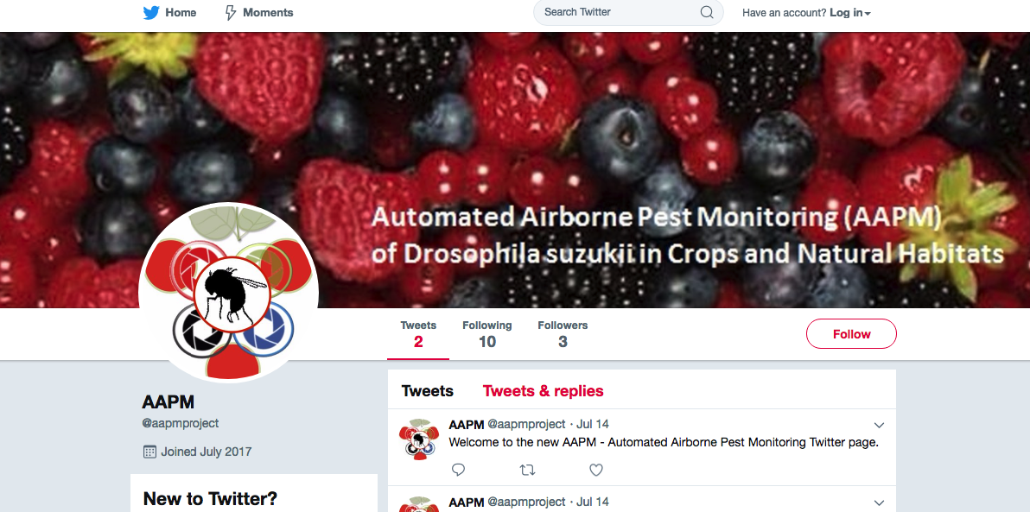
Twitter
Twitter: https://twitter.com/aapmproject
AAPM (@aapmproject) | Twitter
DEFRA presentation – 20th November 2017
SWD presentation – 24th January 2018

Slide 6
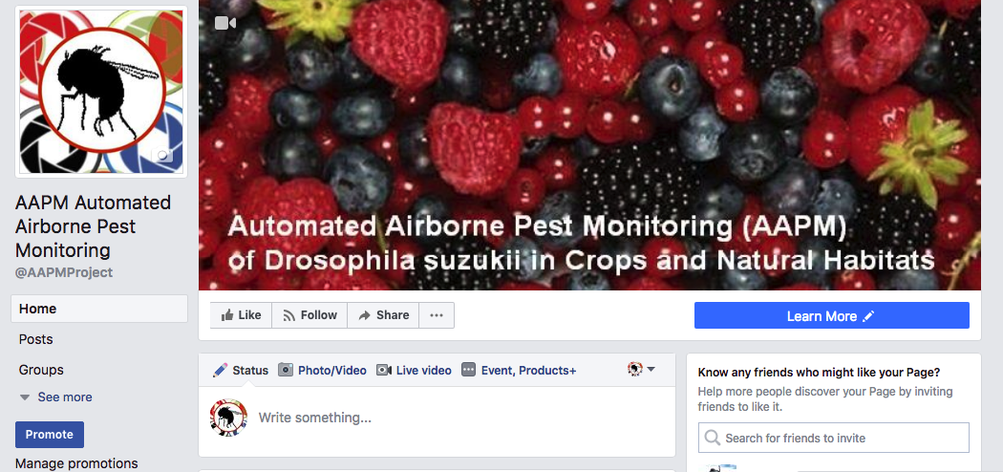
Facebook
Facebook: https://www.facebook.com/AAPMProject/
DEFRA presentation – 20th November 2017
SWD presentation – 24th January 2018

Slide 7
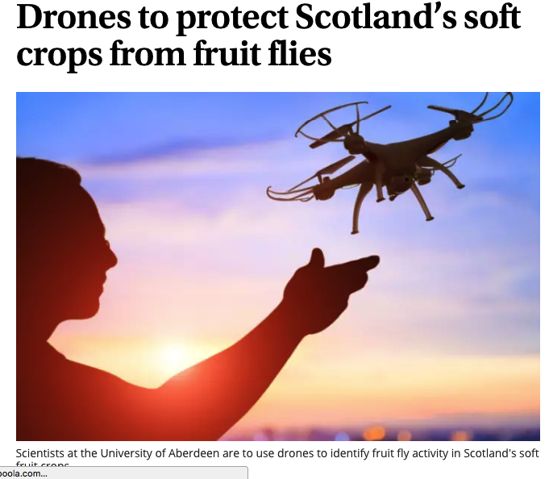
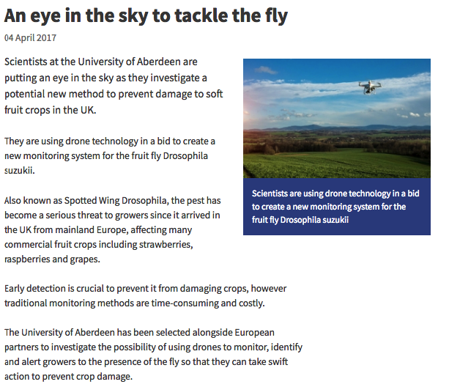
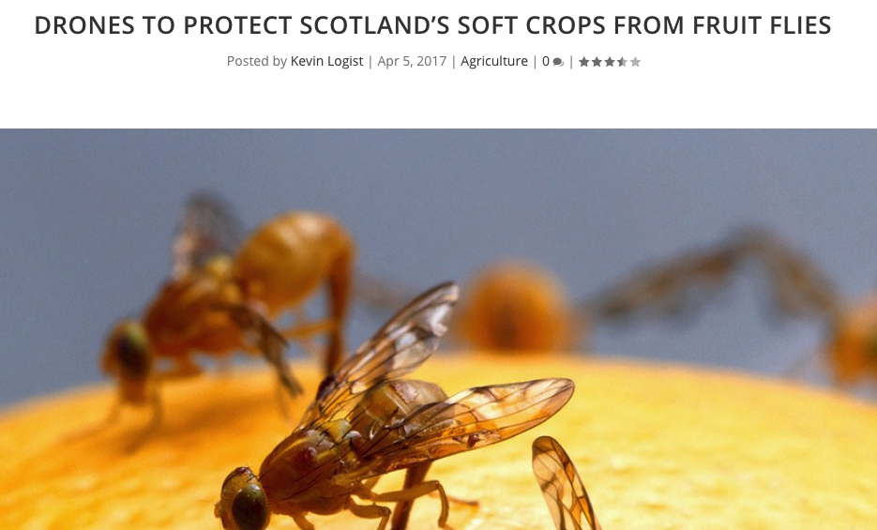
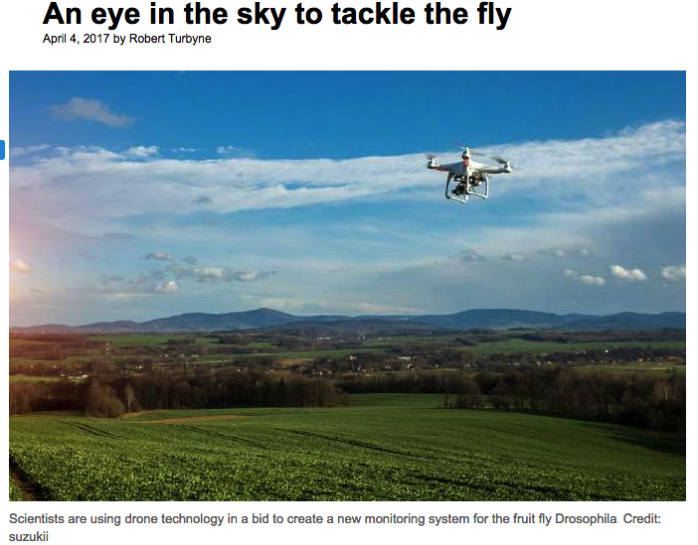
Press Release(s)
DEFRA presentation – 20th November 2017
SWD presentation – 24th January 2018

Slide 8
Press Release(s)
https://phys.org/news/2017-04-eye-sky-tackle.html
https://www.abdn.ac.uk/news/10604/
http://www.scotsman.com/news/environment/drones-to-protect-scotland-s-soft-crops-from-fruit-flies-1-4411855
http://www.producebusinessuk.com/insight/insight-stories/2017/04/06/drones-to-tackle-fruit-fly-spread-on-soft-fruit-farms
http://www.freshplaza.com/article/173464/Scotland-to-combat-fruit-flies-with-drones
https://www.pinterest.co.uk/pin/68257750584329580/
https://www.hortweek.com/research-project-employs-drones-give-early-warning-spotted-wing-drosophila/fresh-produce/article/1430010
https://www.facebook.com/universityofaberdeen/posts/10155313319104432
https://www.wur.nl/en/newsarticle/Drones-keeping-an-eye-on-the-fly.htm
DEFRA presentation – 20th November 2017
SWD presentation – 24th January 2018

Slide 9
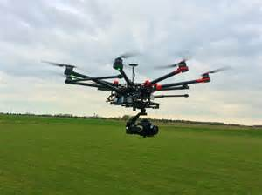
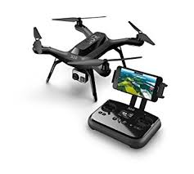
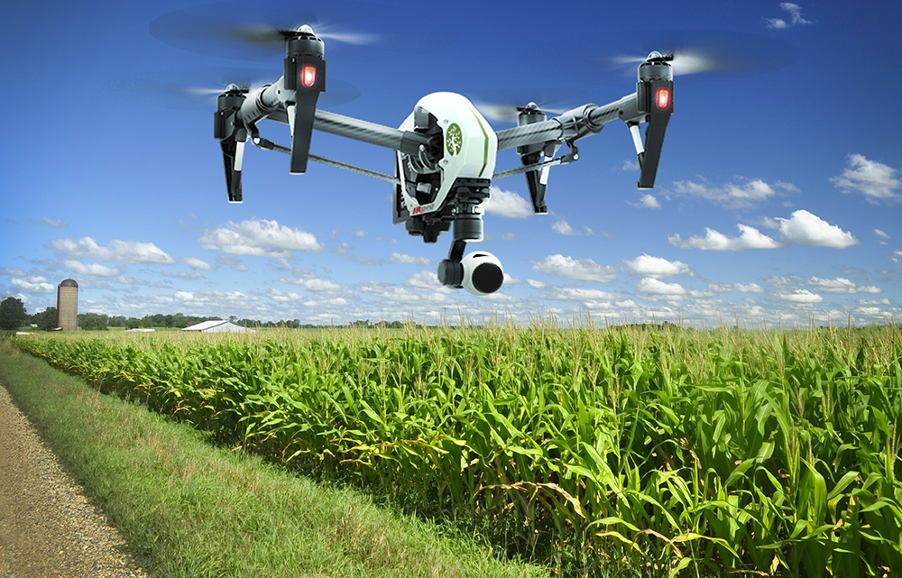
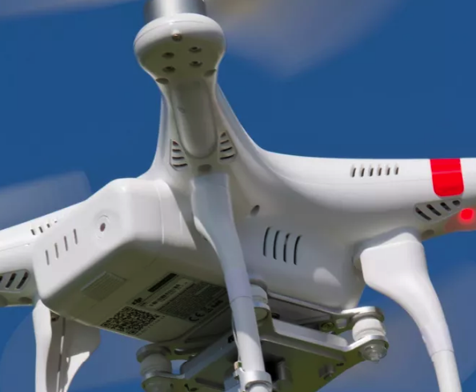
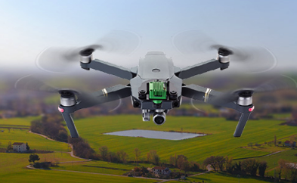
UAV Platforms & Sensors
DJI S900
DSLR Camera
3DR Solo
MapIR Camera
DJI Inspire 1
X3 Camera
DJI Mavic
Camera
DEFRA presentation – 20th November 2017
SWD presentation – 24th January 2018

Slide 10
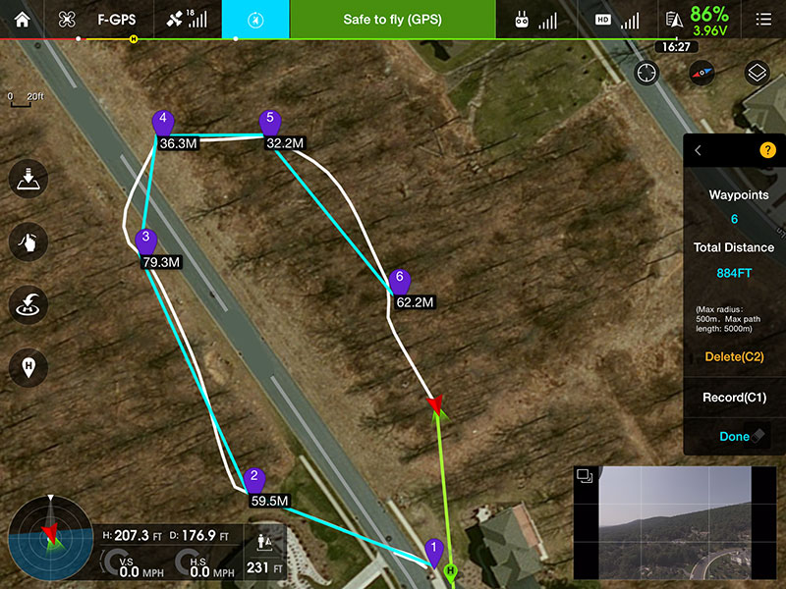
Autonomous Flight
Waypoints – known
locations of Fly Traps
Fly drone from one to
the other
SWD presentation – 24th January 2018

Slide 11
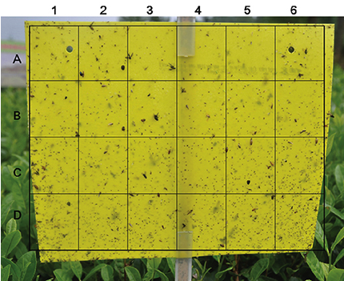
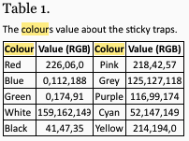
Coloured Fly Traps
Wang, Y., Gao, N., Shi, L., Qin, Z.Y., He, P., Hu, D.Y., Tan, X.F., and Chen, Z., 2015. Evaluation of the Attractive Effect of Coloured Sticky Traps for Aleurocanthus Spiniferus (Quaintance) and its Monitoring Method in Tea Garden in China. Journal of Entomological and Acarological Research. Vol. 47(3):86-90.
SWD presentation – 24th January 2018

Slide 12
Research References (Traps)
Atakan, E., and Pehlivan, S., 2015. Attractiveness of Various Colored Sticky Traps to Some Pollinating Insects in Apple. Turkish Journal of Zoology. Vol. 39: 474-481.
Devi, M.S., and Roy, K., 2017. Comparable Study on Different Coloured Sticky Traps for Catching of Onion Thrips, Thrips tabaci Lindeman. Journal of Entomology and Zoology Studies. Vol. 5(2): 669-671.
Hassan, A-A, and Mohammed, A-D., 2004. Trapping Efficiency of Various Colored Traps for Insects in Cucumber Crop under Greenhouse Conditions in Riyadh, Saudi Arabia. Pakistan Journal of Biological Sciences. Vol. 7(7):1213-1216.
Leeper, J.R., 1978. Using Sticky Traps to Monitor Fruit Flies in Apple and Cherry Orchards. New York’s Food and Life Sciences Bulletin. No. 70. April 1978. 4p.
Wang, Y., Gao, N., Shi, L., Qin, Z.Y., He, P., Hu, D.Y., Tan, X.F., and Chen, Z., 2015. Evaluation of the Attractive Effect of Coloured Sticky Traps for Aleurocanthus Spiniferus (Quaintance) and its Monitoring Method in Tea Garden in China. Journal of Entomological and Acarological Research. Vol. 47(3):86-90.
SWD presentation – 24th January 2018

Slide 13
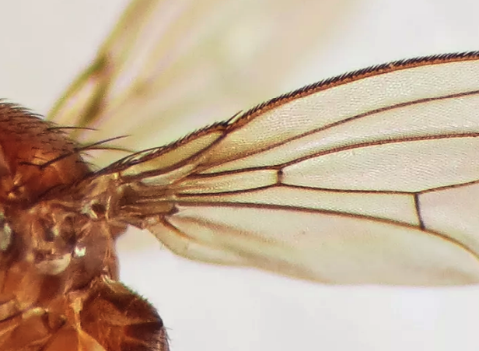
Thank You ….
www.aapmproject.eu
aapmproject@gmail.com
www.abdn.ac.uk/research/ucemm | d.r.green@abdn.ac.uk
DEFRA presentation – 20th November 2017
SWD presentation – 24th January 2018

