Slide 1

Arab Trans
Perceptions of the EU in the Middle East
Valeria Talbot, Paolo Maggiolini
Istituto per gli Studi di Politica Internazionale (ISPI)

Slide 2

Main points
Knowledge and assessment on EU cooperation programs
Perceptions on priority sectors of EU support
Perceptions on EU as a stabilising/destabilising player

Slide 3

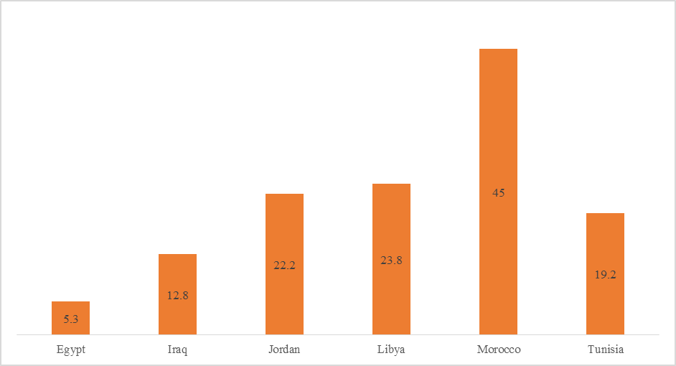
Knowledge about development/cooperation programs funded by the EU
Source: Arab Transitions, 2014

Slide 4
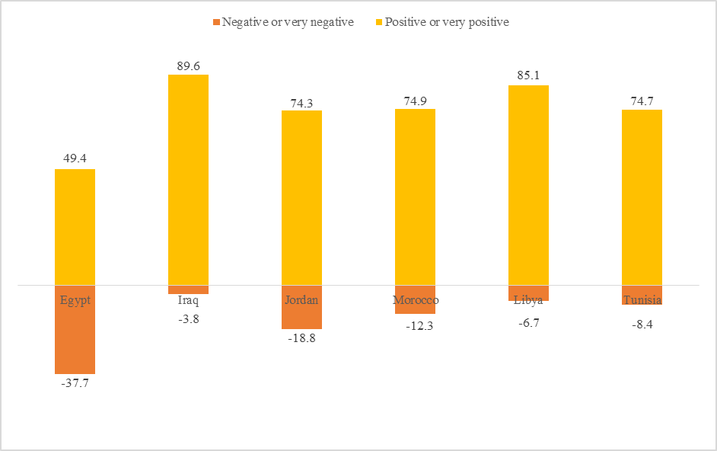
How do you assess the impact of development/cooperation programs funded by the EU? (% of respondents heard of them)
)
Source: Arab Transitions, 2014

Slide 5
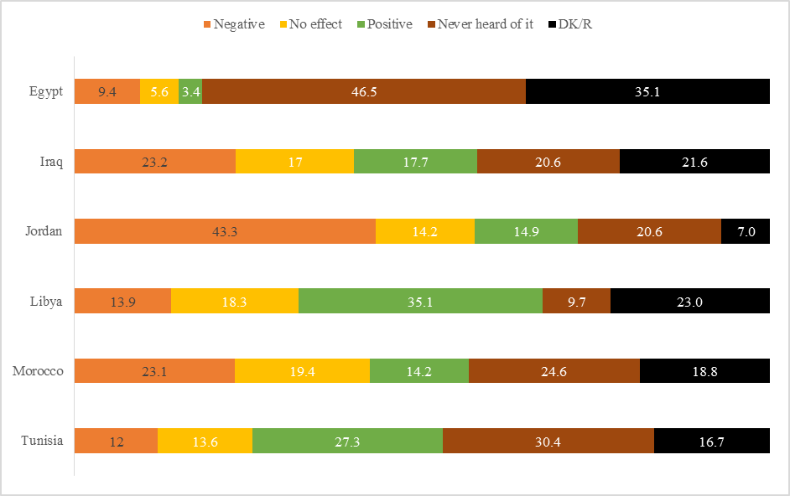
Assessment of EU programs in response to the Arab Uprisings (%)
Source: Arab Transitions, 2014

Slide 6
What policy do you think would be the most positive thing the EU could do in your country?
Source: Arab Transitions, 2014

Slide 7
The EU should provide support for our country (%)
Source: Arab Transitions, 2014

Slide 8
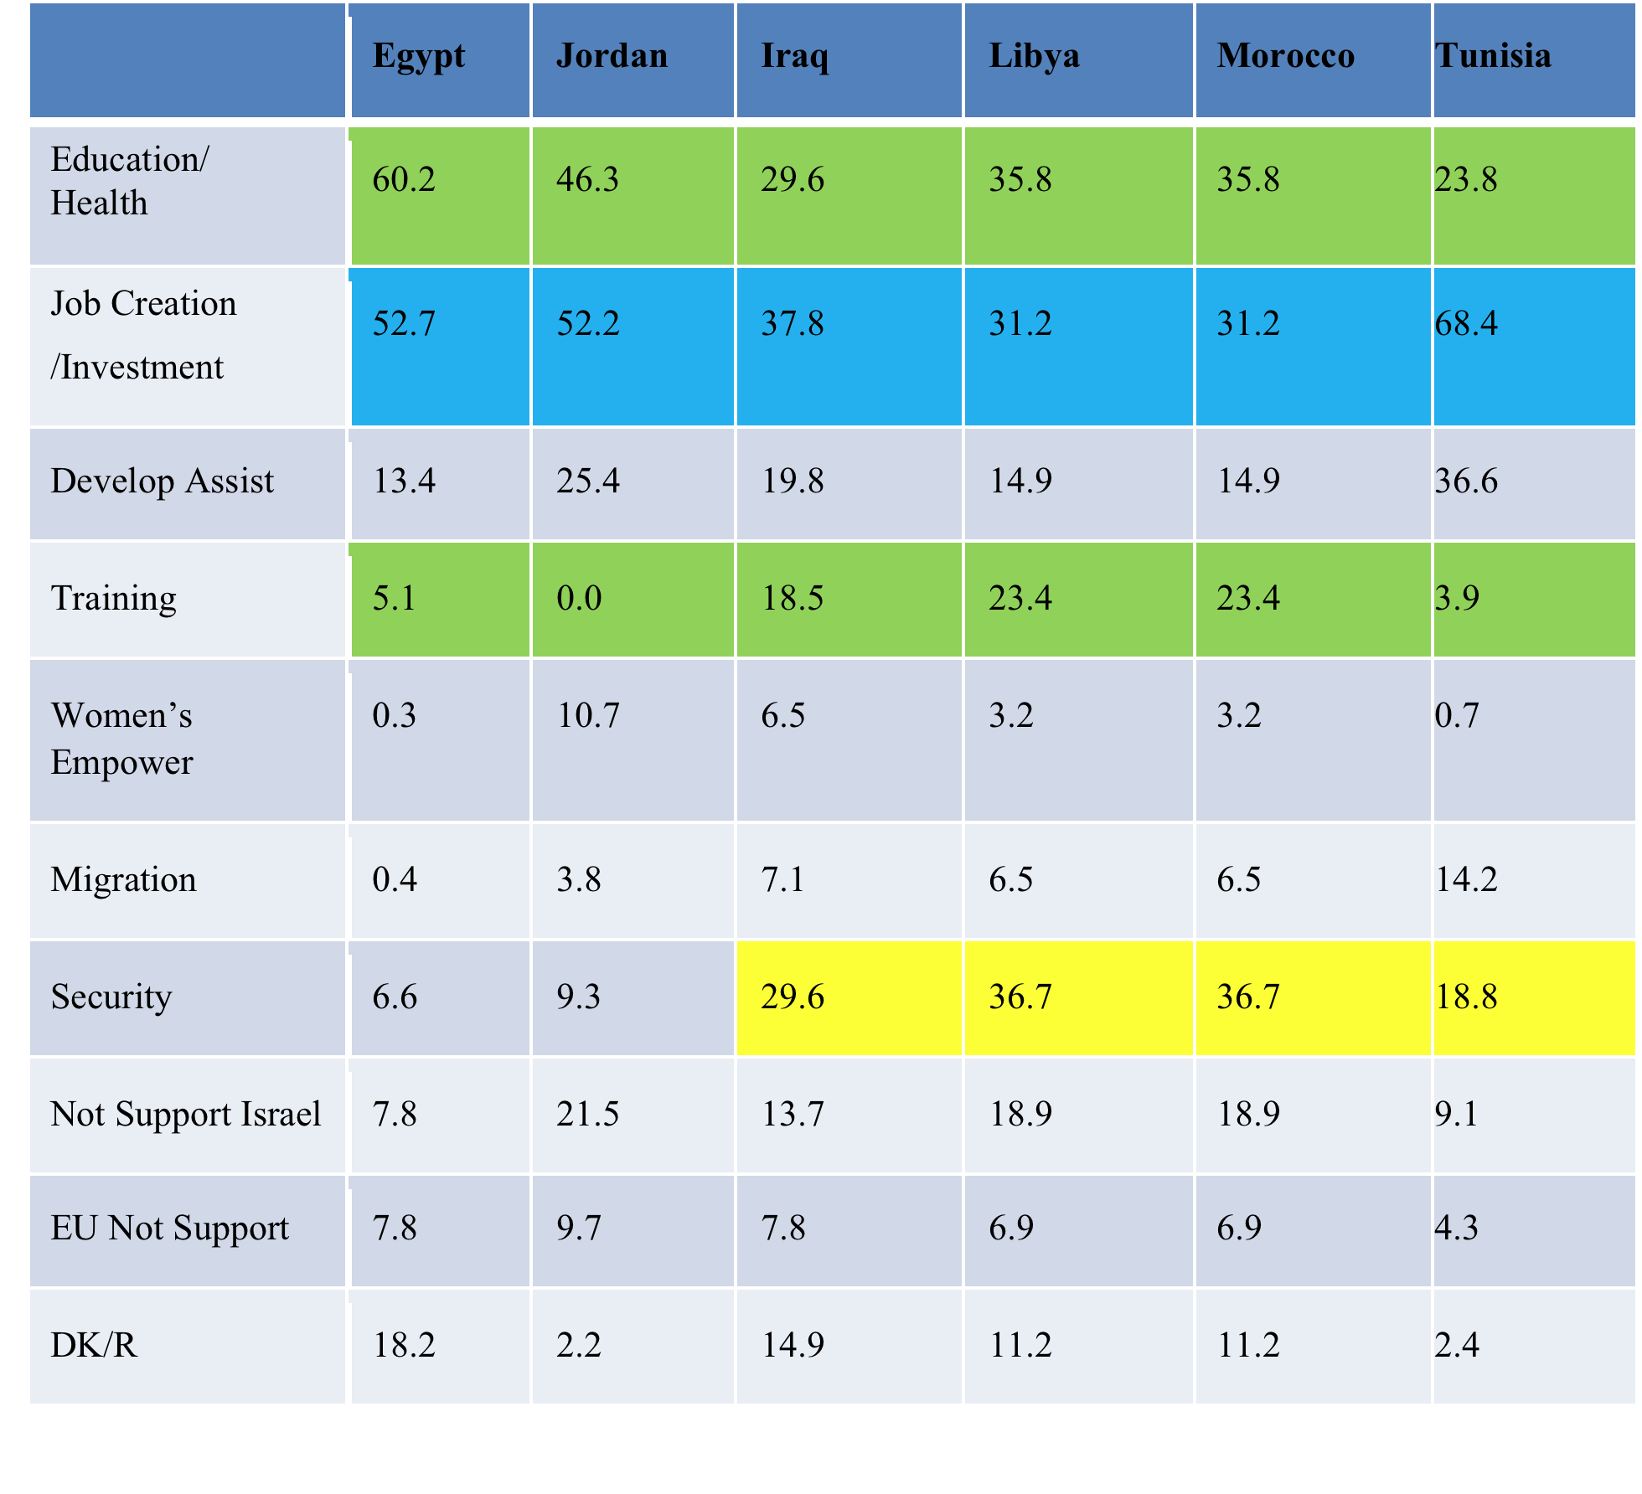
Most positive policy that the EU could influence in country, %
Source: Arab Transitions, 2014

Slide 9
Influence of EU on development of democracy in your country (%)
Source: Arab Transitions, 2014

Slide 10
Perceptions of the EU as having a stabilising/destabilising influence (%)
Source: Arab Transitions, 2014

Slide 11
Countries having a stabilising influence (%)
Source: Arab Transitions, 2014

Slide 12
Countries having a destabilising influence
Source: Arab Transitions, 2014

Slide 13
Conclusions
Lack of knowledge on EU cooperation programs in most surveyed countries
Socio-economic domains have been identified as the main sectors where the EU support should be focused
The EU is perceived as having a stabilising influence only in Libya, Morocco and Tunisia. In general, when compared to other international or regional players it is not considered as a destabilising actor.

Slide 14
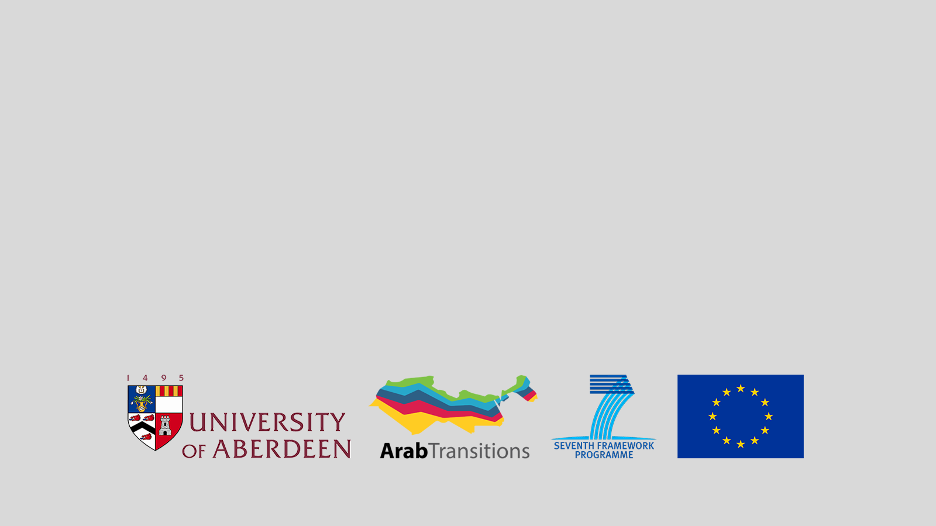
Thank you!

