Slide 1
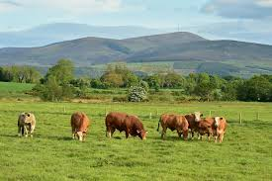
How can we ensure farmed animals flourish?

Slide 2
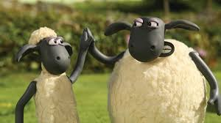
STARTER: High-Five Re-cap
In pairs come up with five reasons why some Christians believe they have a duty to care for farmed animals.
When you have done this, high-five your partner. Who will be the fastest pair? You will have to verify your answers with the class!

Slide 3
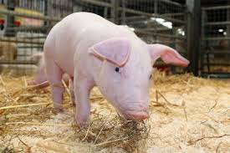
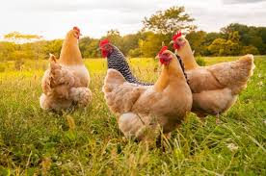
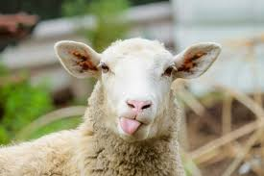
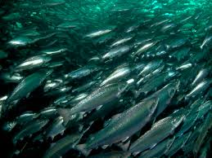
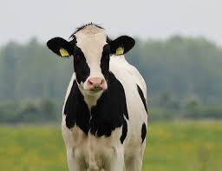
Group work
Each group will be assigned an animal and be provided with an information sheet. Your job is to create a short PowerPoint that explains how your animal could be best allowed to flourish in farming conditions.

Slide 4
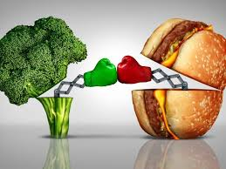
Plenary: DEBATE
“It is OK for Christians to eat meat.”
Think back to your studies over the past few lessons. Each corner of the classroom represents a different stand-point on this issue. You need go to the side that matches your view and be prepared to defend it! You will also want to convince others to join your cause!
The four options are:
Christians should eat meat and not worry about farmed animal welfare.
Christians should eat meat but ensure farmed animals have the best welfare possible.
Christians should be vegetarian.
Christians should be vegan (this is where they do not consume any products from animals, including meat, milk and eggs).

