Slide 1
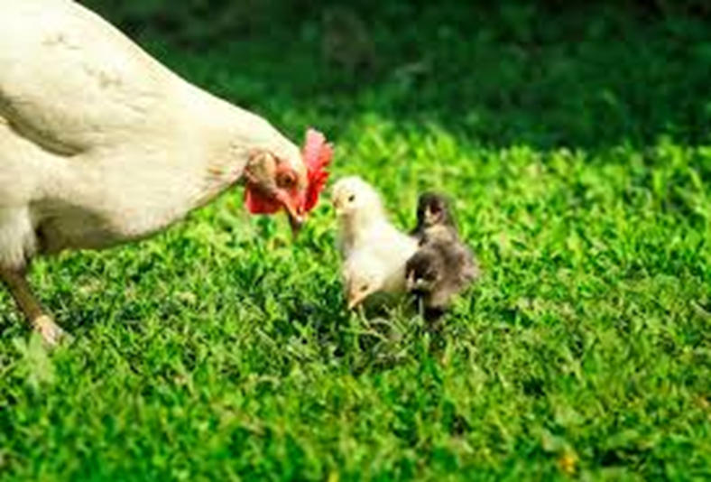
How does our worldview on animal welfare affect the choices we make?
Lesson Objectives:
Identify values that are important to you when it comes to animal welfare.
Investigate the meaning behind food logos.
Evaluate how animal welfare may affect your shopping habits.

Slide 2
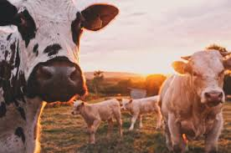
STARTER: What can we do about animal welfare?
Watch the video clip. Are there things YOU could do to help improve animals welfare?

Slide 3


TASK: Fill in the grid.
What is your current worldview on how Chickens should be treated when producing eggs for us to eat?
Chickens farmed for eggs | /
Access to range (roam freely) required
Cages banned
Beak trimming banned (to prevent damage to other birds)
Welfare outcomes monitored
Pre-slaughter stun required
Group size limited to 3000
Male chickens not killed
Chicks required to be reared with mother hens
Notes:
There’s blank space at the bottom of the table for any other ideas that students think should be included. Some classes will benefit from a general discussion before filling in the sheet. There’s a page of pictures for inspiration to aid conversation here.

Slide 4





Which of these logos can you find on your eggs?
How do you feel about seeing these logos?
Do you trust them?
Are you pleased to see them there?
Why do you think they are put on our products?
Notes:
Ideally homework last week would be set to bring in a range of empty egg boxes. You could do this yourself in preparation for the lesson or put together a sheet of pictures of egg boxes.

Slide 5
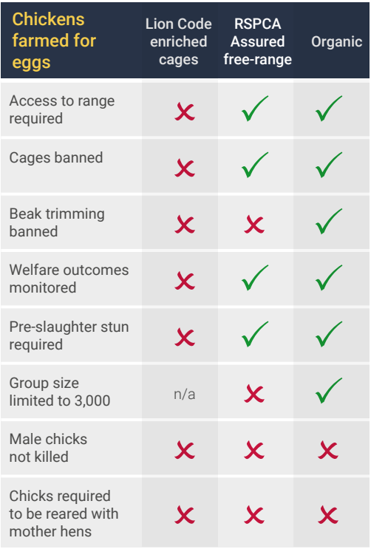
Have a look what these symbols mean and compare them to your tick list…do they fall short, meet or exceed the standards you’d like to see on the farm you began planning last lesson?

Slide 6
TASK: Fill in the grid.
What is your current worldview on how pigs should be treated?
Docking an animal’s tail is the common practice of shortening the length of the tail. For practical reasons it is done to avoid fly strike and to reduce fecal soiling.
Pigs | /
Access to pasture required in grazing season
Tail docking banned
Castration banned
Welfare outcomes monitored
Nose-ringing banned
Access to outdoors
Minimum weaning age 45 days
Pre-slaughter stun required
Castration is the destruction or removal of the testicles of the male. It is carried out on animals which are not wanted for breeding.
Notes:
Depending on the time available in the lesson slide 9-11 can be missed out for the same aims to be achieved.
As before, there’s blank space at the bottom of the table for any other ideas that students think should be included. Some classes will benefit from a general discussion before filling in the sheet. There’s a page of pictures for inspiration to aid conversation here.

Slide 7


Which of these logos can you find on the images of products that come from pigs?
Notes:
Ext – discuss how students feel about seeing these logos. Do they trust them, are they pleased to see them there?

Slide 8
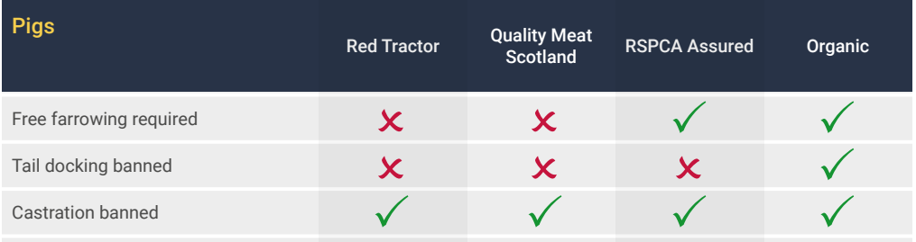
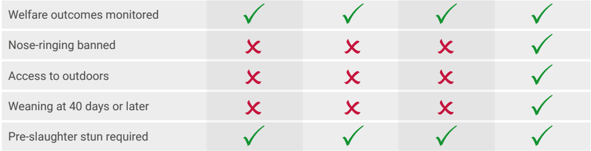
Have a look what these symbols mean and compare them to your tick list…do they fall short, meet or exceed the standards you’d like to see on the farm you began planning last lesson?

Slide 9
Reflection Time Questions:
What are the key findings you’ve made in your investigation today?
Are you surprised about any of your findings? Give examples in your answer.
How far do you think the badge systems on this product meet all that’s required for the animals to flourish?
In what ways has this made you think about your world views about animal welfare?
What changes would you recommend to others who wish to adapt their shopping habits to meet higher animal welfare standards?
Notes:
These could be used for class/group discussions or for personal reflection in their books. For a more interactive approach the question cards could be cut out for group discussion.

Slide 10
Plenary:
Summarise your worldview on animal welfare. Start, ‘Animals should be treated… because….’
Do you think these values should impact the way you shop? Explain your answer.
Extension – how does this compare with the Christian view you have studied in previous lessons?
Notes:
To be written in students' books as a summary of their investigation.

Slide 11
CLASS VOTE!
Will your world view on animal welfare affect the choices you are likely to make in the future?
AGREE
DISAGREE

Slide 12
To consider following this lesson:
‘If farmed animals are given more opportunities for flourishing, it will make animal products more expensive. Can you think of ways to avoid this making food unaffordable for some people?’
Notes:
This is a type of exit question (something for the students to keep the students thinking and talking after they leave the room) or it could be set as a homework.

