Slide 1
Day 1. Trials methodology

Slide 2
#Red4Research 2024 is on 20th September! It brings together individuals who participate in, support, or conduct health research. So, this week, we’ll share how different disciplines contribute to our clinical studies. Watch this space between the 16th and 20th of September! 👀

Slide 3
📏Looking at how we plan, do and share the findings of clinical trials (clinical study type) is called Trials Methodology. This is a way of us thinking whether there might be a better way to do trials. This video explains what it is and why it matters: https://www.youtube.com/watch?v=6sd7pV8XTRY

Slide 4
📏Ever wonder why trials are done the way they are?🧐Join us as Prof. @GilliesKatie covers some of the aspects of the methodology of clinical trials that we're particularly interested in @hsru_aberdeen. Check the facts!👇
Threads:
Fact: There's a lot of research into how to do trials. This research helps us test and refine our approaches, ensuring trials are well designed and tell us what works and what doesn't.
Fact: Well-designed trials have plans to keep people involved all the way through, making sure the study's findings are solid.
Fact: We need different kinds of people to participate - especially those groups impacted by the condition being studied. This way, we can be sure what we learn helps everyone.
Fact: Numbers matter, but it's about the right balance. We calculate how many people we need to make sure our results are accurate, and a trial done efficiently.
Fact: Strategies such as community engagement and targeted outreach are effective in increasing trial diversity and representation.
Fact: Simplicity in trial design can often lead to clearer, more straightforward insights.
Fact: Clinical trials, like any large-scale operation, have a significant environmental footprint, involving extensive travel, material use, and energy consumption. Recognising this, we research how to make clinical trials more sustainable.

Slide 5
📏We have diverse trials methodologists - @shauntreweek's https://www.trialforge.org/ focuses on trials design, conduct and analysis. @GilliesKatie specialises in using behavioural science in trials. @beagoulao improves the relevance & communication of health evidence. #Red4Research

Slide 6
Day 2. Public involvement in clinical trials

Slide 7
🤝 The phrase “nothing about us without us" was first used by disability rights activists calling for stakeholder involvement in policy-making. In this video, the population underrepresented in trials explain the importance of their involvement in trials: https://www.youtube.com/watch?v=JMoVec6R0uM

Slide 8
🤝 Patient and public involvement and engagement (PPIE) in clinical studies matters at @hsru_aberdeen. Join us as our @RzewuskaM shares her perspective on PPIE in trials 👇
Add:
Public and patients bring valuable lived experiences and perspectives to clinical studies, which can enhance the quality of studies by offering different insights compared to scientists.
Involving diverse voices in clinical research is crucial as it fosters innovation, ensures inclusivity, and meets the needs of various communities, promoting fairness and equity.
Various ways exist for involving the public in clinical trials, ranging from consultation to full collaboration as equal partners. Those involved contribute to designing the study, resolving issues, recruiting participants, and communicating findings.
Their involvement ensures adherence to ethical standards, the study's relevance, and ease of trial participation. Thanks to this more people want to join and stay in the study, and they trust the results more.
Involvement in research is a democratic right of the public and patients, and often, this involvement holds personal significance for them.
Public and patient involvement is not strictly a scientific technique. Any involvement is better than none, but how well it works can vary. That's why we're studying it to find the best ways to do it.
We've got set procedures for how we involve the public and patients in clinical trials, based on what we know works well. This shows we're dedicated to doing it.

Slide 9
🤝 Did you know that children can design, run, analyse and report clinical trials? 🤯 Have a look at the START Competition result https://startcompetition.com/, which @shauntreweek had a pleasure to judge! 😊

Slide 10
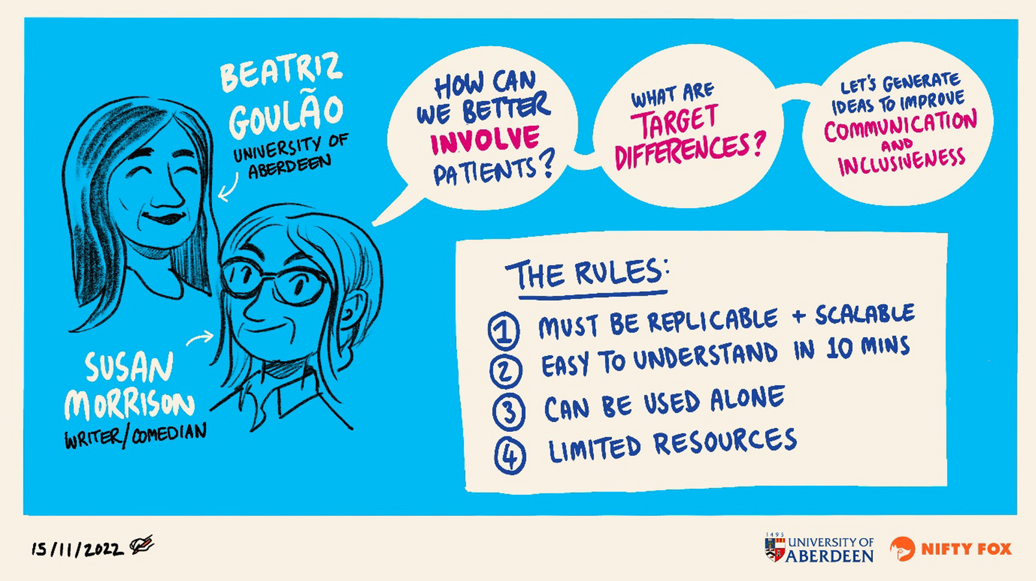
🤝 At ACE, we believe in making patient and public involvement and engagement (PPIE) a responsibility of all researchers. @RzewuskaM, our PPIE lead, guides strategy and aid delivery. 🛠️ Our team also research PPIE, for example, @beagoulao study the use of creative art in trials. 🎨 #Red4Research
Add: https://researchinvolvement.biomedcentral.com/articles/10.1186/s40900-024-00560-8

Slide 11
🤝 Since 2017, ACE (formerly HSRU) has had a diverse remarkable group of public research partners. They support the entire centre and contribute to specific projects. This is the first of this kind group in Scotland! 👏😮 #Red4Research See who they are: https://www.abdn.ac.uk/hsru/what-we-do/ppie/getting-to-know-1222.php

Slide 12
Day 3. Clinical trials

Slide 13
⚖️📝Scientists and healthcare professionals use something called a randomised controlled trial (RCT) to give them information that we can trust that helps us make the best choice in health care. Watch kids break it down simply in this short video: https://www.youtube.com/watch?v=JkROr1XQ7g4&t=77s

Slide 14
⚖️📝Interested in learning how clinical trials work? 🧐 Our Prof. Graeme MacLennan and @SMWileman share facts about them! 👇
Add:
Fact: Trials can test new drugs, but also explore new surgical techniques, medical devices, lifestyle changes, and preventive measures to improve health outcomes.
Fact: Participant safety and welfare is the top priority, with rigorous ethical standards and close monitoring for safety.
Fact: Clinical trials need a diverse range of participants, including healthy individuals.
Fact: Placebos are rarely used without informing participants, and many trials compare new treatments to the best current treatment, not just a placebo.
Fact: Most costs related to participating in a trial are covered by the study, not participants, making it accessible for participants.
Fact: Trials are conducted in various locations, including community clinics and through virtual platforms. Accessibility is broader than you think.
Fact: Anyone can search for and apply to join a clinical trial. Resources like https://bepartofresearch.nihr.ac.uk/, clinicaltrials.gov and our CHaRT trials’ portfolio help to find one that fits.

Slide 15
⚖️📝Our Centre for Healthcare Randomised Trials (CHaRT) is part of the UK Clinical Research Collaboration network. Led by Prof Graeme MacLennan, a core team, alongside 30+ interdisciplinary members, works with researchers nationwide on trials, incl. REBOA 👇 #Red4Research
ADD CHaRT’s Trials: https://www.abdn.ac.uk/hsru/what-we-do/trials-unit/index.php

Slide 16
⚖️📝Did you know that CHaRT offers its own bespoke course teaching designing real-world trials? Check it out: https://on.abdn.ac.uk/courses/designing-real-world-trials/.🤓 In this video, Graeme and Shaun discuss the PRECIS-2 tool covered in the course: https://www.youtube.com/watch?v=yIywQWXdtzI

Slide 17
Day 4. Process evaluation in clinical trials

Slide 18
💬📝To better understand process evaluations in clinical trials join us as @SharonKMcCann our process evaluation team lead explains key aspects of the 'how' and 'why' behind process evaluations in trials. Check the facts! 👇
Add:
Fact: Process evaluations can be used in different ways, e.g. to focus on how well a trial intervention is implemented, or to support trial recruitment by identifying challenges relating to trial design and or conduct that could be addressed and modified.
Fact: Intervention outcome measures (or indicators) tell us what happened, but process evaluations can help explain why an intervention does well (or not)- uncovering underlying reasons for the success or failure of an intervention.
Fact: Understanding why an intervention failed or succeeded is essential for replicating results across different settings or populations.
Fact: While adding complexity to study design, process evaluations can play a crucial role in the evaluation and understanding of intervention implementation or to support trial recruitment challenges.
Fact: The insights gained from process evaluations can optimise resource allocation in the long run by helping to refine and choose interventions more effectively, or to address key problems in relation to trial recruitment during pilot stage.
Fact: Overall, process evaluations can add value to trials of all sizes by identifying factors contributing to intervention success/failure or to identify recruitment challenges relating to trial design or conduct that could be modified.

Slide 19
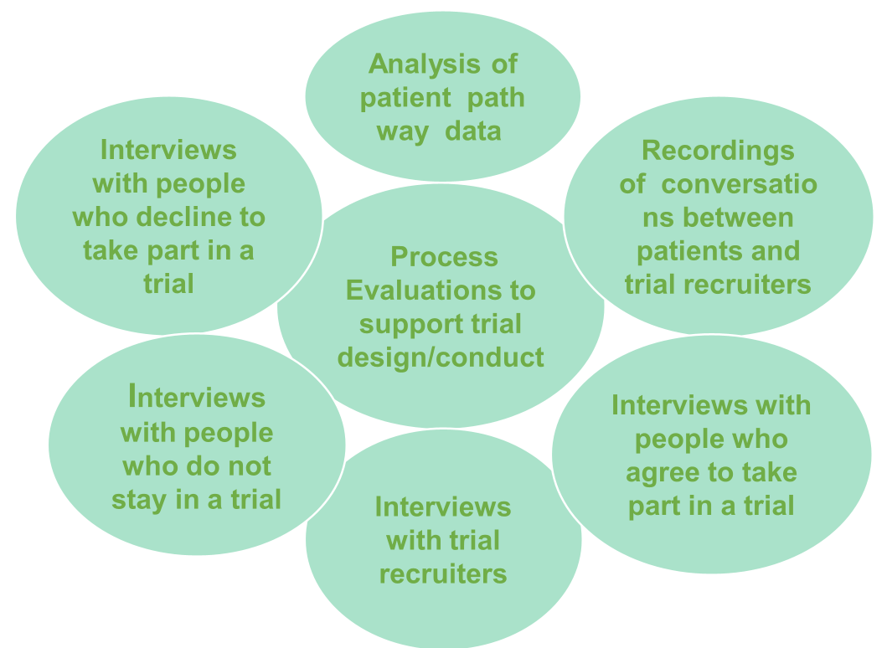
💬📝 Process evaluations can be used in different ways, such as supporting trial recruitment efforts by identifying challenges relating to trial design and conduct that could be modified during piloting. Below are some of the ways we do this.

Slide 20
💬📝Process evaluations can play a crucial role in assessing and understanding trial interventions (specific action or treatment being tested in a trial). Check out the commonly used data collection and analysis methods used for this purpose, described by Moore et al. (bmj.h1258).

Slide 21
💬📝 Our process evaluation team interviews trial participants to understand their views on interventions such as smart inhalers and treatment algorithms below. @SharonKMcCann & @RNNewlands work with trial teams and healthcare experts. #Red4Research

Slide 22
Day 5. Evidence synthesis of clinical studies

Slide 23
🔍📚 It's very important that we don't focus on one study or piece of information to make healthcare decisions. Using evidence synthesis prevents this. This brief and accessible video explains what evidence synthesis is and why it matters: https://www.youtube.com/watch?v=xGdZQNHC8-k

Slide 24
🔍📚 Understanding the world of evidence syntheses of clinical studies.🧐 Join us as our Miriam Brazzelli goes through important aspects of bringing together information from clinical studies. Check the facts! 👇
Threads:
Fact: Evidence syntheses use transparent and reproducible methods to gather, review, and bring together evidence from multiple clinical studies to generate robust conclusions about health interventions, technologies, or health policies.
Fact: The process of gathering and assessing evidence from clinical studies is meticulous, time-consuming and requires expertise in both the topic area and research methodology.
Fact: Quality and relevance of data from clinical studies vary; when conducting an evidence synthesis, rigorous analyses ensure only reliable data inform conclusions.
Fact: Evidence syntheses can focus on summary (aggregate) data, individual participant data or both according to the research questions they need to address. The use of individual participant data allows a more in-depth analysis of participants' characteristics and more reliable and informative conclusions.
Fact: Evidence syntheses can help decide what works for whom and in which situations and inform future research.
Fact: Patients, policymakers, and practitioners use the findings of evidence syntheses to make informed healthcare decisions.

Slide 25
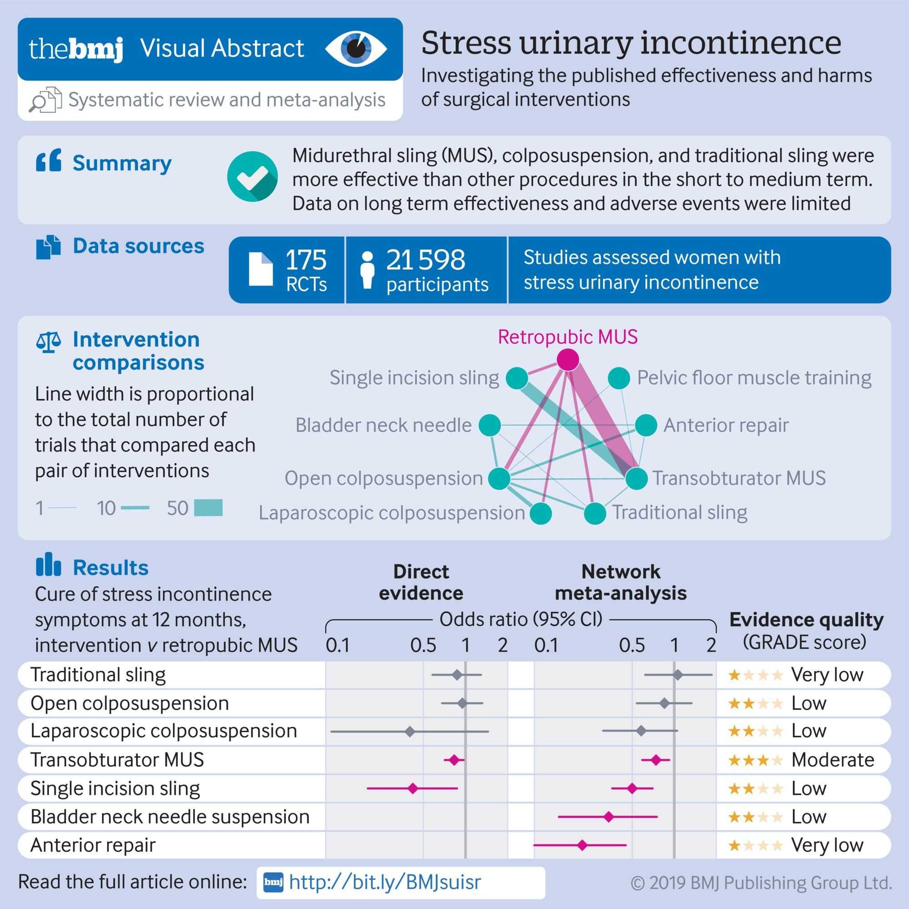
🔍📚 Our evidence synthesis team assess evidence from clinical studies to guide healthcare decisions, such as decisions about women’s health. Our core team - Miriam, Clare, Kusum, Mari and Moira - work closely with statisticians and healthcare experts. #Red4Research

Slide 26
🔍📚 Did you know that Prof Miriam Brazzelli has secured a significant NIHR grant to establish the Aberdeen Belfast Evidence Collaboration (ABEC), which aims to enhance health and social care through robust evidence syntheses?
😮 £3,337,561.07
🗓️ April 2023 - April 2028
Add: https://fundingawards.nihr.ac.uk/award/NIHR153880

