Slide 1
REGULATING PETROLEUM ACTIVITIES TO PROTECT FRAGILE ARCTIC ENVIRONMENTS: ARE CURRENT MEASURES ENOUGH TO PREVENT OIL SPILLS?
Dr Tina Hunter
University of Aberdeen Centre for Energy Law
Presentation at the University of Akureyri, Iceland, 7 April 2015.

Slide 2
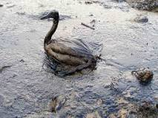
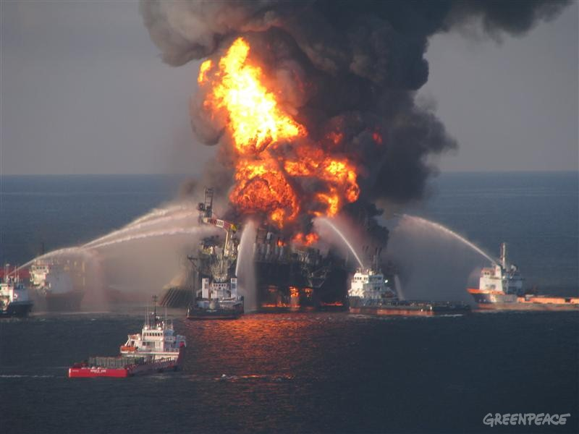
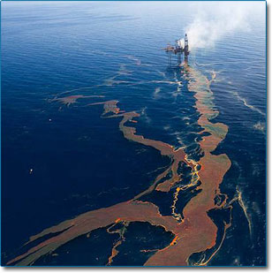

Slide 3
1. How do we regulate petroleum activities?

Slide 4
2. Oil spill prevention
Comprises three areas
Legal regime
Platform safety to prevent explosions/spills
(most spills in production phase from platform incidents)
Environmental regime
Well integrity/WOMPS (ALARP vs GOP)
Science, particularly geosciences (understanding of reservoir and surrounding geology)
Most blowouts occur in exploration wells
Engineering
Well construction
Use of standards, guidelines and advice
NORSOK, API, DNV

Slide 5
Concepts of ALARP and GOP
ALARP is a safety/engineering term
ALARP is all about risk
Identify
Manage risk
reduce risk to As Low as Reasonably Practicable
Compare this to GOP
mint juleps and country clubs?
ECONOMICS SHOULD NOT BE A FACTOR IN ALARP
See Disasterous Decisions by Andrew Hopkins. (CCH, 2013)

Slide 6
3. Are Current preventative measures good enough?
Generally NO!
Focus on response rather than prevention
Wide diversity in standards and requirements by regulators
Focus on oil spill response
Some focus on well control
Norway– 12 days
Greenland similar to Norway
Canada NEB – same season relief well (but backing away from this?)

Slide 7
Deepwater Horizon
Also known as the Macondo blowout
‘complex systems almost always fail in complex ways’
space shuttle ‘Challenger’
Causes
Cementing of shoe
Lack of barriers
Depth
Technology race
Regulation not keep up with technology
MMS
Profit before safety?
Response
wait and see
hair
dumping garbage
topkill
robotic arm

Slide 8
Why is well integrity important?
What prevents groundwater damage or well blowout
No single HF caused damage… is Loss of well control or failure of integrity of the well..
Don’t want wells to leak – when wells leak need environmental response

Slide 9
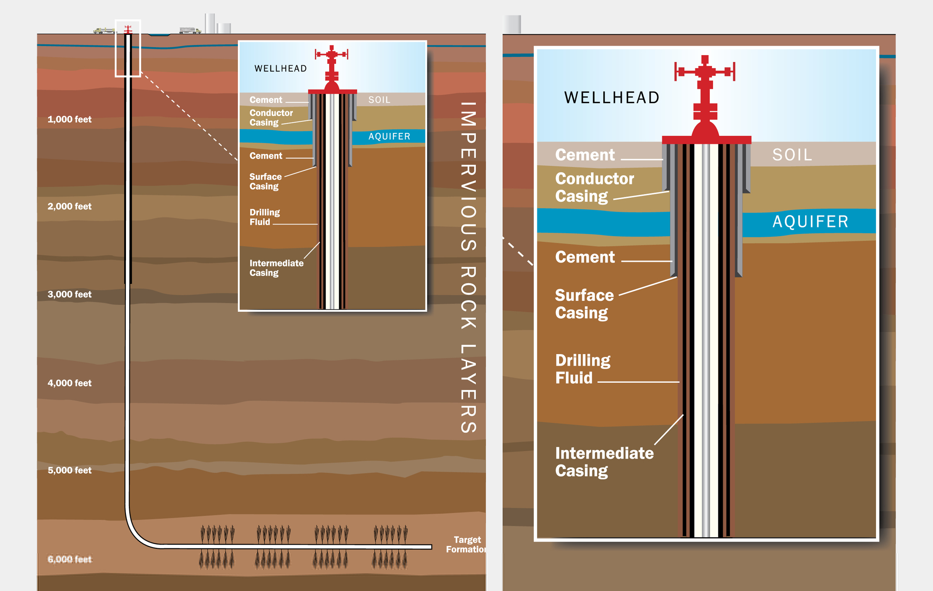
Well integrity

Slide 10
3. Are current preventative measures good enough (continued)
Tackle oil spill prevention and response as legal requirment under the regulatory framework
Need understanding of role of approval, inspection, compliance, monitoring and enforcement
Need for multidisciplinary approach
Law
ALARP vs GOP
Variable quality of well required – NORSOK vs API
importance of inspection not just approvals
Science
understanding of reservoir and the behaviour of target formations
Engineering
well construction and control – function of engineering not law!
Ageing platforms

Slide 11
4. How can we prevent oil spills?
Legal - regulation should
Take into account unique issues related to environment – access, response time, etc, when setting legal requirements
demand ALARP as standard and accept nothing else
Rely on reducing risk rather than what everyone else is doing elsewhere in the world
Adopt NORSOK Standard D-010
Insist on well inspections during construction and well-ops, not just approval of well plan
Real-time monitoring of well data (barrier)
Watch the new kids on the block and minnows
Achievable relief well capability
Second drill rig present at all times

Slide 12
4. How can we prevent oil spills? (cont)
Geoscience
Gain extensive knowledge of reservoir PRIOR to drilling
3D Seismic survey (even 4D?)
Understand the role of depth of reservoir, water depth and overlying geology structure plays in well engineering (esp HPHT Wells)
Friction, temperature, pressure
Cairn Energy – use of Ultrahib as lubricant – toxin/slow to dissipate
Engineering
Well-ops plan – use of best available standards
Risk assessment of WOPb ALARP not GOP
Inspection during construction for compliance to approved well plan

Slide 13
4. How can we prevent oil spills? (continued)
Liability
Set liability in a manner that discourages spill
Eg strict liability in Norway
Liability bonds ($2 billion guarantee in Greenland)
Remove liability caps
Arctic Council
Move from soft law to binding law
Tackle the ‘hard’ issues of liability and same season releif well capability

Slide 14
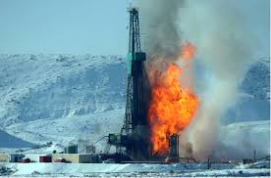
… AND THIS IS ON LAND!

Slide 15
Take-Aways
Not just a regulatory issue
Needs co-ordinated, multi-disciplinary framework and research
Regulators need knowledge to for compliance and enforcement
Inspection is key
Demand highest possible standards
Remove liability caps
Arctic Council to address the hard issues and have ‘teeth’ to address these hard issues

