Slide 1
Webinar 1: The scientific goals of ExoMars and HABIT, payloads and their measuring methodologies
Miracle Israel Nazarious
22/09/2021

Slide 2
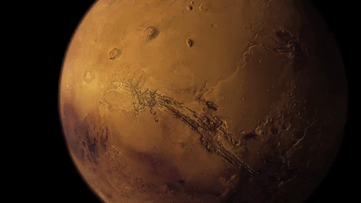
Why Mars?
Department of Planetary Sciences

Slide 3
@MarsWxReport
Average distance from the Sun | 149,597,891 km (1 AU) | 227,936,637 km (1.524 AU)
Equatorial Radius | 6378 km | 3397 km
Length of the day | 24 hours | 24 hours, 37 minutes
Length of the year | 365 days | 687 Earth days (1.88 Earth years)
Tilt of axis towards Sun | 23.45° | 25°
# of natural satellites | 1 (Moon) | 2 (Phobos = Fear, Deimos = Panic)
Gravity | Thanks to Newton! | 1/3rd of Earth
Mass and volume | 5.9722×10²⁴ kg | 1/10th of Earth and would need more than six Mars to fill Earth
Surface temperature | -89.2 °C (Vostok station, Antarctica) to 70.7 °C (Lut Desert, Iran) | -125 °C (at poles in winter) to 20 °C (near equator in summer)
Sea level atmospheric pressure | 1013 mbar | 7.5 mbar (100 times thinner atmosphere)

Slide 4
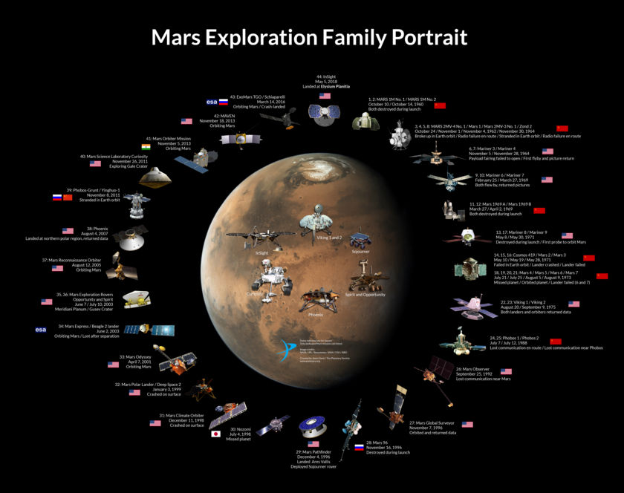
Credit: NASA / JPL / Roscosmos / JAXA / ESA / ISRO / Jason Davis / The Planetary Society
8 active orbiters, 2 lander, 3 rovers, 1 helicopter and more to join the fleet
Department of Planetary Sciences

Slide 5
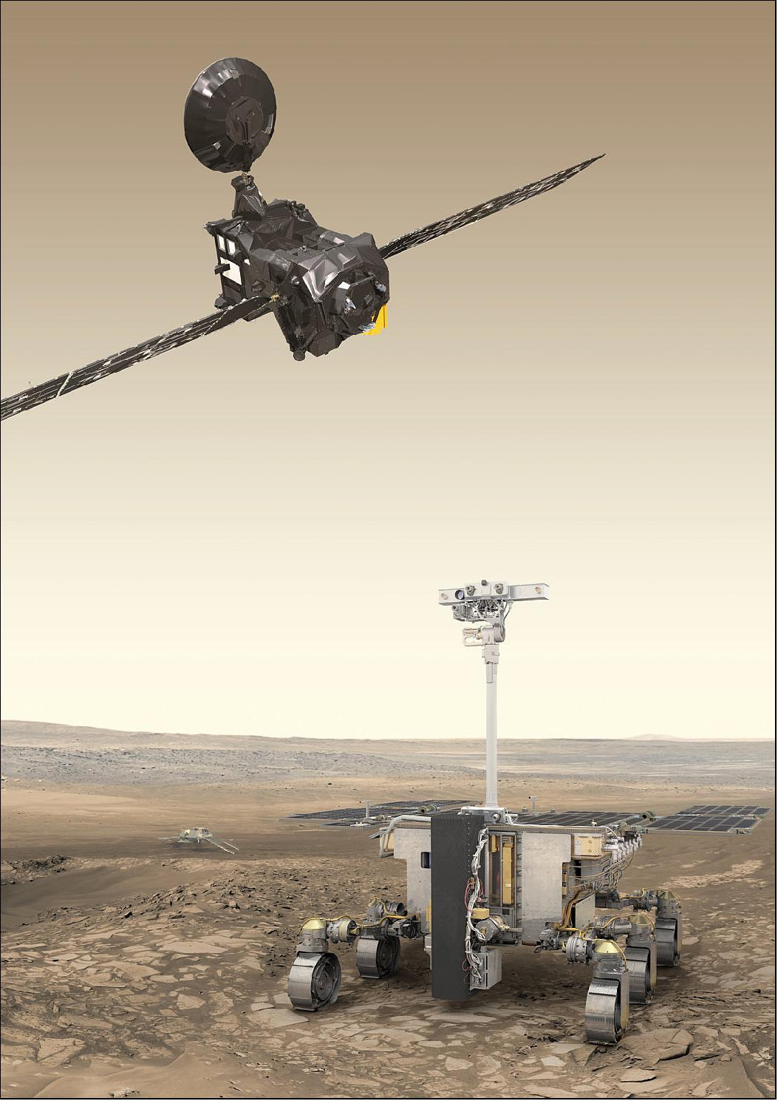
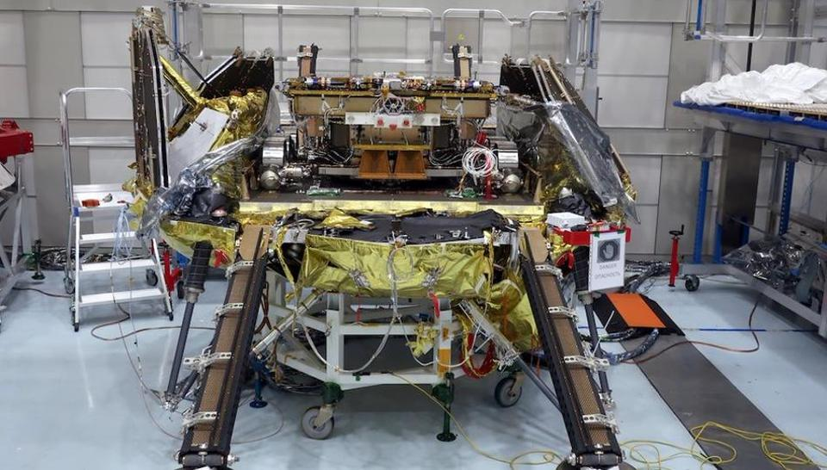
Goal: Search for past and present life on Mars
ExoMars 2022 Rover and Surface Platform scheduled for launch in September 2022
TRACE GAS ORBITER
'ROSALIND FRANKLIN' ROVER
'KAZACHOK' SURFACE PLATFORM
HABIT
M.-P. Zorzano
5

Slide 7
Scientific objectives of ExoMars mission
To search for signs of past and present life on Mars (Rover)
To investigate the water/geochemical environment as a function of depth in the shallow subsurface (Rover drill)
To study Martian atmospheric trace gases and their sources (Trace Gas Orbiter, Rover)
To characterize the surface environment (Surface Platform)
Department of Planetary Sciences

Slide 8
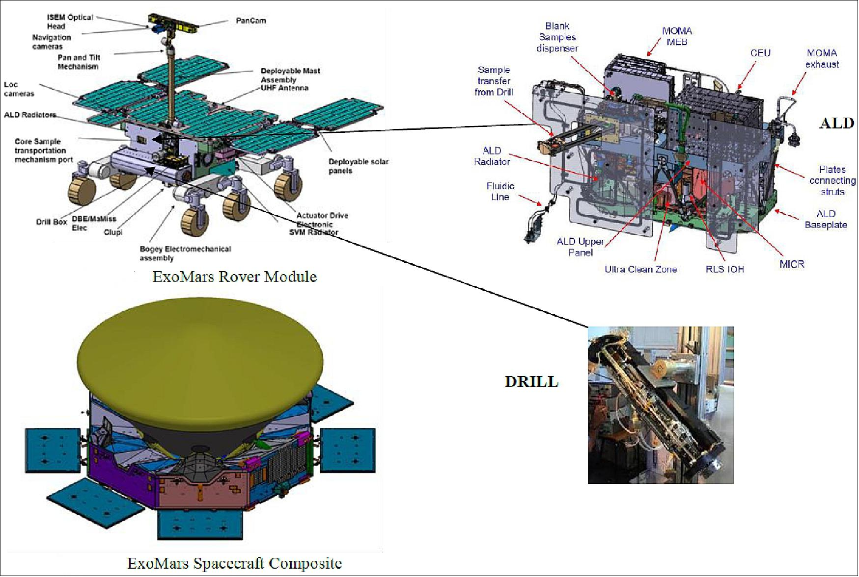
Payloads and their measuring methodologies
Rover:
https://exploration.esa.int/web/mars/-/45103-rover-instruments
Department of Planetary Sciences

Slide 9
Payloads and their measuring methodologies (contd.)
Surface Platform:
https://exploration.esa.int/web/mars/-/56933-exomars-2020-surface-platform
Department of Planetary Sciences

Slide 10
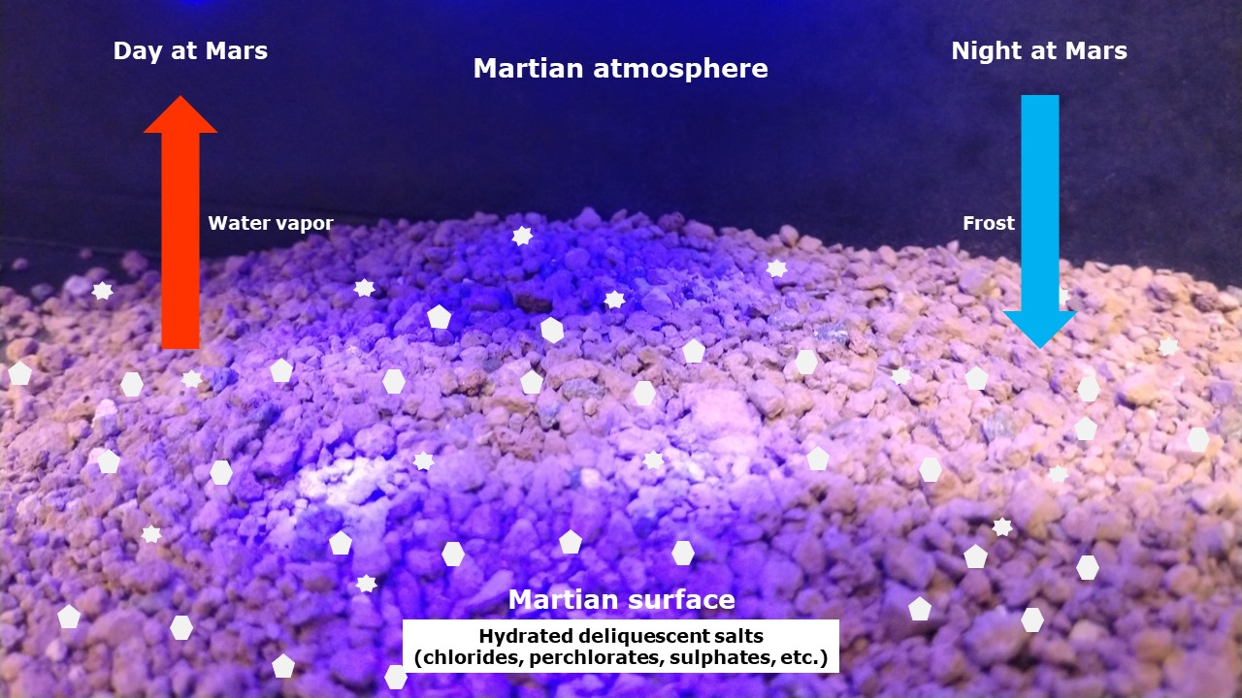
Water cycle on Mars

Slide 11
ExoMars 2022 mission:
HABIT - HabitAbility: Brines, Irradiation and Temperature

Slide 12
Experiment kit
Salt for conducting 3 experiments in varying conditions (indoor, outdoor, etc)
With operating and safety instructions
included
Department of Planetary Sciences

Slide 13
Hygroscopic salts
Tendency to absorb moisture from the air
Some of the hygroscopic salts on Mars:
Calcium Chloride
Magnesium Chloride
Sodium Chloride
Ferric Sulphate
Magnesium Sulphate
Calcium Perchlorate
Magnesium Perchlorate
Sodium Perchlorate
Calcium Chloride
Department of Planetary Sciences

Slide 14
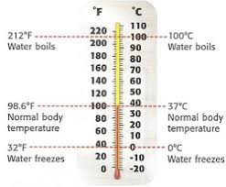
Temperature
Intensity of heat present in a substance or object
Measure of hotness or coldness
Unit: °C, °F, K
Department of Planetary Sciences

Slide 15
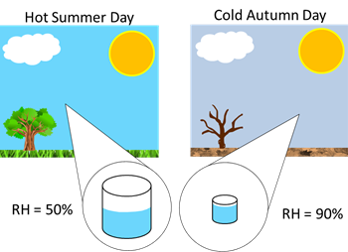
Relative humidity
Measure of how much water vapor is in the air, compared to how much it could hold at that temperature. Unit: %
For example, a relative humidity of 50 percent means the air is holding one half of the water vapor it can hold
Relative humidity of 100% does not necessarily mean that rain is falling. It just means that the air is holding as much moisture as it can at a given temperature, in the form of water vapor.
Department of Planetary Sciences

Slide 16
Hydration or deliquescence
Tendency to absorb moisture from the air and dissolve in it
Department of Planetary Sciences

Slide 17
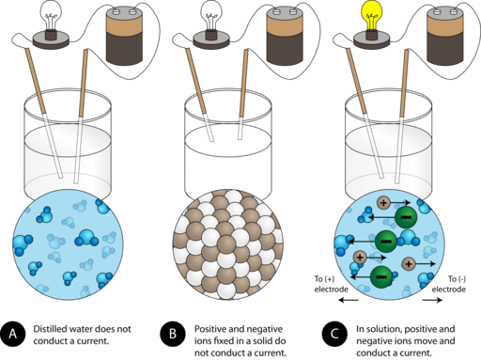
Electrical conductivity
Level at which a substance allows electricity to pass through
Department of Planetary Sciences

Slide 18
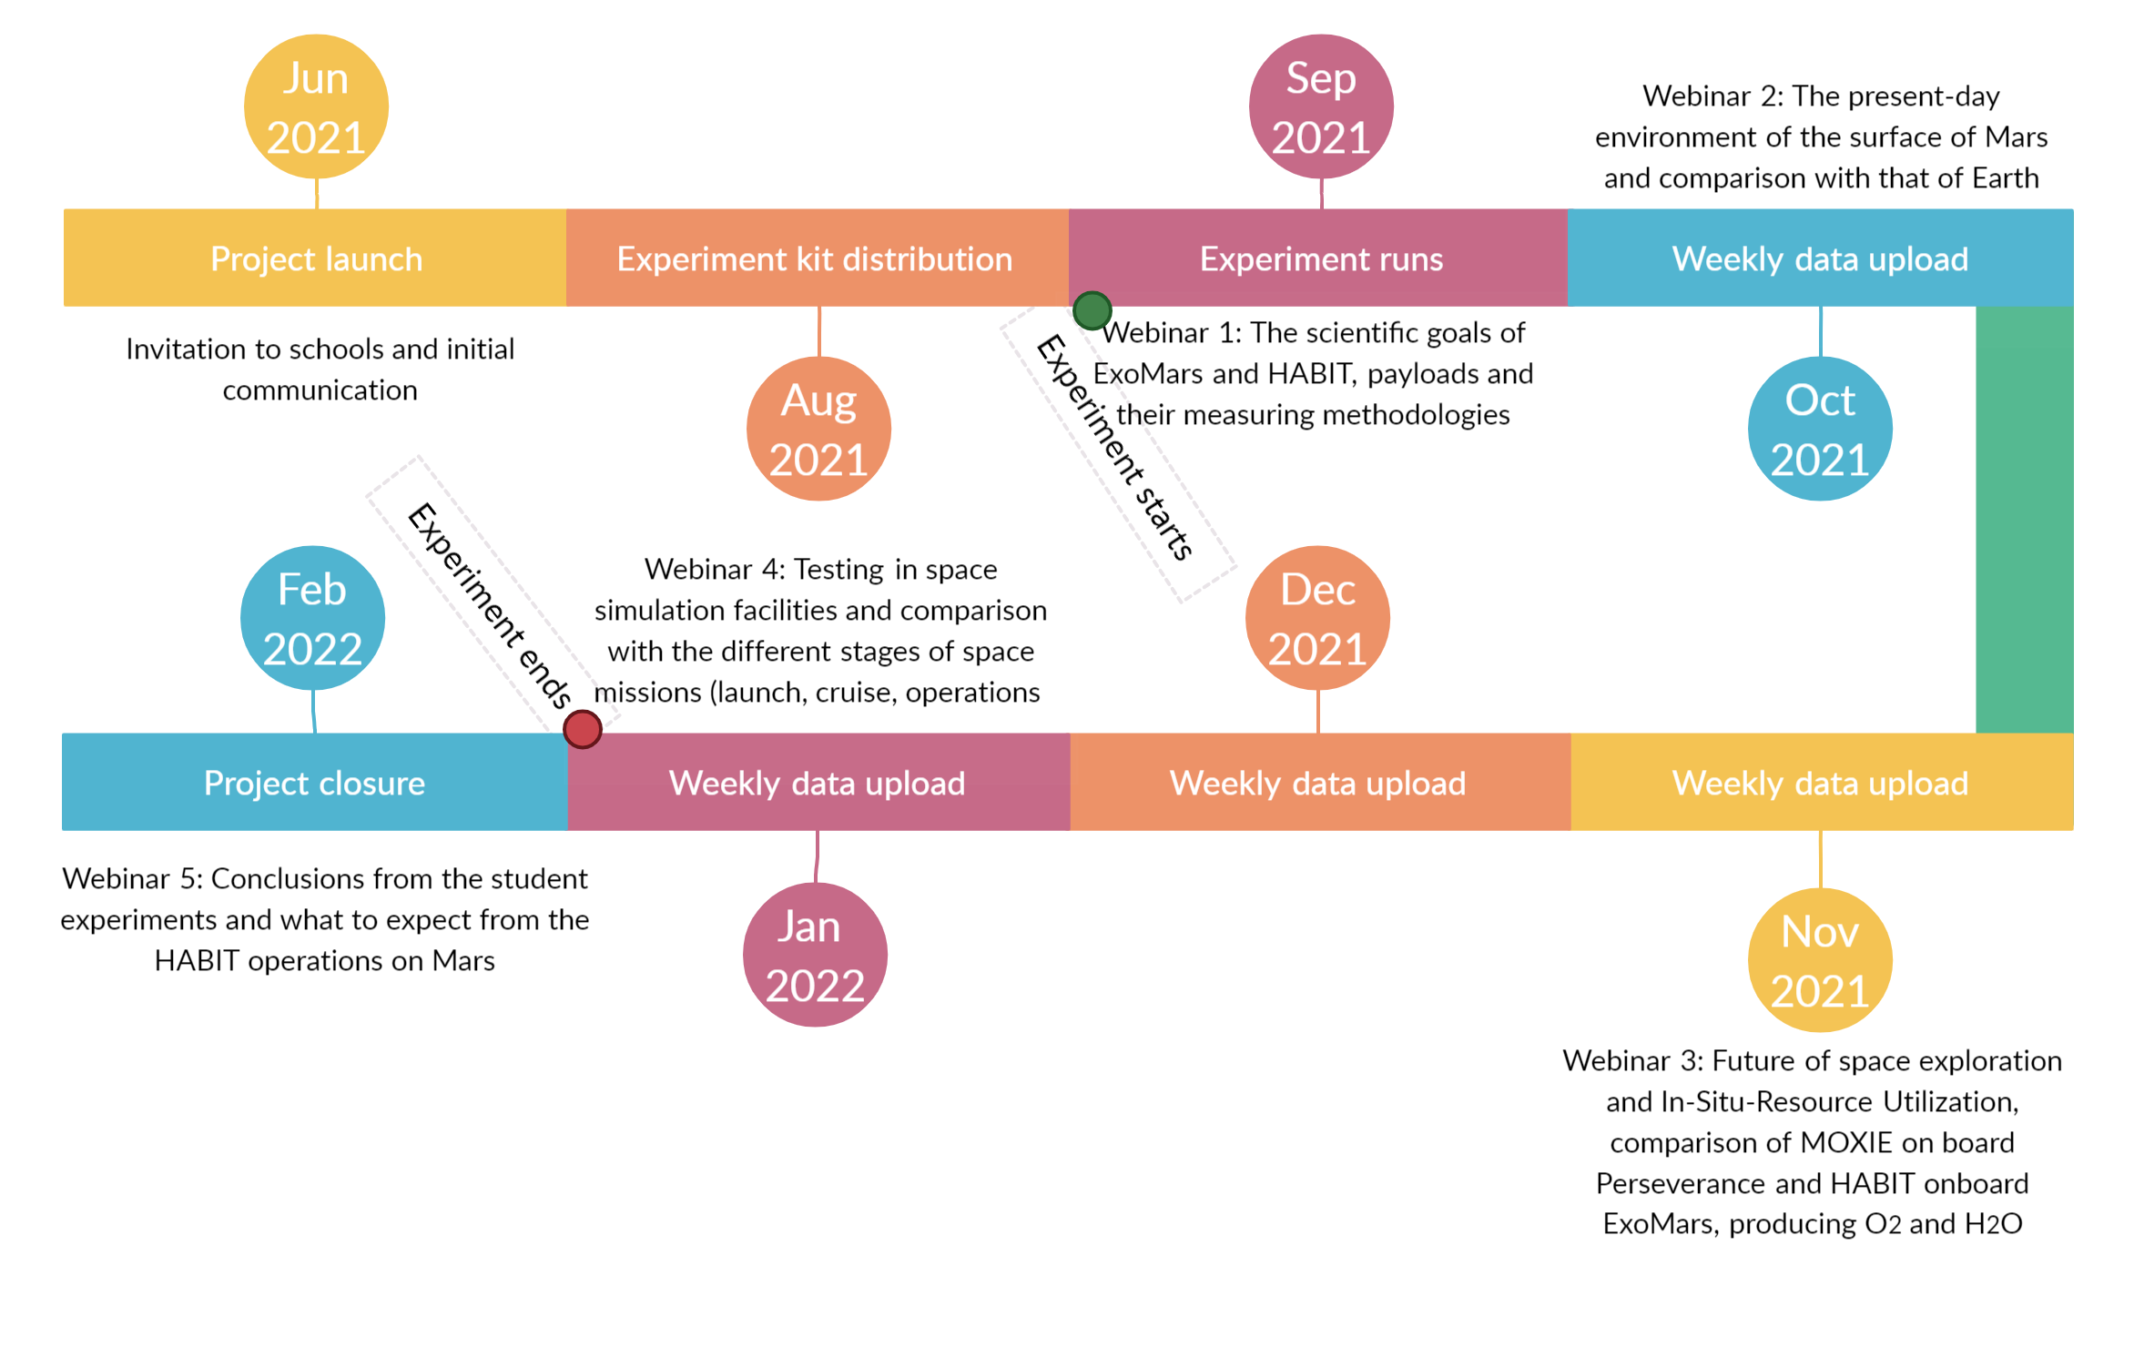
Project schedule
Department of Planetary Sciences

Slide 19
Any questions?

Slide 20
Up Next…
Webinar 2: The present-day environment of the surface of Mars and comparison with that of Earth

