Slide 1
Missed Opportunities? Democracy in EU Policy and MENA Perceptions After the Arab Uprisings
The Arab Transitions Project: Political, Economic, and Social Transformations in
the Middle East and North Africa
Andrea Teti
University of Aberdeen

Slide 2
Work Packages
WP1
Theory, Method
WP2
Backgr’d Reports
WP6
Country Reports
WP7
Transition Analyses
WP8
Youth & Social Media
WP9
EU-MENA
WP5
Data
Explore Models
Transition
Pol
Survey
Dataset
Area Studies
ENP / DA
Policy
Hybrid regimes
Arab- Trans Survey Data (2014)
Mobilisation Information Age
Soc
Longitudinal Database
Surveys, Indicators
Resilience
MENA
Perception of EU policy
Brittle
Political Science / Sociology
Econ
Cyclical

Slide 3
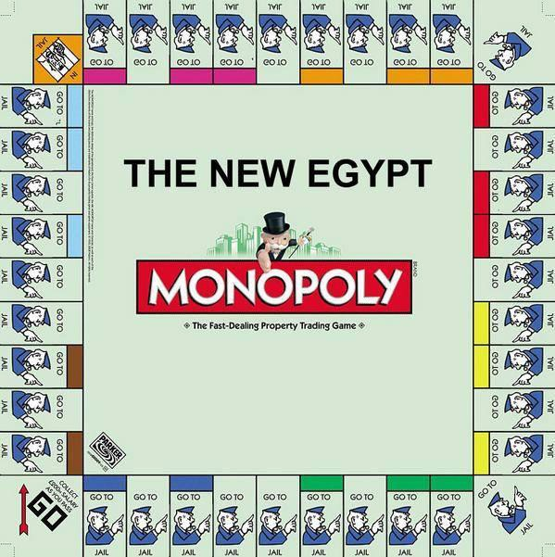
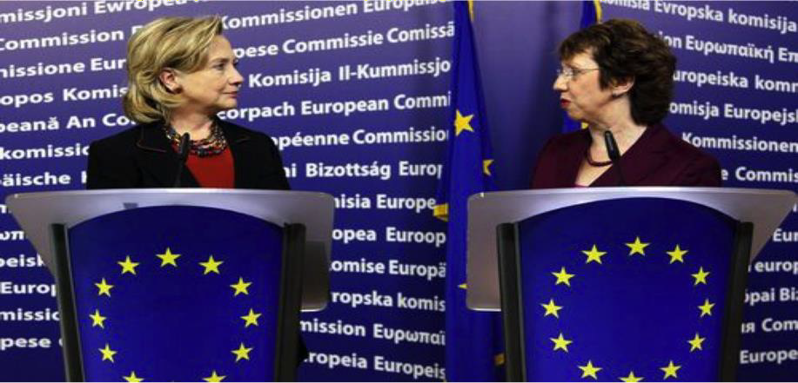
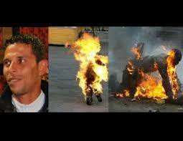
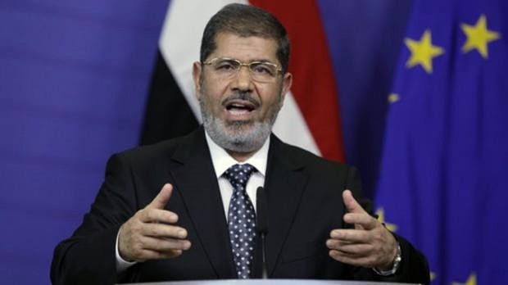
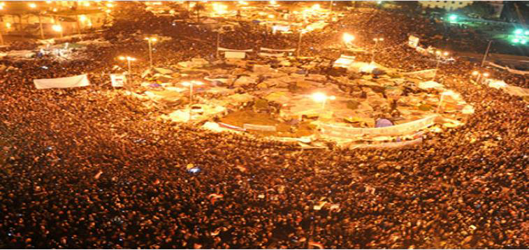
Background
…From Arab Spring to Islamist Winter?

Slide 4
Conceptions of Democracy in EU Policy

Slide 5
Methodology
Documents
Pre-Uprisings
The EU’s Role In Promoting Human Rights And
Democratisation In Third Countries (2001)
EU post-Enlargement Neighbourhood Policy
(2004)
Strengthening the ENP (2006)
COM(2009)188/3, 2008 ENP implementation review
Post-Uprisings
PfDSP 08/03/2011; NRCN 25/05/2011
Delivering a New ENP 15/05/2012
Working Towards Stronger Partnership
20/03/2013
Neighbourhood at the Crossroads, 27/03/2014
Review of ENP, 18/11/2015
Discourse Analysis:
conditions of possibility
Caveats:
multiple programmes: ENP, EIDHR,
UfM, etc.
multiple institutions/cultures: EEAS (Council/RelEx)
multiple authors

Slide 6
A New approach responding to the Uprisings?
‘Three Ds’: Delivery, Development, Democracy
Delivery: Pre-AU: ‘positive conditionality’ vs. Post-AU: ‘more-for-more’ (N.B.: JOIN(2013)4 benchmarking)
Development: Pre-AU & Post-AU: ‘sustainable and inclusive growth’ (method: FTAs)

Slide 7
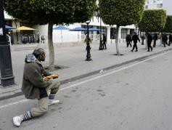
Democracy I
Preambles: holistic conception of democracy: ‘27 Democracies,’ indivisibility of HR, inclusive growth, partnership
From Inseparability of HR to…
…Hierarchy: civil-political (elections) > socio-economic (labour)
…Selectivity: e.g. voting > association, protest
= ‘thin’ democracy: procedural & market-driven

Slide 8
Democracy II
Civil Society: orthodox definition (vs. ‘social partners’)
→ TUs disappear into DevCo/Trade vs. JOIN(2013)4 funding unreg. groups
Social & Economic rights: ‘democracy’…
…is associated with expressions citing or referring to civil & political rights
…is never explicitly associated with social & economic rights (only in preambles)
PfDSP referers to socio-economic inequality, subsequent documents do not: soc/econ → aid & outside DHR framework
From rights to aid: ‘competence’ → DevCo/Trade/IFIs: from entitlement to
concession
Conceptual Structure of ‘Democracy’: 1. civ-pol>soc-econ HR; 2. rights → aid
→ Explanation for (low) EU popular credibility/reputation?

Slide 9
Preliminary Conclusions
Conceptual Structure of ‘Democracy’
Hierarchy of HR: civil, political > economic, social
Moral economy of Democracy: From rights to aid…
→ Explanation for (low) EU popular credibility/reputation (also degree of ‘non-normativity’ of EU power)?

Slide 10
Conceptions of Democracy in MENA Populations

Slide 11
Two Essential Characteristics of Democracy
% By Type of Characteristic
A Political Right An Economic Right Fighting Corruption
78.8
78
74.8
73.8
69.5
61.8
59.5
61.3
60.8
62.8
57.1
52.4
50.1
42
34.7
32.5
32.9
32
30
23
19.7
Egypt
Iraq
Jordan
Libya
Morocco
Tunisia
Total

Slide 12
Demands for Political Rights, Economic Rights, & Fighting Corruption as Drivers of the Arab Uprisings
% Nominating as One of Two Reasons
Corruption
Political
Economic
76.9
69.2
62.2
63.8
62.8
61.3
63.8
57.1
57.3
57.7
50.5
49.5
53.1
44.9
47.8
41.1
42.8
34.5
36.4
21.4
23.4
Egypt
Iraq
Jordan
Libya
Morocco
Tunisia
Total

Slide 13
Perceived Challenges, % Nominating as One of Two Main Challenges
90.3
87.6
Economic Situation
Corruption of Politicians and/or Civil Servants
Internal Security
Authoritarianism
79.8
79.3
71.3
70
60
₆₁62.1
58.6
49.2
55.3
51
48.7
49.5
42.2
37.3
28.5
20.7
17.4
12.9
9.8
12.192.8
2
2.3
6.6
8.8
Egypt
Iraq
Jordan
Libya
Morocco
Tunisia
Total

Slide 14
Is Democracy Incompatible with Islam?
Agree
Disagree
30.4
27.7
23.3
21.2
18.8
6.3
Egypt
Iraq
Jordan
Libya
Morocco
Tunisia
-45.7
-58.6
-68.5
-65.4
-70.7
-72.6

Slide 15
Democracy Preferable System of Gov't & Gov't Should Make Laws According to Wishes of the People
Democracy Better than Alternatives
% Self-Describing as religious
Religious Somewhat religious Not religious
6%
39%
55%
Make Laws According to the Wishes of the People
89.8
81.7
80.3
77.7
78.4
75.2
74.6
69.2
61.3
59.5
63.1
62.1
56.8
51.2
Egypt
Iraq
Jordan
Libya
Morocco
Tunisia
Total

Slide 16
Implementing Sharia: Breadth and Depth
Extent to Which Government Should Implement Sharia, % Selected Countries
Extent to Which Different Categories of Laws Should be Based on Sharia
Family Law Criminal Law Inheritance Law
No/R Partly Only
32.1
40.5
74.8
41.5
25.1
94.4
_{92.6}
96.2
94
93.5
88.5
89.1
85.1
⁹¹
90.7
86.4
84.6
77.8
83.6
88.2
77.7
61.8
62.3
63.4
59.6
48.1
52.4
53.4
33
56.7
ALGERIA
EGYPT
IRAQ
JORDAN
LIBYA
MOROCCO
TUNISIA
24.4
0.8
19.8
13.1
2.7
5.1
EGYPT
IRAQ
TUNISIA
JORDAN
MOROCCO

Slide 17
Type of Government Suitable for Country, %
60
Preference for a Religious
Party, %
80
60
40
20
0
-20
-40
-60
-80
Agree Prefer a Religious Party Disagree Prefer a Religious Party
Undecided
50
Unrestricted Parliamentary Democracy
40
Parliamentary System - Islamic parties
only Authoritarian
executive
30
20
10
Non- Parliamentary Islamic System
0
Egypt Iraq Jordan Libya Morocco Tunisia

Slide 18
Conclusions
EU Policy: Centred on formal, procedural democracy
Hierarchy of HR (civil-political > social-economic)
From rights to aid…
MENA Populations: Complex view of democracy
‘Thick’ (formal) vs. ‘thin’ (substantive): social justice & economic rights
inclusive & politically sustainable development
No single political role or effect of religion
Religious values, organizations, & leaders are distinct
Separation of public and private (soc/econ)
Implications: Mobilisation & Radicalisation

Slide 19
Thank you

